Slide 1
National University Of Kaohsiung Taiwan
T.Y.Yeh
Professor Department of Civil and Environmental Engineering

Slide 2
Yeh was born in Taiwan, in 1965. He received a Batcher degree in environmental engineering from National Chung Kung University in 1987, received a Master’s degree in Civil and environmental from UC Berkeley in 1992 and a Ph.D. degree in Civil and environmental from Penn State University in 1997. He is a professor in the department of Civil and environmental engineering at National University of Kaohsiung.

Slide 3
What is wastewater treatment
Usually refer to sewage treatment, or domestic wastewater treatment
process of removing contaminants from wastewater, both runoff and domestic

Slide 4
Where does wastewater come from?
Residences (kitchen, bathroom)
Commercial institution
Industrial institution (usually require specialized treatment process)

Slide 5
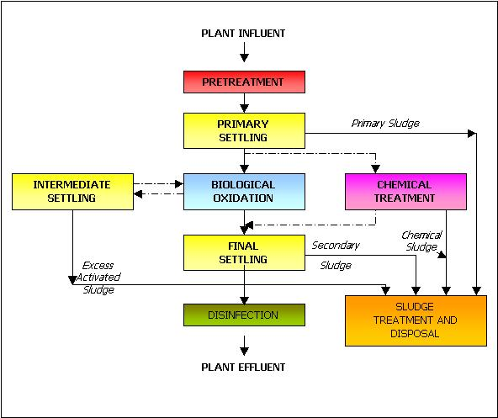
Conventional Wastewater Treatment Process
Pre-treatment involves:
Screening
Grit Removal
Oil separation
Flow equalization
Chemical Treatment is used in conjunction with the physical and chemical processes:
Chemical precipitation
Adsorption
Sludge Treatment and Disposal involves:
grinding, degritting, blending, thickening, stabilization, conditioning, disinfection, dewatering, heat drying, thermal reduction.
Disinfection can use:
Chlorine compounds
Bromine Chloride
Ozone
UV Radiation

Slide 6
Biological Treatment
In the case of domestic wastewater treatment, the objective of biological treatment is:
To stabilize the organic content
To remove nutrients such as nitrogen and phosphorus
Types:
Aerobic Processes
Anoxic Processes
Anaerobic Processes
Combined Aerobic-Anoxic-Anaerobic Processes
Pond Processes
Attached Growth
Suspended Growth
Combined Systems
Aerobic
Maturation
Facultative
Anaerobic

Slide 7
Major Aerobic Biological Processes
Type of Growth | Common Name | Use
Suspended Growth | Activated Sludge (AS) | Carbonaceous BOD removal (nitrification)
 | Aerated Lagoons | Carbonaceous BOD removal (nitrification)
Attached Growth | Trickling Filters | Carbonaceous BOD removal. nitrification
 | Roughing Filters (trickling filters with high hydraulic loading rates) | Carbonaceous BOD removal
 | Rotating Biological Contactors | Carbonaceous BOD removal (nitrification)
 | Packed-bed reactors | Carbonaceous BOD removal (nitrification)
Combined Suspended & Attached Growth | Activated Biofilter Process Trickling filter-solids contact process Biofilter-AS process Series trickling filter-AS process | Carbonaceous BOD removal (nitrification)

Slide 8
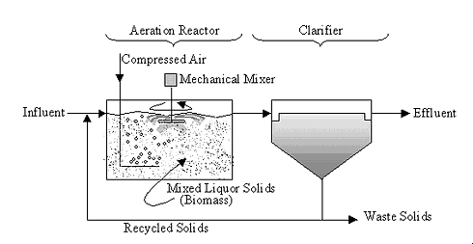
Activated Sludge Process
The aeration tank contains a suspension of the wastewater and microorganisms, the mixed liquor. The liquor is mixed by aeration devices (supplying also oxygen)
A portion of the biological sludge separated from the secondary effluent by sedimentation is recycled to the aeration tank
Types of AS Systems: Conventional, Complete-Mix, Sequencing Batch Reactor, Extended Aeration, Deep Tank, Deep Shaft

Slide 9
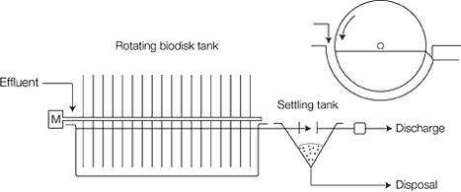
Rotating Biological Contactors
It consists of a series of circular disks of polystyrene or polyvinyl chloride that are submerged in wastewater and rotated slowly through it
The disk rotation alternately contacts the biomass with the organic material and then with atmosphere for adsorption of oxygen
Excess solids are removed by shearing forces created by the rotation mechanism

Slide 10
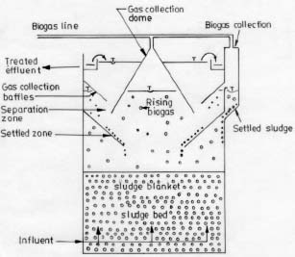
Upflow Anaerobic Sludge Blanket
Wastewater flows upward through a sludge blanket composed of biological granules that decompose organic matter
Some of the generated gas attaches to granules that rise and strike degassing baffles releasing the gas
Free gas is collected by special domes
The effluent passes into a settling chamber

Slide 11
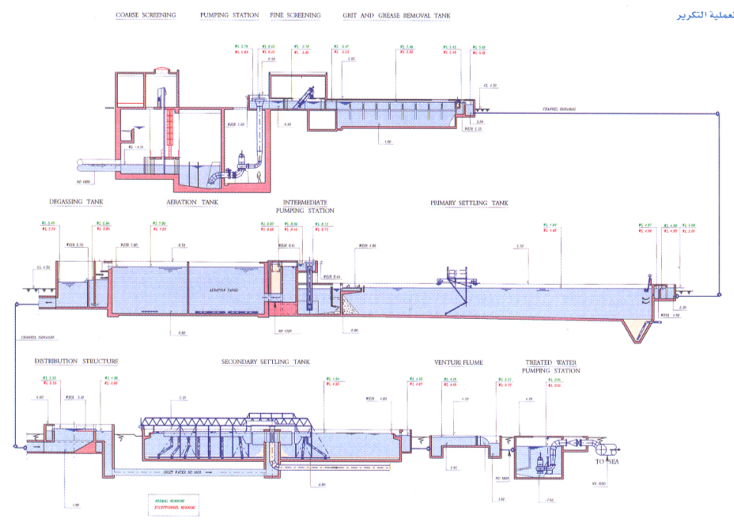
Technology to be used inside WWTPs proposed by the Government
Coarse Screening
Fine Screening
Grit and Grease Removal Tank
Pumping
Degassing Tank
Pumping
Primary Settling Tank
Aeration Tank or Biofilter
Venturi Flume
Treated Water Pumping Station
Distribution Structure
Secondary Settling Tank

Slide 12
Hydrology: Current Research Related Conferences
5th Biodiversity Conference March 10-12,2016 Madrid, Spain

Slide 13
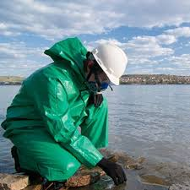
Hydrology: Current Research Related Journals
Journal of Geology & Geosciences
Journal of Geophysics & remote Sensing

Slide 14
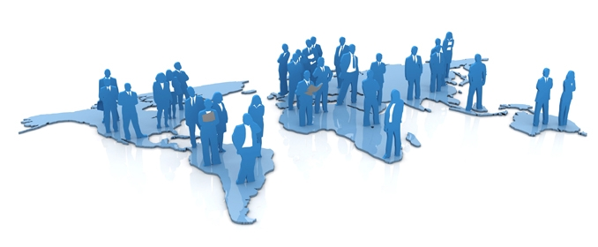
OMICS Group Open Access Membership
OMICS International Open Access Membership enables academic and research institutions, funders and corporations to actively encourage open access in scholarly communication and the dissemination of research published by their authors.
For more details and benefits, click on the link below:
http://omicsonline.org/membership.php

