Slide 1
OMICS Journals are welcoming Submissions
OMICS International welcomes submissions that are original and technically so as to serve both the developing world and developed countries in the best possible way.
OMICS Journals are poised in excellence by publishing high quality research. OMICS International follows an Editorial Manager® System peer review process and boasts of a strong and active editorial board.
Editors and reviewers are experts in their field and provide anonymous, unbiased and detailed reviews of all submissions.
The journal gives the options of multiple language translations for all the articles and all archived articles are available in HTML, XML, PDF and audio formats. Also, all the published articles are archived in repositories and indexing services like DOAJ, CAS, Google Scholar, Scientific Commons, Index Copernicus, EBSCO, HINARI and GALE.
For more details please visit our website: http://omicsonline.org/Submitmanuscript.php

Slide 2
Research Interests of Prof. Dr. Tarik Ozkul
American University of Sharjah UAE

Slide 3
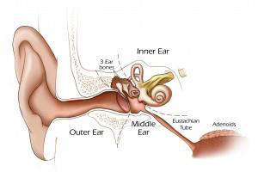
Prosthetic device for activation of dysfunctional eustachian tube patients
Thousands of people and animal suffer from dysfunctional Eustachian tube problems,
The only known surgical cure is intentional rupturing of ear drum which lasts about 6 months.
I am part of a team who designed a prosthetic device designed to cure the problem.
M.H. Ozkul, T. Ozkul, “Recent promising technological developments on hearing restoration” J. of Biomedical Sci.& Eng., Vol.4, No.3, 147-232 (2011), 158-163.

Slide 4
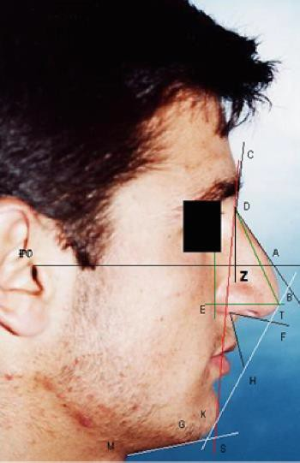
Researching facial standards of beauty
Measurement of facial beauty is a non-exact science,
An objective way of measurement is necessary in order to avoid litigation,
Part of a team to find beauty standards for different race and nations
Ozkul, T. Ozkul, M. H. “ A study towards fuzzy logic-based assessment of nasal harmony of rhinoplasty patients” Journal of the Franklin Institute, Vol. 343, Issues 4-5, July 2006, pp 329-339.

Slide 5
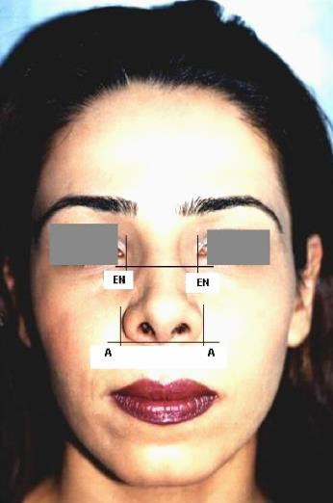
Machine assessment of facial standards
Results of the beauty standards are intended to utilized by medical professionals for assessment of patient.
Patients condition is assessed before and after surgery by a sophisticated fuzzy logic based tool
M.H. Ozkul, T. Ozkul, “A Fuzzy-logic-based model for assessment of human facial harmony based on theory of averages" Journal of the Franklin Institute, Volume 348, Issue 8, October 2011, Pages 2216-2234.

Slide 6
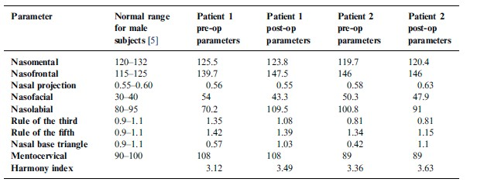
Fuzzy logic assessment of facial condition
Software tool is intended to generate objective scoring of overall facial value,
By generating results before and after surgery, the improvement of the patient is documented by an objective tool,
Ozkul, T. Ozkul, M. H. “ A study towards fuzzy logic-based assessment of nasal harmony of rhinoplasty patients” Journal of the Franklin Institute, Vol. 343, Issues 4-5, July 2006, pp 329-339.

Slide 7
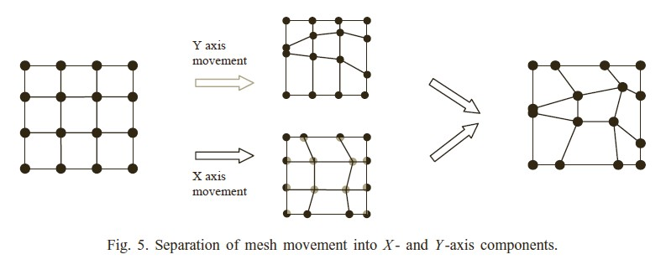
Surgical planning aid
Rhinoplasty is a complicated surgery with many parameters to deal with,
Many parameters are coupled, meaning changing one inadvertently changes others,
Part of a research team to design a software aid for planning the surgery for best end result
Ozkul, T., Ozkul, M. H. “ Computer simulation tool for rhinoplasty planning” Computers in Biology and Medicine, Vol. 34, Issue 8, December 2004, pp. 697-718.

Slide 8
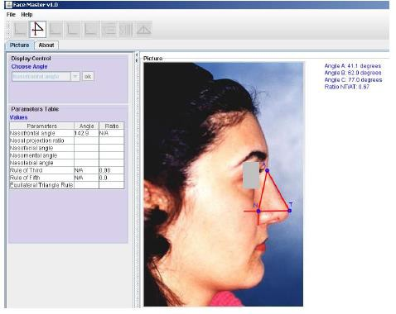
Software tool for measurement of facial parameters
Part of a team designed software tool for measurement of facial parameters,
Practical java based tool for extracting important facial parameters easily,
Our tool is being used by many researchers all around the world from criminal investigators to medical researchers
T. Ozkul, M. H. Ozkul, R. Akhtar, F. Al-Kaabi and T. Jumaia, “A Software Tool for Measurement of Facial Parameters” The Open Chemical and Biomedical Methods Journal, Vol. 2, pp. 69-74, 2009.

Slide 9
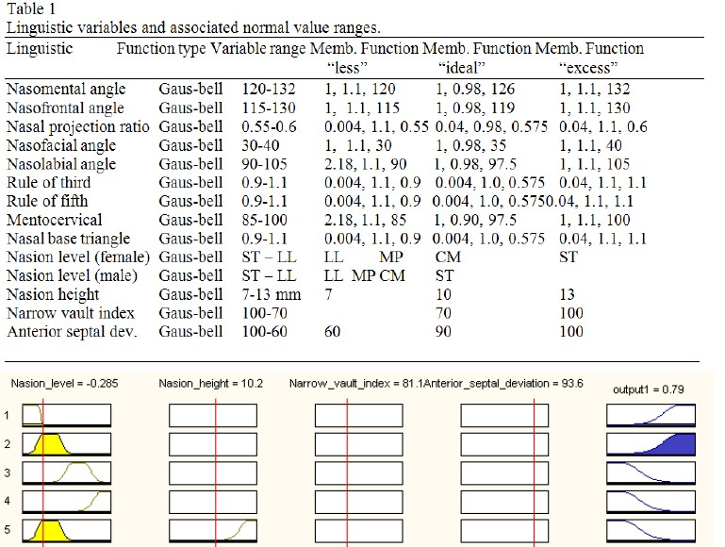
Estimation of anatomical variants
effecting surgical results
Part of a team searching anatomical variants effecting surgical operations negatively,
Some patients have certain anatomical features which renders surgical results negatively,
Designing an smart software aid for surgeons to identify and help surgeons in such conditions.

Slide 10
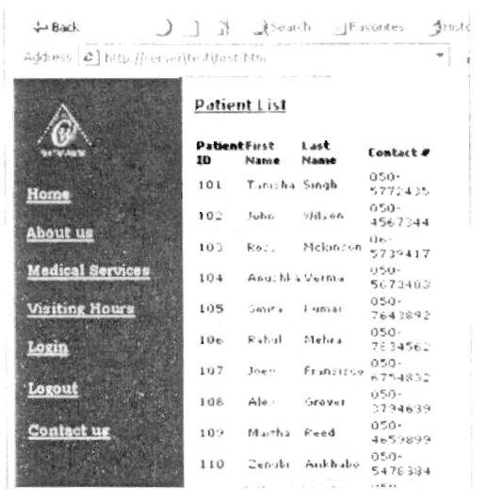
Wireless patient information
integration
Part of a team working toward wireless
integration of patient information

Slide 11
Using fuzzy logic for interesting
applications
Fuzzy logic is a versatile tool for smart applications,
Fuzzy logic is used for various applications

Slide 12
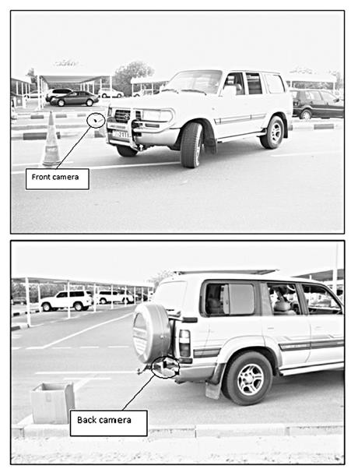
Fuzzy logic based parking aid
A tool for self
parking,
Uses front and back cameras and integrated fuzzy logic system for self parking vehicles

Slide 13
Educational experiments
I am very excited about exploring educational
methods increasing motivation of students,
I am an expert on patents with 20+ patents of my own, and would like to teach this to my students,
I have experimented with “patent based
education” in my classes with stunning results.

Slide 14
Patent Based Education
This is a term I have coined. In an educational experiment with my senior students we had 11 patent worthy projects generated by the students using this method. (Really - not kidding.)
This really altered my perception of how we
should educate our students

Slide 15
Patented inventions
I am with industry background and always tried to integrate academia and industry (which I have repeatedly failed)
Industry has needs and expects these to be addressed in practical and economical manner,
Academia, unfortunately never addresses these needs satisfactorily which keeps the gap between them.

Slide 16
Patented inventions
Practical tool for measurement of surface roughness of concrete for carbon fiber applications,
Carbon fiber is an excellent tool for strengthening building structure. Carbon fiber and epoxy stick to the concrete surface very well. But study indicated that there is an optimum roughness of concrete. Above or below that roughness level, carbon fiber does not stick to the surface as much as it is supposed to. This tool uses a practical and quick way of measuring surface roughness.

Slide 17
Patented inventions 2
Practical tool for measurement of bug hole rating
of surface
Bug holes are imperfections on the finished wall surfaces. Architects desire to have surfaces with minimal bug holes. Bug holes makes surface finishing harder and more expensive. Measurement of bug hole is a subjective task and source of argument between the contractor and the architect. This tool provides an objective way of measuring this parameter.

Slide 18
Patented inventions 3
Our world is going through difficult times and seems that greed of human being is destroying our world. It is the duty of every sensible scientist and engineer to do something about it. In my opinion unless renewable energy becomes cost wise competitive with carbon based fuel, greed will get the best of us and we will continue to destroy our world altogether. Renewable energy is my passion and I want to reduce price of renewable energy to carbon based fuel. I have several inventions toward this goal.

Slide 19
Patented inventions 4
What do you see when you look at a classical 3
bladed wind turbine?
I don’t know about you, but I see ugly beasts lacking finesse and beauty. I have designed a kind of wind turbine which is not only effective in medium level winds but also beautiful to look at. I called them “whirling dervish” because they resemble whirling dervishes which rotate serenely with devotion.

Slide 20
Patented inventions 5
Solar energy is accepted as the most reliable renewable energy. Current classical technology is too expensive and we need to reduce it to 1/10 of its current price to be competitive. My patented solar collector design is radically different than current ones and solves many issues of current solar collectors. Initial data indicates that we may reduce the cost to carbon based fuel costs.

Slide 21
Patented inventions 6
Deserts are the areas receiving most sunlight. If only we could find a way of covering these vast areas with solar collectors.
We have come up with a way of converting desert sand to perfectly shaped parabolic solar collectors using automated equipment and an interesting strand of bacteria which binds sand particles. Result is a solar collector with minimal carbon footprint.

Slide 22
OMICS Group Open Access Membership
OMICS publishing Group Open Access Membership enables academic and research institutions, funders and corporations to actively encourage open access in scholarly communication and the dissemination of research published by their authors.
For more details and benefits, click on the link below:
http://omicsonline.org/membership.php

Slide 23
Upcoming Conference
For upcoming conferences please follow the below mentioned link
http://www.conferenceseries.com/

