Slide 1


OMICS Group
OMICS Group International through its Open Access Initiative is committed to make genuine and reliable contributions to the scientific community. OMICS Group hosts over 400 leading-edge peer reviewed Open Access Journals and organizes over 300 International Conferences annually all over the world. OMICS Publishing Group journals have over 3 million readers and the fame and success of the same can be attributed to the strong editorial board which contains over 30000 eminent personalities that ensure a rapid, quality and quick review process. OMICS Group signed an agreement with more than 1000 International Societies to make healthcare information Open Access.
Contact us at: contact.omics@omicsonline.org

Slide 2

OMICS Journals are welcoming Submissions
OMICS Group welcomes submissions that are original and technically so as to serve both the developing world and developed countries in the best possible way.
OMICS Journals are poised in excellence by publishing high quality research. OMICS Group follows an Editorial Manager® System peer review process and boasts of a strong and active editorial board.
Editors and reviewers are experts in their field and provide anonymous, unbiased and detailed reviews of all submissions.
The journal gives the options of multiple language translations for all the articles and all archived articles are available in HTML, XML, PDF and audio formats. Also, all the published articles are archived in repositories and indexing services like DOAJ, CAS, Google Scholar, Scientific Commons, Index Copernicus, EBSCO, HINARI and GALE.
For more details please visit our website: http://omicsonline.org/Submitmanuscript.php

Slide 3
Tejraj M. Aminabhavi
Editor PPT

Slide 4
Research Interests
Molecular transport, membrane-based separations, pervaporation, gas separation, electrodialysis, micro, ultra and nanofiltrations and reverse osmosis
Controlled release polymeric micro/nanoparticles, transdermal patches and hydrogels for drugs, proteins, peptides, genes, and pesticides
Molecular modeling on polymer surfaces, QASR and docking studies on small molecules, prediction of polymer blend compatibility, drug diffusion and gas transport
Polyurethane coatings, polymer composites, heat resistant and conducting polymers
Liquid state properties, polymer solution theories and metal complexation chemistry

Slide 5
Industrial Consultancies
Reliance Life Sciences, Navi Mumbai (2007-2011)
Bharath Heavy Electricals Limited (BHEL), Bangalore, India (2004-2007)
Gujrat State Fertilizers Corporation, Vadodara, Gujarat, India (1996-2002)
Texas Research Institute, Austin, Texas, USA (2006,2007 and 2008)

Slide 6
Awards
CIPET Award for Research in the field of Polymer Science and Technology on “Polymers in Drug Delivery and Membrane Science” as Runner-up for the Fourth National Award (2014) under Technology Innovation by the Ministry of Fertilizers, Chemicals, and Petroleum, New Delhi, India
18th Nikkei Asia Prize, Japan received on 22nd May 2013 in Tokyo for the contributions in Applied Polymer Science under the category of Science, Technology and Innovation.
Laureate of 22nd Kwarizmi International Award (KIA) from the Ministry of Science, Research and Technology, Iranian Research Organization for Science and Technology (IROST), Tehran, Iran for 2008-2009: Received from the President of Iran (Mahmoud Ahmadinejad) at Tehran on Feb. 9th 2009.
Madurai Kamaraj University, Indian Science: Received from the Vice Chancellor (Professor P. Maradamutthu), Madurai Kamaraj University, Madurai (April, 2007)
Listed as the 4th Most Productive Scienctist of India by the National Institute of Science, Technology & Development Studies on “Status of India in Science and Technology as Reflected in its Publication Output in Scopus International Database” during 1996-2006.

Slide 7
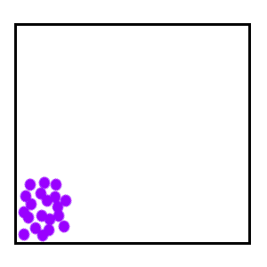
The Movement
of Molecules:
Diffusion,
Osmosis &
Active Transport
Images: Diffusion Animation, Biology Corner; Diffusion, J Krieger

Slide 8
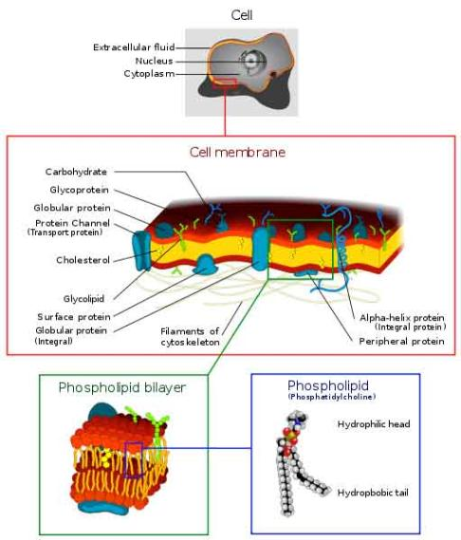
Plasma Membrane
Separates the cell from its environment.
Phospholipid molecules oriented so that hydrophilic (_____ _____) heads directed outward and hydrophobic (_____ _____) tails directed inward.
Proteins embedded in two layers of phospholipids (lipid bilayer).
Membrane is semi-permeable. Q: What does that mean?
Image: Cell Membrane diagram, Wiki
Notes:
Water loving
Water hating
Some materials can move across the membrane, others cannot.

Slide 9
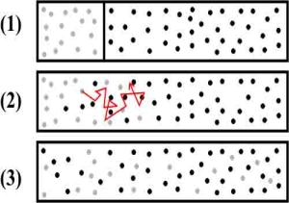
Passive Transport
Primary function of plasma membrane → regulate movement of molecules entering or leaving cell.
Movement of molecules across plasma membrane requires energy.
Movement of molecules is passive if no energy sources of the cell are expended.
_____________ = when molecules move down a concentration gradient, from a higher to a lower concentration.
Q: What type of things might affect the rate of diffusion?
Images: Diffusion Animation, Biology Corner; Diffusion, J Krieger
Notes:
Diffusion
Temperature: molecules are always moving, and move faster at higher temperatures.
Size: small molecules move faster than large molecules.
Concentration Gradient: difference in concentration of a substance between two areas

Slide 10
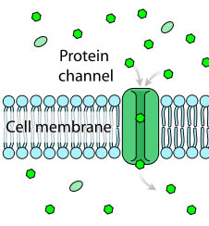
Passive Transport
_____________ Diffusion
Proteins assist in diffusion of molecules across plasma membrane.
Movement only occurs in the presence of a concentration gradient.
Some molecules move across the membrane more quickly if diffusion is facilitated by a carrier molecule.
Image: Facilitated Diffusion, M. Ruiz
Notes:
Facilitated

Slide 11
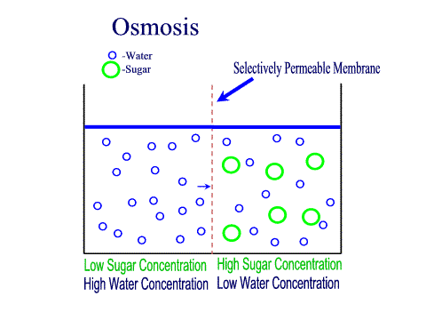
Passive Transport - Osmosis
Q: Diffusion of what across the plasma membrane?
Environment surrounding cells may contain amounts of dissolved substances (solutes) that are…
- equal to
- less than
- greater than
…those found within the cell.
Plasma membrane
CELL
Liquid environment outside the cell.
Liquid environment inside the cell.
Images: Osmosis animation
Notes:
A: Water

Slide 12
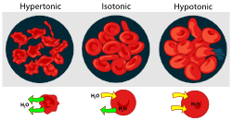
Passive Transport - Osmosis
Tonicity and Osmosis
__________: equal concentration of a solute inside and outside of cell.
__________: a higher concentration of solute.
__________: a lower concentration of solute.
Water will always move toward a hypertonic environment!!
Images: Osmosis with RBCs, M. Ruiz
Notes:
Isotonic
Hypertonic
Hypotonic

Slide 13
Let’s do some osmosis problems, to practice our knowledge.
Passive Transport - Osmosis
Second clamp to seal “cell”.
A solution to put inside the “cell”.
+
CLAMP #2
+
A solution to put the “cell” into.
Plasma membrane
Dialysis Tubing
CELL
Liquid environment outside the cell.
Liquid environment inside the cell.
CLAMP #1
Notes:
Experiment using dialysis tubing (semi-permeable membrane) and clamps to make a pretend cell.
What happens when different dilutions of sugar (a big molecule that cannot pass through semi-permeable membrane) are used inside versus outside of cell.
Will the artificial cell lose weight, gain weight or stay the same in the following scenarios?
1. Fill cell with 20% sugar solution, submerge in container of 60% sugar solution
2. Fill cell with 35% sugar solution, submerge in container of pure water.
3. Fill cell with pure water, submerge in a container of 2% sugar solution.

Slide 14
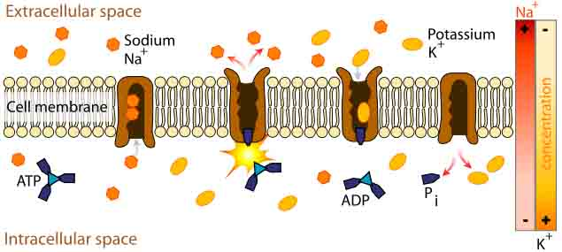
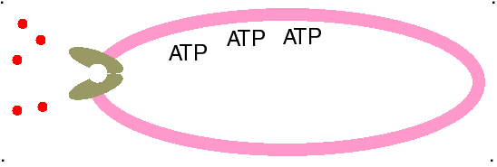
_________ Transport
How most molecules move across the plasma membrane.
Analogous to a pump moving water uphill.
Types of active transport are classified by type of energy used to drive molecules across membranes.
ATP Driven Active Transport
Energy from adenosine triphosphate (ATP) drives substances across the plasma membrane with aid of carrier molecules.
Image: Sodium-potassium pump, M. Ruiz
Notes:
Active

Slide 15

Congratulations if you publish your work in this journal
Signature of Editor

Slide 16
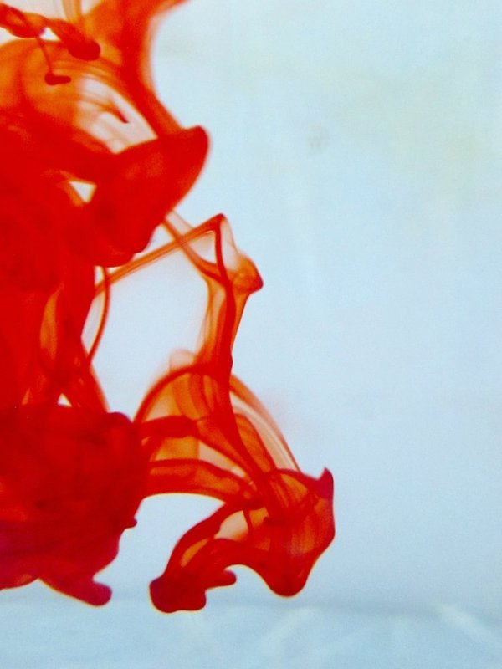

OMICS Group Open Access Membership
OMICS publishing Group Open Access Membership enables academic and research institutions, funders and corporations to actively encourage open access in scholarly communication and the dissemination of research published by their authors.
For more details and benefits, click on the link below:
http://omicsonline.org/membership.php

