Slide 1
VALENTINA PASTORE MD
Pediatric Surgery,
University of Foggia
Italy
phone: +39 3404695614
e-mail: valentina.pastore@teletu.it
valentinapastore1427@gmail.com

Slide 2
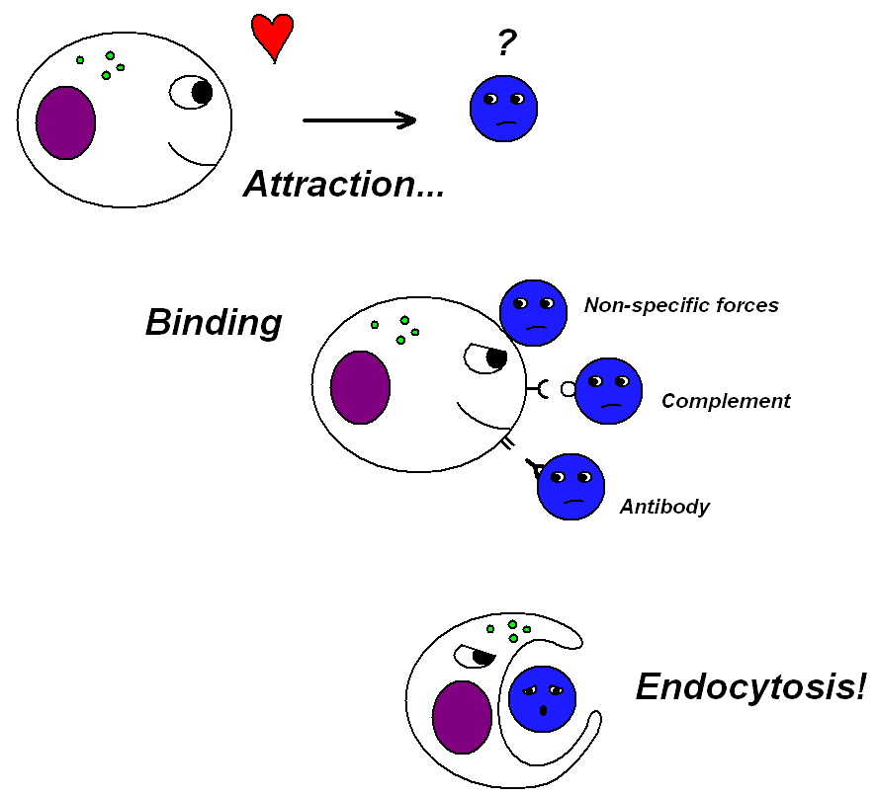
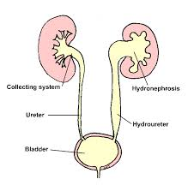
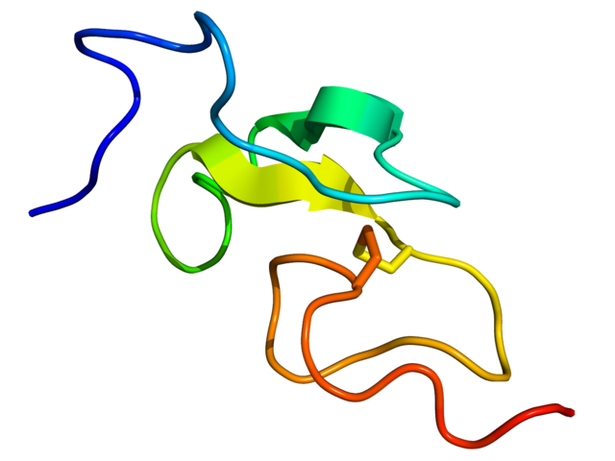
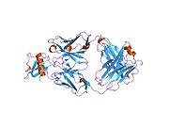
The main research interest:
The phagocytosis and distant migration of polydimethylsiloxane used for treatment of vesico-ureteral reflux in pediatric age
The prevention and reduction of renal damage in children with congenital uropathy by studing cytokines
EGF
MCP-1

Slide 3
The research results and clinical outcomes have been presented at conferences
9th EUPSA Annual Meeting , Istanbul 18-21 June 2008
Congresso Nazionale Congiunto 24-27 September 2008, Catania
3° Congresso Congiunto SICP,SIUP, SIVI 22-25September 2010, Torino
3rd World Congresso of Pediatric Surgery, 21-24 October 2010, New Delhi
La ricerca clinica e sperimentale in chirurgia endoscopica e mini-invasiva pediatrica. 21 May 2011, Napoli
4° Congresso Congiunto SICP,SIUP, SIVI 21-24 September 2011, Padova
Papsa Congress 2012. 18-21 March 2012, Cape Town

Slide 4
The research results and clinical outcomes have been published
F Bartoli, R Penza, G Aceto, F Niglio, O D'Addato, V Pastore, V Campanella, S Magaldi, C Lasalandra,G Di Bitonto,L Gesualdo. Urinary egf, mcp-1 and ß2 microglobulin in children with ureteropelvic junction obstruction. J Pediatr Surg. 2011; 46 (3):530-6
Bartoli F, Niglio F, Pastore V, Campanella V, Leggio S, Aceto G, Germano M, D'Addato O, Penza R. Polydimethylsiloxane (macroplastique) injection for vesicoureteral reflux in duplex ureter: a comparison with single renal systems. J Pediatr Urol 2011; 7 (5): 516-519
Pastore V, Aceto G, Niglio F, Basile A, Cocomazzi R, Faticato MG, Lotito A, Bartoli F. Clinical characteristics and management of children with ureteropelvic junction obstruction and severe vesicoureteral reflux: preliminary results. Annals of Pediatric Surgery 2013; 9 (3): 114-116
Pastore V, Aceto G, Niglio F, Basile A, CocomazziR, Faticato MG, Bartoli F. Laparoscopic assisted nephroureterectomy for shape urolithiasis and xantogranulomatous pyelonephritis. Case report and review of literature. African Journal of Pediatric Surgery 2013; 10: 285-288

Slide 5
All the results with a retrospective review of all
the surgical techniques applied in children
have been discussed in a book:
V. Pastore.
L'idronefrosi. Evoluzione del pensiero scientifico e del trattamento chirurgico.
Edizioni del Rosone, December 2013
ISBN 978-88-97220-99-2

Slide 7
NEW RESEARCH PROJECT
Research on molecular pathways of renal damage and their modulation in experimental and clinical models of congenital uropathy by using nanocarriers

Slide 8
BACKGROUND/ STATE OF THE ART
1. In the last years, the interest of clinicians has focused on the potential role of plasmatic and urinary markers of renal function for early detection and monitoring of chronic kidney disease bacause pro-inflammatory cytokines or growth factors play a major role in activating apoptotic signalings which are the main factors to cause tubular atrophy and epithelial to mesenchymal transition [1,2]
2. The main factors triggering injury to the kidney are stretching and loss of integrity of tubular epithelium, followed by an inflammatory response mainly mediated by monocyte [3]

Slide 9
3. Reactive oxygen species play an important role in traslating inflammatory responce into cellular death, so that their monitoring is of detrimental importance to understand the responce to drugs [4]
4. Treatments with drugs often require high drug concentrations in the kidney and unfortunately such high concentrations are often associated with adverse effects. Furthermore, high renal drug concentrations may not translate into high concentrations in the target cells.
5. Kidney-targeted drug delivery is of great significance to overcome these problems and new anti-apoptotic therapies carried by nanocarriers have been proposed [5,6]

Slide 10
AIM 1
As first step of this new research, the role of oxidative
stress and inflammatory process on the mitochondrial
function, in animal models of obstructive and reflux
nephropathy, will be assessed.
Genic expression which control :
mitochondrial biogenesis
apoptosis and macro-autophagia
oxidative homeostasis
will be studied by using renal cellular homogenate.
At scheduled time urinary samples will be obtained to
test Creatinine, MCP-1, EGF Beta-2 microglobulin.

Slide 11
AIM 2
Nanaocarriers will be prepared and drugs
linked to them (inhibitors of apoptosis signal
and anti-fibrotic drugs) will be administered
to experimental animal mdels [7].
At scheduled time new urinary samples will
be obtained to test Creatinine, MCP-1, EGF
Beta-2 microglobulin.

Slide 12
AIM 3
After the approval of Ethic Commission,
patients with grade 3 and 4 hydronephrosis
and high grade vesico-ureteral reflux will be
enrolled in the study to receive administration
of intravesical compound embedded with
specific anti-apoptotic and anti-fibrotic drugs.
Urinary samples will be the only biological
sample collected before treatment and at
scheduled follow-up.

Slide 13
MILESTONE/ INNOVATION
To understand the impact of the mechanism of
inflammatory injury on mitochondrial function
and the ability to restore normal mitochondrial
function by administration of drugs carried by
nanocarriers.
Children seriously affected by urological
conditions, in adult age, will be at risk for
developing high blood pressure, cardiovascular
diseases and renal tumor and insufficiency [8]

Slide 14
BIBLIOGRAPHY
Lucarelli G et al. Emerging urinary markers of renal injury in obstructive nephropathy. Biomed Res Int 2014; 2014:303298
Sanz AB et al. TWEAK and the progression of renal disease: clinical translation. Nephrol Dial Transplant 2014; 29 Suppl 1: i54-i62
Meng XM et al. Inflammatory processes in renal fibrosis. Nat Rev Nephrol 2014. doi: 10.1038/nrneph.2014.114
Salzano S et al. Linkage of inflammation and oxidative stress via release of glutathionylated peroxiredoxin-2, which acts as a danger signal. Proc Natl Acad Sci USA 2014 pii:201401712
Ucero AC et al. A polymeric nanomedicine diminishes inflammatory events in renal tubular cells. PloS One 2013; 8: e51992
Guhasarkar S et al.Intravesical drug delivery: challenges, current status, opportunities and novel strategies. J Control Release 2010; 148:147-159
Loyer P et al. Natural and synthetic poly(malic acid)-based derivates: a family of versatile biopolymers for the design of drug nanocarriers. J Drug Target 2014; 22: 556-575
Driver TH et al. Urinary kidney injury molecule 1 (KIM-1) and interleukin 18 (IL-18) as risk markers for heart failure in older adults: the health, aging, and body composition (ABC) study. Am J Kidney Dis 2014; 64:49-56

