Slide 1

OMICS Journals are welcoming Submissions
OMICS International welcomes submissions that are original and technically so as to serve both the developing world and developed countries in the best possible way.
OMICS Journals are poised in excellence by publishing high quality research. OMICS International follows an Editorial Manager® System peer review process and boasts of a strong and active editorial board.
Editors and reviewers are experts in their field and provide anonymous, unbiased and detailed reviews of all submissions.
The journal gives the options of multiple language translations for all the articles and all archived articles are available in HTML, XML, PDF and audio formats. Also, all the published articles are archived in repositories and indexing services like DOAJ, CAS, Google Scholar, Scientific Commons, Index Copernicus, EBSCO, HINARI and GALE.
For more details please visit our website: http://omicsonline.org/Submitmanuscript.php

Slide 2
OMICS Journals are welcoming Submissions
OMICS International welcomes submissions that are original and technically so as to serve both the developing world and developed countries in the best possible way.
OMICS Journals are poised in excellence by publishing high quality research. OMICS Group follows an Editorial Manager® System peer review process and boasts of a strong and active editorial board.
Editors and reviewers are experts in their field and provide anonymous, unbiased and detailed reviews of all submissions.
The journal gives the options of multiple language translations for all the articles and all archived articles are available in HTML, XML, PDF and audio formats. Also, all the published articles are archived in repositories and indexing services like DOAJ, CAS, Google Scholar, Scientific Commons, Index Copernicus, EBSCO, HINARI and GALE.
For more details please visit our website: http://omicsonline.org/Submitmanuscript.php

Slide 3

EPIGENETICS
‘the study of mitotically and/or meiotically heritable changes in gene function that cannot be explained by changes in DNA sequence’
Adrian Bird (2007)

Slide 4

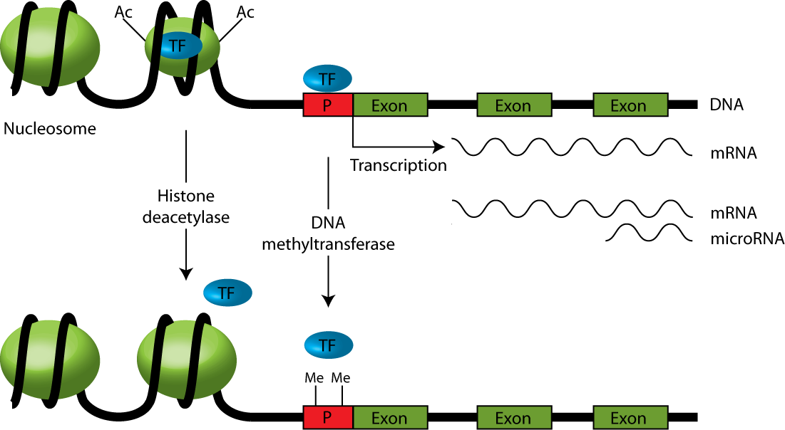

Epigenetic mechanisms
Ac
- Me

Slide 5
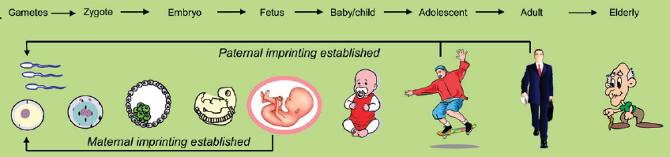
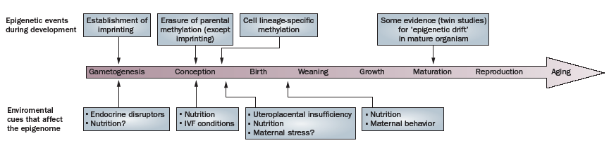
Gluckman et al. 2009

Slide 6
Disease:
a price of adaptation?

Slide 7
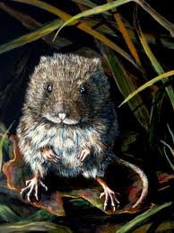
Predictive Adaptive Response (PAR) hypothesis
The epigenetic adaptation processes implying alterations of gene expression to buffer the organism against environmental changes support adaptability to the expected life-course conditions.
Gluckman and Hanson, 2004
EXAMPLE: MEADOW VOLE
spring-born offspring –
thin coat
autumn-born offspring –
thick coat

Slide 8


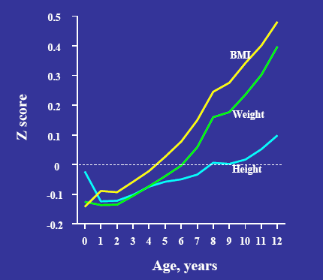


Catch-up growth and adult-onset metabolic disease

Slide 9
Type 2 diabetes in cohorts exposed to the Ukraine famine of 1932-33
in early life

Slide 10
Study design: geography
No famine
Severe famine
(PD up to 15%)
Extreme famine (PD 25% or more)

Slide 11
Type 2 Diabetes Odds Ratio’s
Ukraine, all regions combined relative to births in December, 1938
Prevalent cases, 2000-2008
In relation to Monthly Deaths/1,000 population, 1932-1938
Adapted from Vaiserman et al. 2013

Slide 12
Conclusions
In utero exposure to Ukraine famine led to an increased risk of type 2 diabetes in adulthood.
The highest risk was seen in those persons who were exposed to the famine periconceptionally.
3. It suggests an epigenetic basis for this long-term programming effect.
Notes:
12

Slide 13
Seasonal programming
of diabetes mellitus
in Ukraine

Slide 14
December-born persons
😐
😐
☺
☹
Genes
Prenatal impacts
Postnatal impacts
Life-course impacts
May-born persons
😐
☹
☺
😐
Genes
Prenatal impacts
Postnatal impacts
Life-course impacts

Slide 15
Seasonality of birth for T1D in Ukraine
Vaiserman et al., Diabetologia 2007

Slide 16
Seasonality of birth for T2D in Ukraine
Vaiserman et al 2009

Slide 17
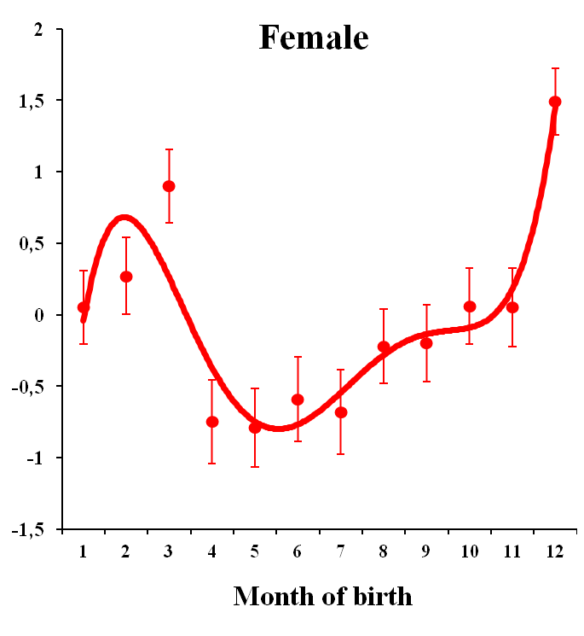
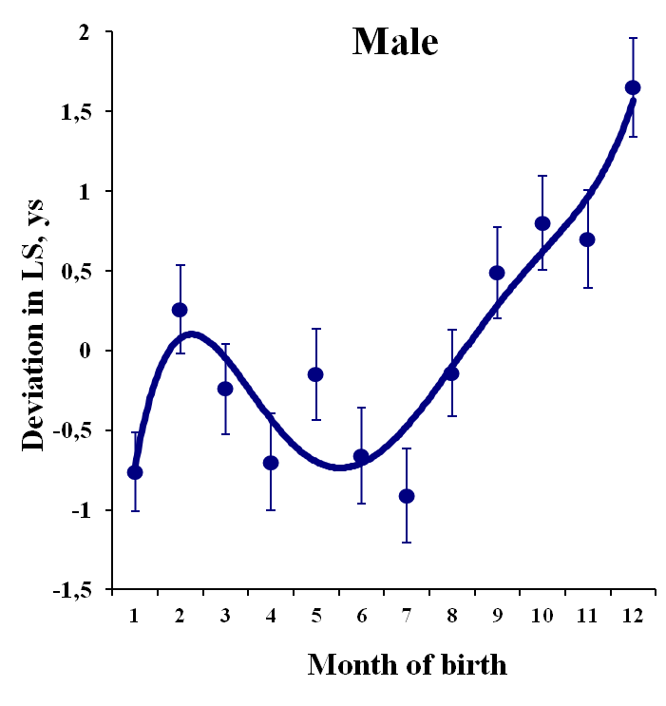
Seasonal programming
of adult longevity in Ukraine
Vaiserman et al 2002

Slide 18
Aging trajectory:
could it be epigenetically programmed?

Slide 19
‘Diabetic’ aging trajectory (BW<2.5 kg)
Adapted from Vaiserman, 2014

Slide 20
‘Cancerous’ aging trajectory (BW>4.5 kg)
Adapted from Vaiserman, 2014

Slide 21
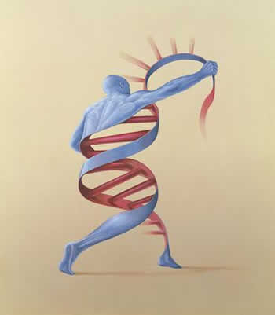
Epigenetic programming of aging trajectories in early life
Alexander Vaiserman,
Institute of Gerontology, Kiev

Slide 22


Journal of Gerontology& Geriatric Research Related Journals
Aging Science
Alzheimer's Disease & Parkinsonism
Depression and Anxiety
Emergency Mental Health
Palliative Care & Medicine

Slide 23

Journal of Gerontology& Geriatric Research Upcoming Conferences
http://www.conferenceseries.com/

Slide 24


OMICS International Open Access Membership
OMICS International Open Access Membership enables academic and research institutions, funders and corporations to actively encourage open access in scholarly communication and the dissemination of research published by their authors.
For more details and benefits, click on the link below:
http://omicsonline.org/membership.php
www.ilmo.it

