Slide 1

Vic Grout
Centre for Applied Internet Research (CAIR)
Glyndwr University
Plas Coch Campus, Mold Road, Wrexham, North Wales, LL11 2AW, UK
Email: v.grout@glyndwr.ac.uk
Tel/Fax: +44(0)1978 293203

Slide 2
Recent Publications
Ries, C.B. & Grout, V., “Code Generation Approaches for an Automatic Transformation of the Unified Modeling Language to the Berkeley Open Infrastructure for Network Computing Framework”,The International Conference on Soft Computing and Software Engineering (SCSE 2013), March 1-2, 2013, San Francisco, California, USA.
Davies, J. & Grout, V., “A Joined Up Framework for Identifying Dissertation Topics in a Technical Environment (Computer Networking)”, in What is Research-Led Teaching? Multidisciplinary perspectives (eds. A. Miller, J. Sharp & J. Strong), CREST Guild of Higher Education, 2012.
Folorunsho, O., Picking, R. & Grout, V., “Mobile Apps: Innovative Technology for Globalization and Inclusion of Developing Countries”, Proceedings of the 5th International Conference on Education, Research and Innovation (ICERI 2012), 19th-21st November 2012, Madrid, Spain.
Kreider, M., Bär, R., Beck, D., Terpstra, W., Davies, J., Grout, V., Lewis, J., Serrano, J. & Wlostowski, T., “Open Borders for System-on-a-Chip Buses: A wire format for connecting large physics controls”, American Physical Society Physical Review: Special Topics – Accelerators and Beans, Volume 15, Issue 8, August 2012.
Ries, C.B., Schröder, C. & Grout, V., “Model-based Generation of Workunits, Computation Sequences, Series and Service Interfaces for BOINC based Projects”, Proceedings of the 2012 International Conference on Software Engineering Research and Practice(SERP'12), Las Vegas, USA, 16-19 July 2012.
Davies, J.N., Payne, M., Evans, P. Sparey-Taylor, G., Rvachova, N., Korkh, O., & Grout, V., “Communications System for a solar car”, Proceedings of the Ninth International Network Conference(INC 2012), July 11-12 2012, Port Elizabeth, South Africa, pp93-102.

Slide 3
Biography
Vic was awarded the BSc(Hons) degree in Mathematics and Computing from the University of Exeter (UK) in 1984 and the PhD degree in Communication Engineering (Thesis title: "Optimisation Techniques for Telecommunication Networks") from Plymouth Polytechnic, now the University of Plymouth, (UK) in 1988. He is currently Professor of Computing Futures at Glyndŵr University, Wrexham, Wales. He also serves on the UK National Committee of the Council of Professors and Heads of Computing (CPHC) as the Chair of the Council of Heads of Computing in Wales/Cyngor Penaethiaid Cyfrifiadura Cymru (CPCC). He is an approved British Computer Society (BCS) accreditation assessor, an Institute of Engineering and Technology (IET) recommended speaker and a European Commission (EC) ‘Horizon 2020’ (H2020) Expert Research Assessor and Ethics consultant.Vic has worked in senior positions in academia and industry for nearly 30 years and has published over 300 research papers, patents and books. His research interests span several areas of computational mathematics, including artificial intelligence and the application of heuristic principles to large-scale problems in Internet design, modelling, simulation, management and control. He has also worked extensively on projects using Internet technologies to help the elderly and disabled live longer independent lives. He is an experienced ‘futurologist’ - with particular a focus on the ethical and moral dimensions of technological evolution, 'big data', ‘big connectivity’ and the 'Internet of Things' - and writes regularly in the ‘Turing’s Radiator’ blog (vicgrout.net).
Professor Grout is a Chartered Engineer, Chartered Electrical Engineer, Chartered Scientist, Chartered Mathematician and Chartered IT Professional, a Fellow of the Royal Society of Arts (FRSA), Institute of Mathematics and its Applications (FIMA), British Computer Society (FBCS) and Institution of Engineering and Technology (FIET) and a Senior Member of the Institute of Electrical and Electronics Engineers (SMIEEE) and the Association of Computing Machinery (ACM). He formed and initially chaired the biennial international conference series on Internet Technologies and Applications (ITA 05, 07, 09, 11, 13 & 15) and is a frequent contributor to TV and radio, including the newly launched runaview.com discussion forum:“… bringing together 1000 of the UK's most entertaining & dynamic personalities.”

Slide 4
Research interest
Futurology,
Computing Philosophy
Computing Ethics
Artificial Intelligence
Computational Mathematics
Optimisation and Heuristics
Network Algorithms

Slide 5
Work Package 3
User Interaction Technologies

Slide 6
Key Interface Considerations for ‘Care in Business’:
Types of user interface technologies
  What’s available/relevant now?
  What can/should be developed?
Modalities of device usage
  How’s it used in a ‘Care in Business’ scenario?
  Is this right/best?
Evaluation of user interaction technology
  What works?
  How do we assess this accurately?
Ethics of AL technologies
  What’s allowed? (By law? By the company?)
  What’s acceptable? (To the person being cared for? To the carer?)
How does interface design relate to the user’s environment (WP1) and connectivity (WP2)

Slide 7
Some previous experience …
Easy Line+ project – “Low-cost advanced white goods for a longer independent life for elderly people”.
Funded under the Ambient Assisted Living section of the IST component of the EU framework 6 programme (2.3m Euros)
Objective: To develop a range of advanced white goods to help elderly people, with or without disabilities, maintain a longer independent life in their own home.
Consortium Partners: University of Zaragoza, BSH (Bosch/Siemens), G2V Grupo de Empresas, Motive Technology, Glyndŵr University.

Slide 8
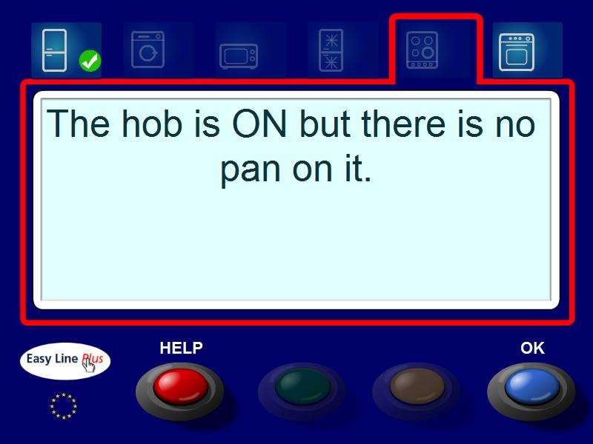
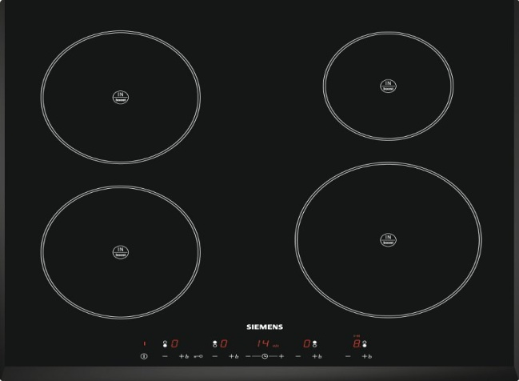
Example Easyline+ Interaction
The hob has been left on with no pan on it.
The message is sent to the user:
Notes:
8

Slide 9

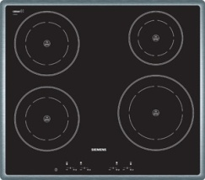

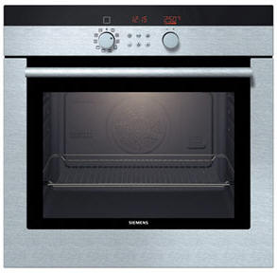
More Scenarios
Fridge / Freezer:
Records what goes in and out.
Warns about expired products.
Warns if door is left open.
Etc.
Hobs:
Warns if pan is left on a hob
Warns of excessive heat in inappropriate areas
Etc.
Oven:
Automatically chooses appropriate temperature and duration.
Tells user that food is ready.
Etc.
Washing machine:
Warns of wrong mix of colours or fabrics.
Chooses appropriate washing programme
Checks levels of detergent and softener.
Etc.
Notes:
9

Slide 10
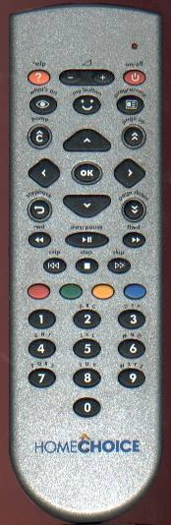
SCUFF Design Principles
Simplicity
Consistency
Universality
Familiarity
Flexibility
In Easyline+, these principles led us to base device interaction on the red, green, yellow and blue buttons on a TV remote control.
Notes:
10

Slide 11
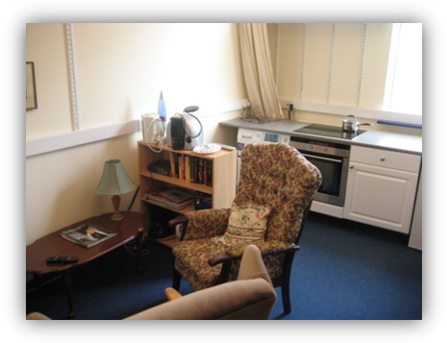
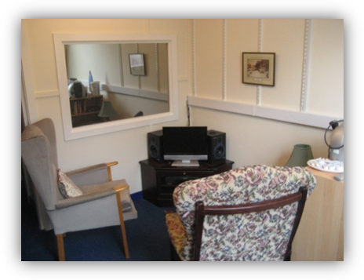
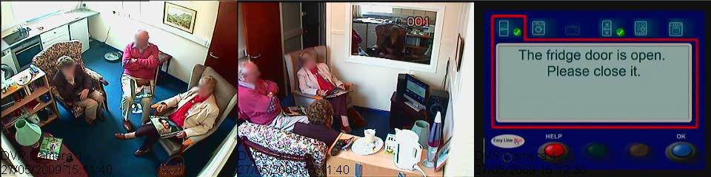
Usability lab at Glyndwr University
Can be used to simulate natural environments of the carer at work or the person being cared for at home
Notes:
11

Slide 12
How do we Integrate the SCUFF Design Principles?
Simplicity
Consistency
Universality
Familiarity
Flexibility
These principles are desirable in their own right but can be mutually contradictory. (A simple design may not be flexible enough, for example.) How do we overcome this? Compromise? Discard some objectives?
What’s appropriate for ‘Care in Business’

Slide 13
Thank you. Any questions?
Notes:
13

Slide 14
Project-II
Ants in the Internet!
(or ‘Working together works best’)

Slide 15
Disclaimer!
The purpose of this presentation is to entertain and arouse interest. To this end, the authors show gleeful disregard for standard networking conventions (terminology) and precision (accuracy).
or, to put it another way …
Any similarities between the content here and that of a respectable, technical (competent) presentation on networking are entirely coincidental!

Slide 16

Networks, Routers and Routing









Today’s networks (eg, the Internet) carry data in small packets
The ‘big issue’ is how these packets find their way around

Slide 17
Networks, Routers and Routing
Router
A


B
B

B

B
B
For data (eg, an email) to find its way from sender to receiver, the packet has to have an address …
… and the routers in the network need to know what to do with it

Slide 18
Networks, Routers and Routing
Now where?
?
?
?

? ?
Each router has to look at each packet and decide where to send it next …
… so each router needs to know a bit about the rest of the network …
… and then make a decision based on what it knows
  a ‘routing protocol’

Slide 19
Routing Protocols
“Tell me a little about yourself …”
?
?
?
?
?
?
Each router exchanges information with its neighbours …
… to build up a complete picture of the network …
… then works out the ‘best’ route to each destination

Slide 20
Routing Protocols
“This is how
to get to B”
B
B
The problem is that each of these routes is calculated independently
Routers only think about their own routes one at a time …
… and have no idea what the other routers are up to

Slide 21
‘Joined-up Routing’
“Now, how
about C?”
B
C
B
C
Looking at the bigger picture …
… it may be better …

Slide 22
‘Joined-up Routing’
B
C
B
C
Looking at the bigger picture …
… it may be better …
… to choose different individual routes?

Slide 23
‘Joined-up Routing’
B
C
B
C
Looking at the bigger picture …
… it may be better …
… to choose different individual routes?
Sounds simple!

Slide 24
Problems!
!
Two difficulties with this:
  Considering all routes together takes much longer than separately
  How can the routers co-operate in this way …
    … when they are working out routes independently for themselves?

Slide 25
Requirements
?
So we need …
  efficient, approximate methods of calculating routes … and …
  a way of sharing intended routes
… and the solution may be …

Slide 26
A Solution?
Ants!

Slide 27
Ant colony behaviour
Leave a trail
of pheromone
Read
pheromone
As ants move around looking for food …
… each lays down a trail of pheromone
  a message for other ants
  the more ants, the more pheromone
Following ants detect the pheromone
Collectively, the colony finds the best ‘strategy’

Slide 28
Ant colony optimisation (ACO)
Ant colony methods have already been used successfully to solve various design and planning problems …
… for example, the travelling salesman problem (TSP)

Slide 29
Ant colony routing? (ACR)
‘Ant’ packets




Can we use ant colony methods to improve routing?
Send out ‘ant’ packets into the network …
… laying down ‘electronic pheromone’ …
… to share routing information …
… and improve the overall routing strategy for the network?

Slide 30
Ant colony routing? (ACR)
‘Ant’ packets




Some successful, small-scale simulation work has been carried out …
… but now for the big networks …
… and the ‘production’ routers!
Your mission (Nigel), should you choose to accept it, …

Slide 31
… any questions?
Thank you …

