Slide 1





OMICS International
OMICS International through its Open Access Initiative is committed to make genuine and reliable contributions to the scientific community. OMICS International journals have over 3 million readers and the fame and success of the same can be attributed to the strong editorial board which contains over 30000 eminent personalities that ensure a rapid, quality and quick review process. OMICS International signed an agreement with more than 1000 International Societies to make healthcare information Open Access.
Contact us at: contact.omics@omicsonline.org

Slide 2

OMICS Journals are welcoming Submissions
OMICS International welcomes submissions that are original and technically so as to serve both the developing world and developed countries in the best possible way.
OMICS Journals are poised in excellence by publishing high quality research. OMICS International follows an Editorial Manager® System peer review process and boasts of a strong and active editorial board.
Editors and reviewers are experts in their field and provide anonymous, unbiased and detailed reviews of all submissions. The journal gives the options of multiple language translations for all the articles and all archived articles are available in HTML, XML, PDF and audio formats. Also, all the published articles are archived in repositories and indexing services like DOAJ, CAS, Google Scholar, Scientific Commons, Index Copernicus, EBSCO, HINARI and GALE.
For more details please visit our website: http://omicsonline.org/Submitmanuscript.php

Slide 3
Main Scientific Interests
Victor M Starov Department of Chemical
Engineering,
Loughborough University, UK

Slide 4
SCIENTIFIC INTERESTS
KINETICS OF SPREADING MEMBRANE SEPARATION
KINETICS OF REVERSIBLE COAGULATION
RHEOLOGY OF CONCENTRATED
SUSPENSIONS

Slide 5
PUBLICATIONS PRESENTATIONS AT | 259
SCIENTIFIC MEETINGS | 200
h-index | 29
Sitations | 2816
PHD STUDENTS SUPERVISED
More than
DSc SUPERVISED
35
3

Slide 6
OUTLINE
SURFACE FORCES ACTION
SPREADING OVER POROUS SUBSTRATES: SATURATED AND DRY, SURFACTANT SOLUTIONS
SPREADING OVER SURFACES COVERED WITH FATTY ACID OR LIPID LAYERS
SPREADING OVER HYDROPHOBIC SURFACES
SUSFACTANTS ON THIN WATER LAYERS IMBIBITION INTO POROUS MEDIA
Rheology of concentrated suspensions/emulsions

Slide 7
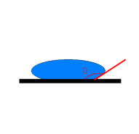
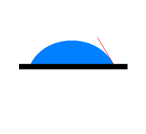
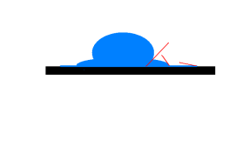
A water droplet on three different substrates
θ contact angle
Glass or mica Partial wetting, 0<θ<π/2
Teflon
Non-wetting,
θ>π/2
Complete wetting Silicone wafer,
water spreads out
completely
θ(t) dynamic contact angle
WHAT IS THE REASON?

Slide 8
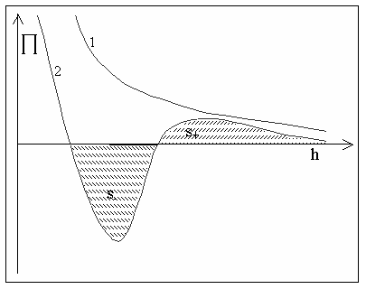
Disjoining pressure: 1 Complete wetting
2 Partial wetting
cosθ = 1 − ^{S− − S+}
γ

Slide 9
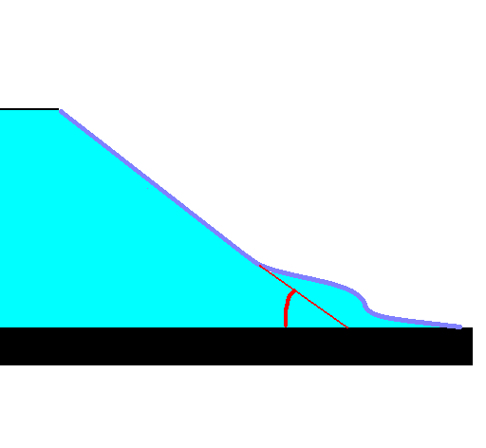
Disjoining pressure determines the
liquid shape in the transition zone
Contact angle

Slide 10
Static advances and receding contact angles on smooth homogeneous substrates
Deformation of soft solids in contact
with transition zone
Non-flat liquid layers Line tension
Influence of roughness
Motion of drops/bubbles in thin
capillaries
Kinetics of spreading in the case of complete wetting

Slide 11
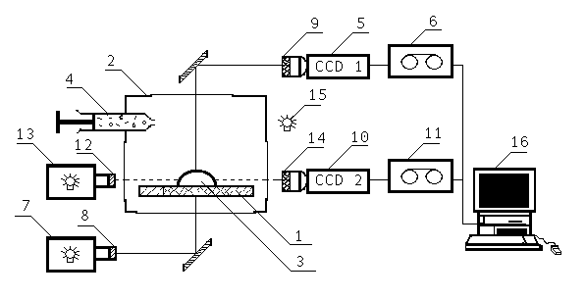

Experimental set-up
1-substrate, 2-hermetically closed, thermo stated chamber, 3-liquid drop, 4-syringe, 5, 14- front view and view from above CCD cameras, 6, 11-VCRs, 7, 13- light sources, 8, 12 collimating lenses, 9,14-tele-photo objectives, 15-flash gun, 16-PC.

Slide 12
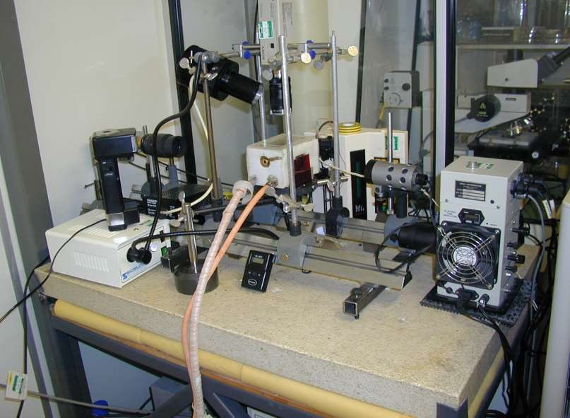

Slide 13
SPREADING OVER SATURATED POROUS LAYERS

Slide 14
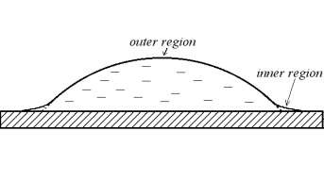
Spreading over saturated
porous layers
“Outer” solution
Matching of outer and inner solutions results in
Spreading law
spherical cap
μL
3
⎛ πL³ ⎞
⎛
t ⎞
0.1
_{τ =} 0 ⎜ 0 ⎟
L(t) = L 1 +
,
⎜
⎟
⎠
10γω ⎜ 4V ⎟
0
⎝
τ
3
⎝ ⎠
dL _{= ω} γθ
dt
μ
Effective lubrication
coefficient
ω
can be both experimentally
determined and calculated

Slide 15

SILICONE OILS ON
NITROCELLULOSE MEMBRANES
⎛
3
⎛ ⎞
V ³γ
⎞
0.1
Fitted as:
L = L (1 + t /τ )^{n}
L = L ⎜1 + 10⎜ ⁴ ⎟
ω t ⎟
0
0 ⎜
⎟
L μ
⎝
⎝ π ⎠
10
⎠
0
0.29
L,
cm
0.28
0.27
0.26
1 - 12 point
n 0.13 ± 0.01
0.25
0.24
0.23
3 - 12 point
n 0.11 ± 0.01
0.22
0.21
0.20
0.19
0.0
0.5
1.0
1.5
t, s
2.0
2.5

Slide 16
Initial stage differs from the
capillary regime!
-1.20
-1.25
ln L
-1.30
-1.35
-1.40
-1.45
-1.50
-1.55
-1.60
-2.0
-1.5
-1.0
-0.5
ln t
0.0
0.5
1.0

Slide 17





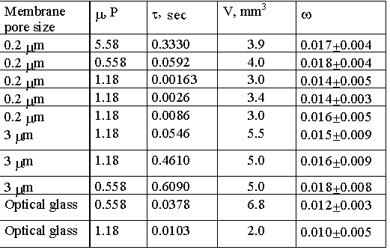
EXPERIMENTAL VALUES OF EFFECTIVE LUBRICATION COEFFICIENT ω

Slide 18




SPREADING OVER DRY POROUS LAYERS
SIMULTENEOUS SPREADING AND IMBIBITION INTO THE POROUS SUBSTRATE
COMPLETE WETTING

Slide 19
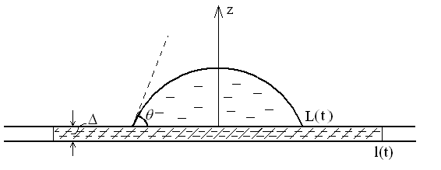
Spreading over dry
porous substrates
L(t)
l(t)
radius of the drop base,
radius of the wetted region inside the porous layer,
θ(t) dynamic contact angle

Slide 20
DRY POROUS SUBSTRATE
Drop volume
V (t) = V − πmΔ l(t)²
0

Slide 21

SPREADING SHRINKAGE
dL
velocity of spreading
= v₊ − v₋
dt
velocity of shrinkage

Slide 22
SPREADING OF
LIQUID
DROPS OVER DRY POROUS
LAYERS:
COMPLETE WETTING
CASE
0.3
0.1
2π mΔK
−
⎛
⎞
1/ 3
dL _{= 0.1⎜} 4V ⎟ ⎜10γω ⎟
⎛ ⎞ 1
2 / 3
p
4
1
⎛ ⎞
⎜
⎟
p c
⎜
⎟
(t + t )
0.9
⎜ (V −πmΔl ) θ ⎟
_{ln} l
L
dt
⎝ π ⎠
⎝
μ
⎠
3μ
2
2
0
⎝ 0
⎠
dl ₌ K_{p} p_{c} / μ
dt
l ln ^{l}
L
K_{p}p_{c} is determined independently
NO FITTING PARAMETERS

Slide 23
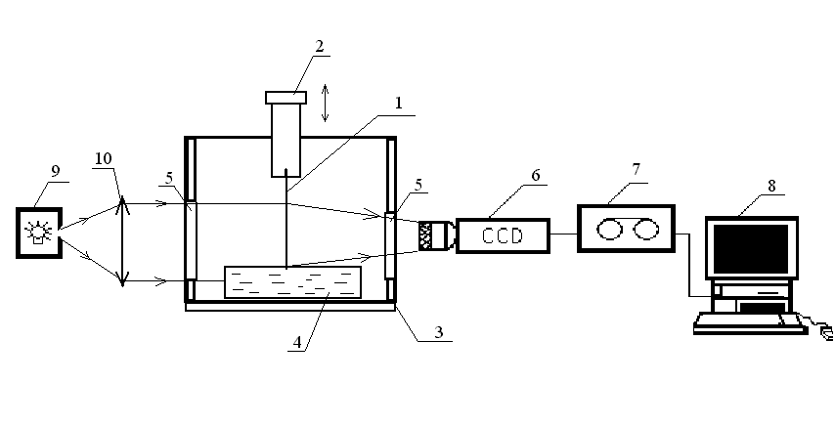
CAPILLARY IMBIBITION: DETERMINATION OF K_{p} p_{c}
d
Experimental set-up
1-membrane, 2-lifting up/down device, 3-thermo stated chamber, 4- Petri dish with liquid, 5-optical glass windows, 6-CCD camera, 7-video tape-recorder, 8- PC

Slide 24
Capillary imbibition of silicone oils:
independent determination of K_{p} p_{c}
d² (t) = 2K p t /μ
0.9
p c
0.4
- linear fit
0.3
0.6
d, cm
0.5*d²
0.2
0.3
0.1
0.0
0.0
0
30
60
90
0
20
40
60
80
10
t, s
t, s
Nitrocellulose membrane 0.22 μm

Slide 25
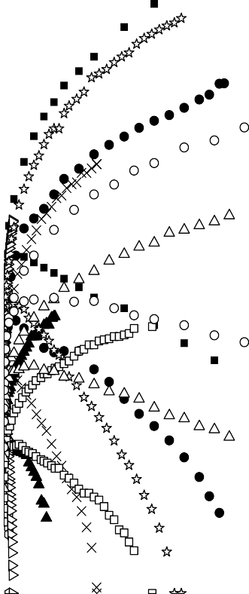

Slide 26
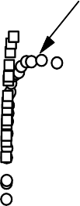
Dimensionless
values
L = L / L , l = l / l* , t = t / t*
m
5
_{l}*
4
L, l, mm
L_{m}
3
2
1
_{t}*
0
0
60
120
180
t, s

Slide 27
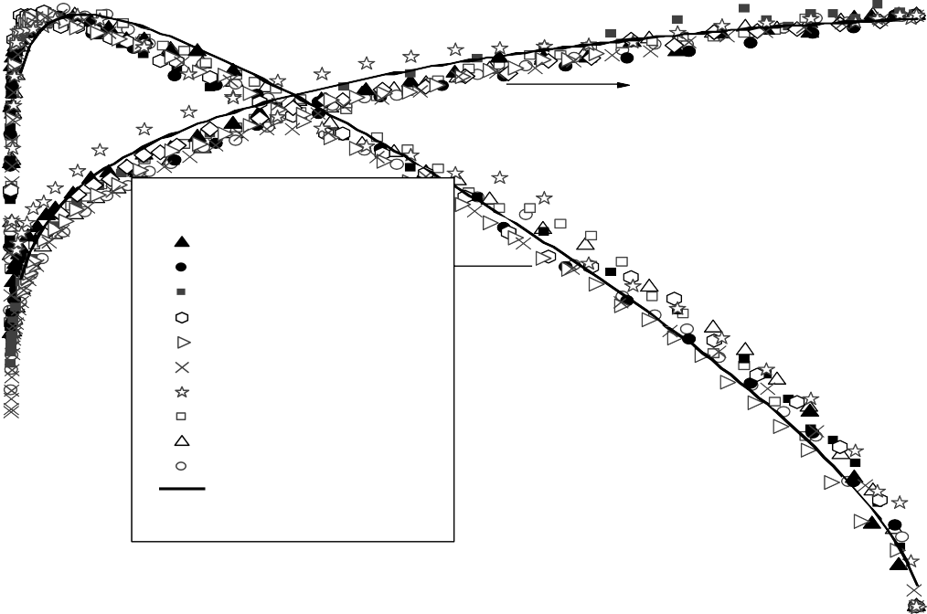
Universal behaviour: solid lines according to our theory predictions
L = L / L , l = l / l*, t = t / t*
m
1.0
1.0
L
l
SO20 V₀=3.1 mm, r=0.2 _{μ} SO20 V₀=9.0 mm, r=0.2 _{μ} SO20 V₀=15.6 mm, r=0.2 _{μ}
3
L
3
3
0.5
3
SO20 V=3.8 mm , r=3
μ
0.5
0
3
SO20 V₀=5.5 mm, r=3 _{μ} SO100 V₀=8.6 mm, r=3 _{μ} SO100 V₀=14.5 mm, r=3 _{μ} SO500 V₀=3.6 mm, r=3 _{μ} SO500 V₀=8.7 mm, r=3 _{μ} SO500 V₀=14.5 mm, r=3 _{μ}
Theory
3
3
3
3
3
0.0
t
0.0
0.0
0.5
1.0

Slide 28
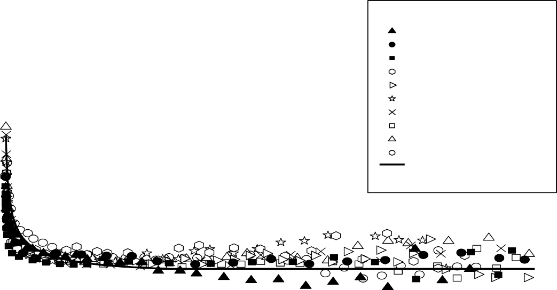

Slide 29
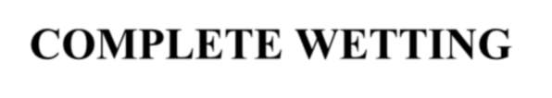
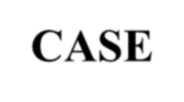

SPREADING OF LIQUID DROPS OVER THICK POROUS LAYERS COMPLETE WETTING
CASE

Slide 30
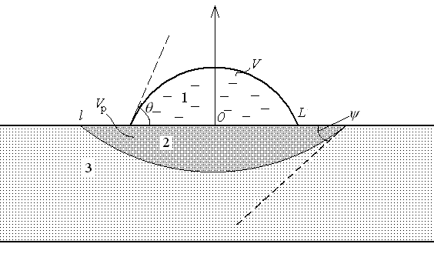
SPREADING OF LIQUID DROPS OVER THICK POROUS LAYERS: COMPLETE WETTING CASE
ψ(t)
effective contact angle

Slide 31
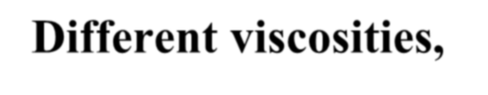

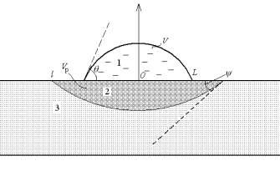
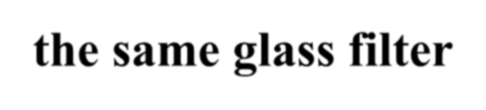

Different viscosities,
the same glass filter
1.0
L/L*
0.8
1.0
l/l*
5
1
2
3
0.8
4
0.6
0.6
3
porosity 0.53
average pore size 4.7 μm
θ/θ_{m}
0.4
0.4
2
0.2
0.2
1
0.0
0.0
0.2
0.4
0.6
0.8
1.0
0.0
0
1.0
0.0
0.2
0.4
0.6
0.8
1.0
t/t*
t/t*
UNIVERSAL
BEHAVIOUR
0.8
0.6
1 μ=5 c P
2 μ=100 cP
3 μ=500 cP
∗
ψ /ψ
0.4
0.2
0.0
0.0
0.2
0.4
0.6
0.8
1.0
t/t*

Slide 32
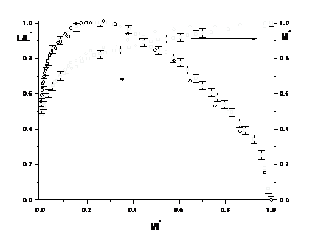
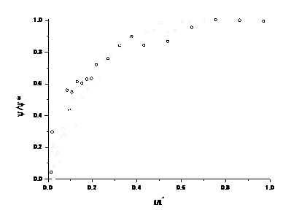
Glass and metal filters with similar properties
4
3
1
2
θ/θ_{m}
2
1
0
0.0
0.2
0.4
0.6
0.8
1.0
t/t*
UNIVERSAL
BEHAVIOUR
1-metal filter: m=0.32, r=26.1 μm. 2-glass filter: m=0.31, r=26.8 μm Silicone oil μ=5 c P

Slide 33
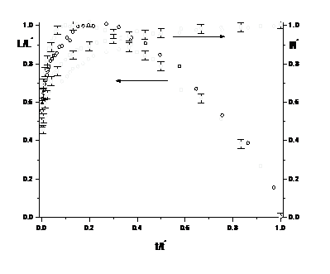
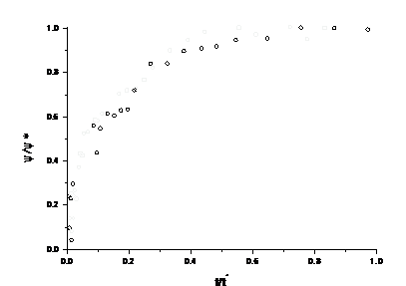
Glass filters:
different porosity
and averaged pore sizes,
μ=500 cP
5
4
1
2
3
θ/θ_{m}
2
1
0
0.0
0.2
0.4
0.6
0.8
1.0
t/t*
Stage 1 difference
Stage 2 universal behaviour
1 m= 0.56; r= 3.7 μm
2 m= 0.31; r=26.8 μm

Slide 34
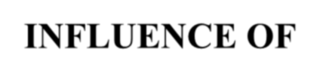
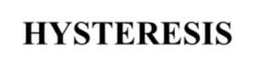
SPREADING OF SDS
SOLUTIONS
INFLUENCE OF HYSTERESIS
PARTIAL WETTING

Slide 35
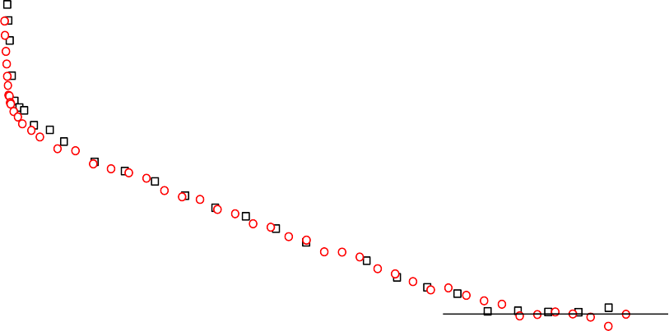
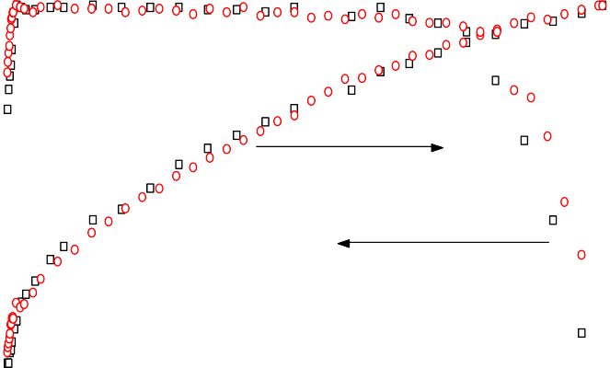
SPREADING OF SDS SOLUTIONS OVER NITROCELLULOSE MEMBRANES:
influence of hysteresis
THREE STAGES OF SPREADING
1 θ decreases, L, increases until the maximum value
r=0.22 μm
2.0
2 L constant, θ decreases linearly
1.5
1
3 L decreases, θ constant
θ/θ_{m}
1.0
1.0
1.0
l/l *
0.8
L/L
m
2
0.8
0.5
3
0.6
0.6
0.0
0.0
0.2
0.4
0.6
0.8
1.0
0.4
0.4
t/t*
0.2
0.2
θ_{a} advancing contact angle
0.0
0.0
θ constant contact angle
0.0
0.2
0.4
0.6
0.8
1.0
e
t/t*

Slide 36
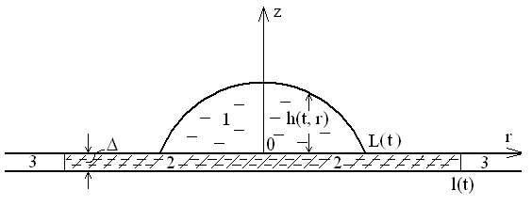
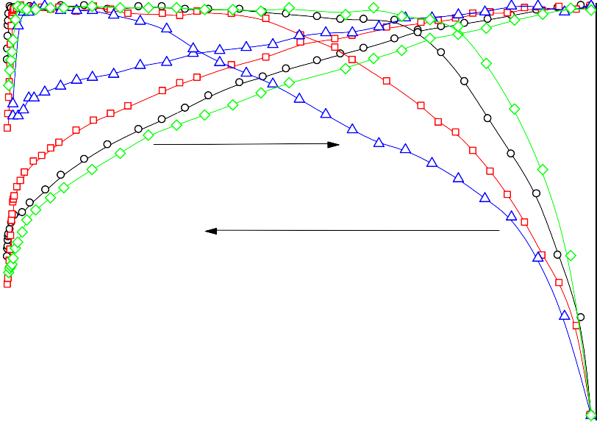
Contact angle hysteresis:
influence SDS concentration
1.0
1.0
r=0.22 μm
SDS 0%
0.1%
0.2%
0.5%
L/L_{m}
0.8
l/l
*
0.8
0.6
0.6
0.4
0.4
0.2
0.2
0.0
0.0
0.0
0.2
0.4
0.6
0.8
1.0
t/t*
HYSTERESIS DECREASES WITH SDS CONCENTRATION

Slide 37
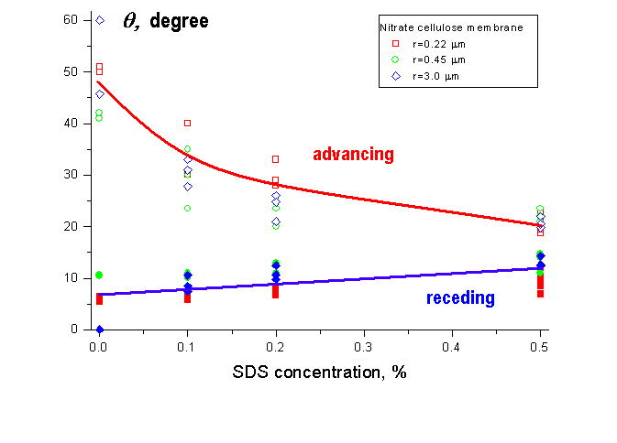
Contact angle hysteresis: influence of SDS concentration

Slide 38
HYSTERESIS ON NON-POROUS
NITROCELLULOSE SUBSTRATE
70
θ advancing contact angle
θ receding contact angle
a
60
θ_{a} , θ_{r} (degree)
r
50
40
30
20
10
0
0.0
0.2 0.4 0.6 0.8
SDS concentration, %
1.0

Slide 39
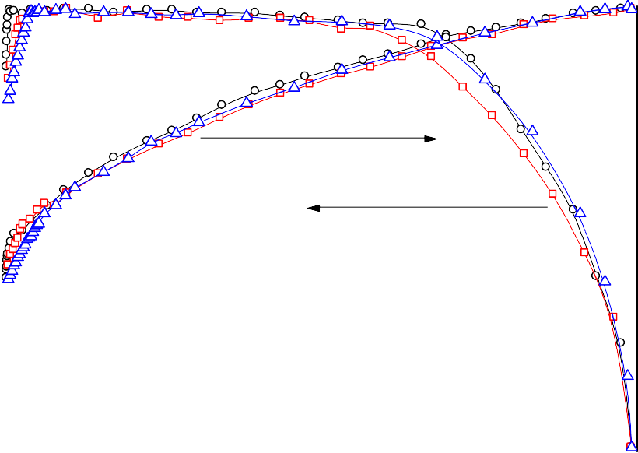
Pore size influence:
WEAK DEPENDENCY
1.0
1.0
l/l*
0.8
SDS 0.1%
r1=0.22μm r2=0.45μm r3=3.0μm
L/L
m
0.8
0.6
0.6
0.4
0.4
0.2
0.2
0.0
0.0
0.0
0.2
0.4
0.6
0.8
1.0
t/t*

Slide 40
SPREDING OVER FATTY
ACID SURFACES
OR LIPID LAYERS

Slide 41
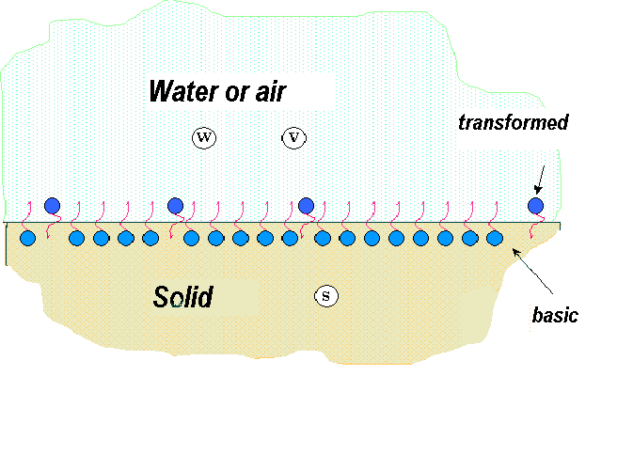
SOLID SUBSTRATE WITH ROTATIONALLY MOBILE CHAINS OF FATTY ACID

Slide 42
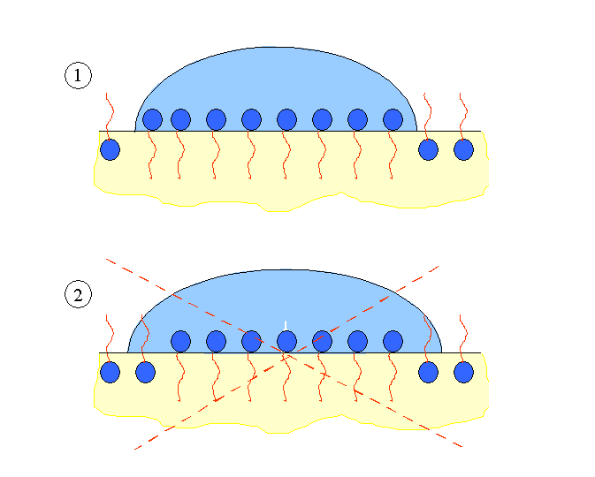
NO LATERAL INTERACTION –
NO SPREADING

Slide 43
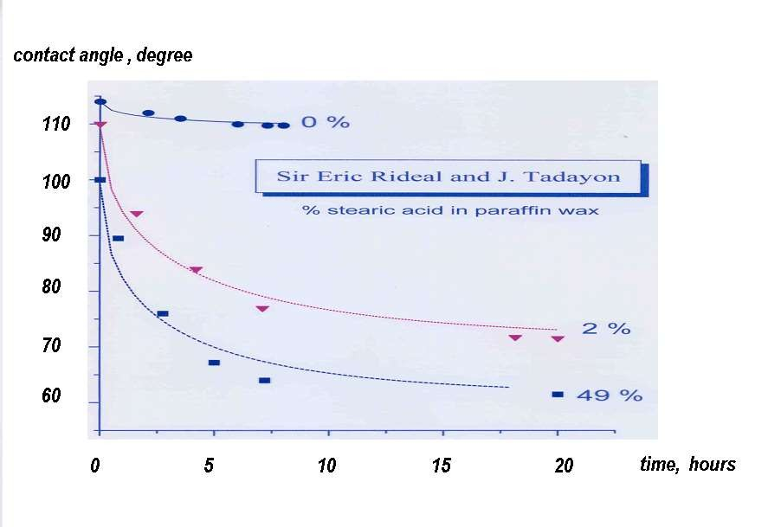

Slide 44
SPREADING OVER HYDROPHOBIC SUBSTRATES

Slide 45
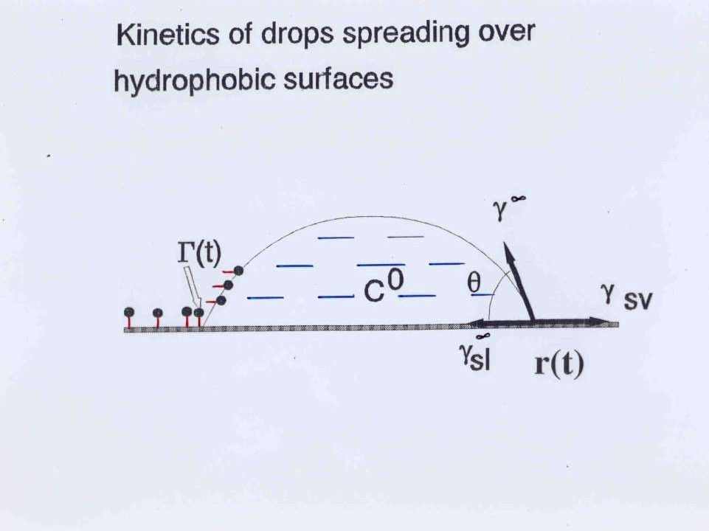

Slide 46
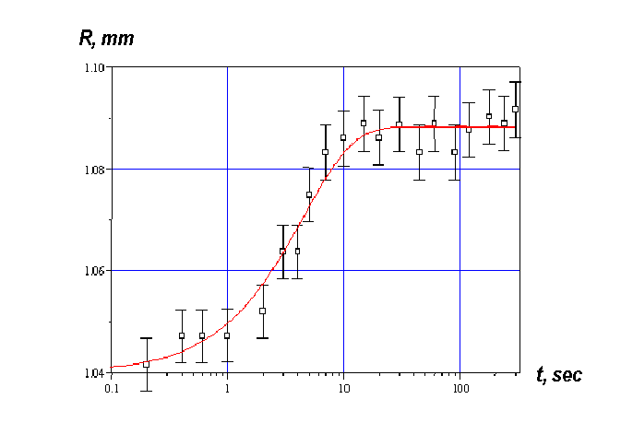
SPREADING OF DROPS (2.5±0.2 μl) OF
0.05% SDS SOLUTION OVER PTFE WAFER

Slide 47
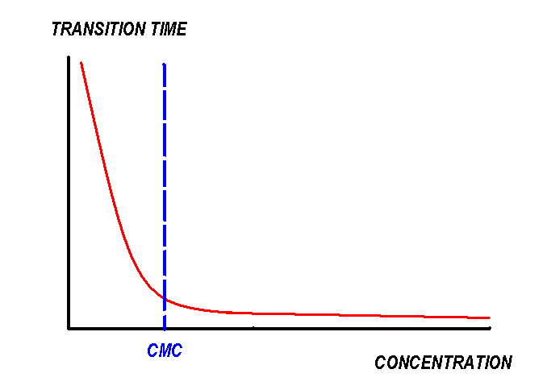
THEORY PREDICTION

Slide 48
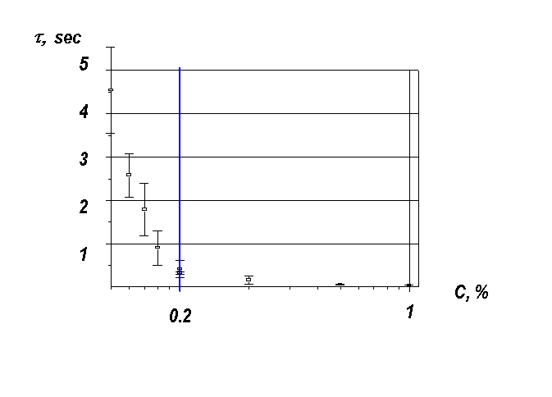
TRANSITION TIME, τ, ON CONCENTRATION
SPREADING OF SDS SOLUTIONS OVER PTMF

Slide 49
SURFACTANTS ON THIN WATER LAYERS:
MARANGONI FLOW

Slide 50
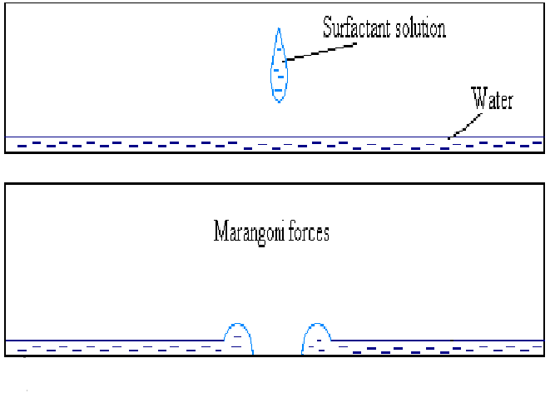
SURFACTANT ON THIN WATER LAYER
R(t)

Slide 51
100
R (mm)
10
0.01
0.1
1
10
t (s)

Slide 52
100
R (mm)
1/4
10
0.01
0.1
1
10
t (s)

Slide 53
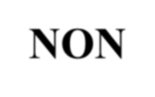

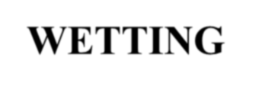
Capillary imbibition of
surfactant solutions
NON-WETTING

Slide 54
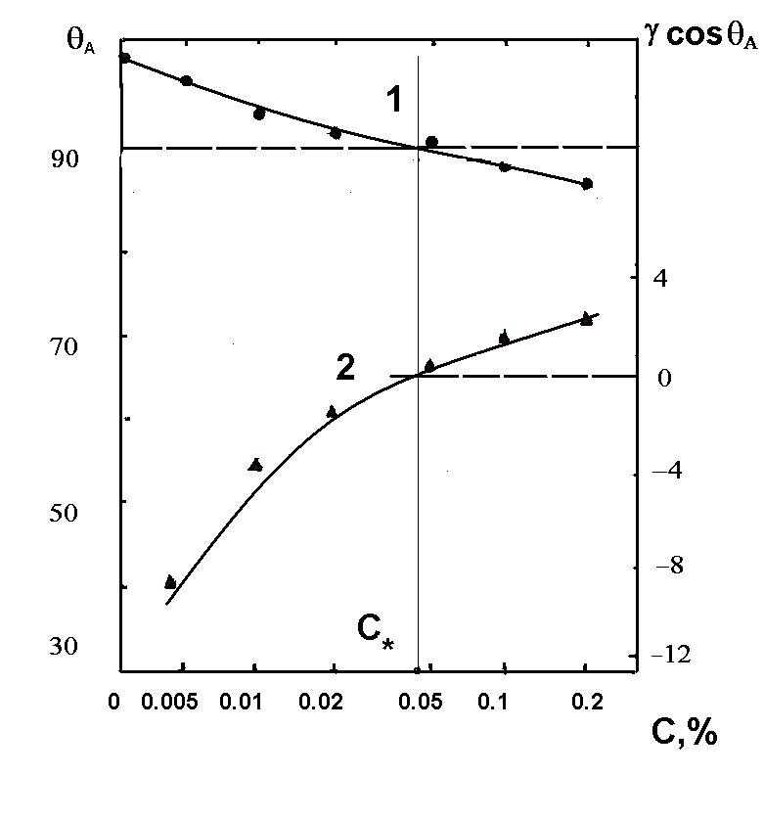
SYNTAMID-5 ON HYDROPHOBISED
QUARTZ SURFACE

Slide 55
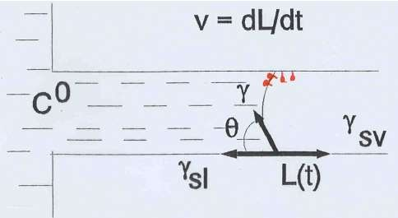
IMBIBITION OF SURFACTANT SOLUTIONS INTO HYDROPHOBISED QUARTZ CAPILLARIES
SPONTANEOUS PROCESS!

Slide 56
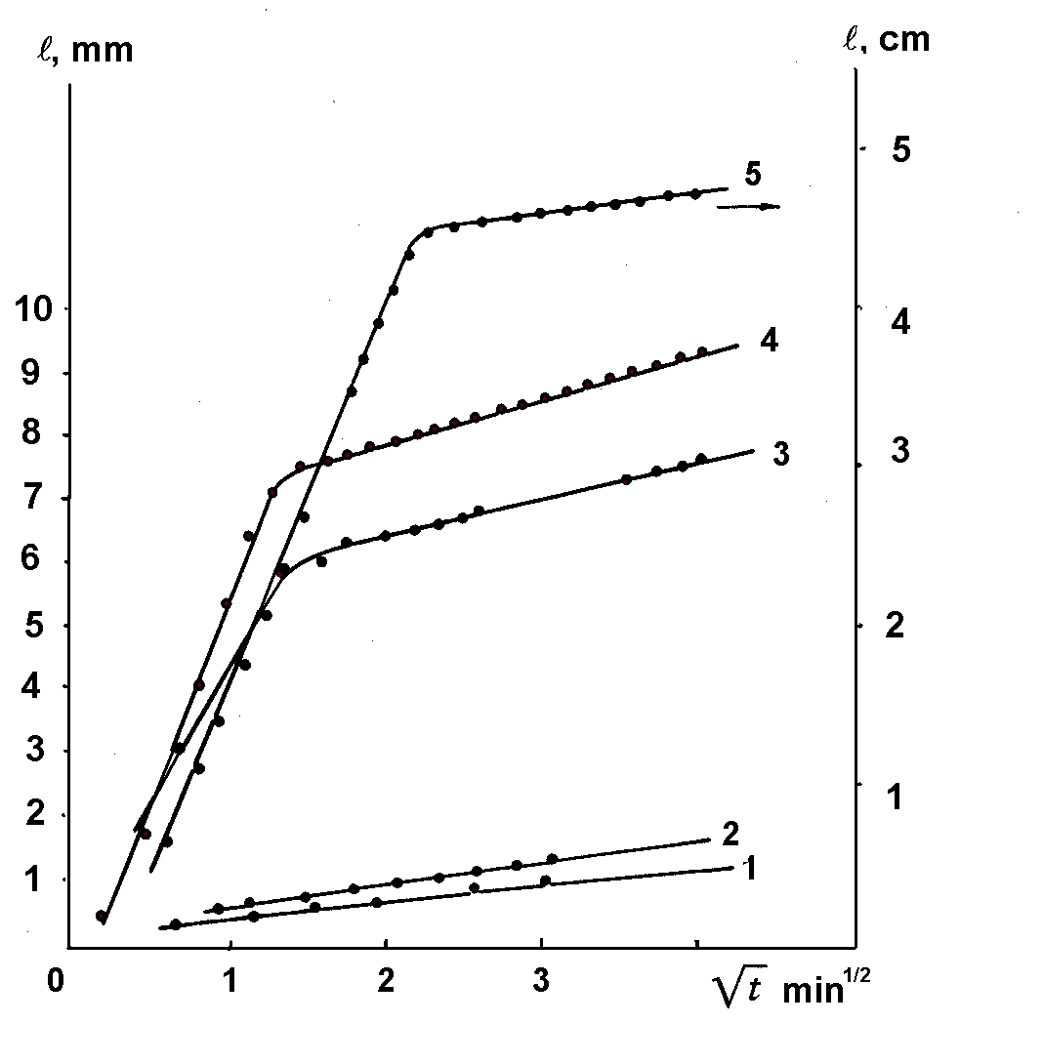
Imbibition length, l, on time, t , Syntamide-5 horizontal
hydrophobized quartz capillary, r = 16 μm.
1 1 0.05%; 2 0.1%; 3 0.4%; 4 0.5%; 5 1%.

Slide 57
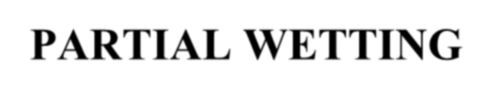
CAPILLARY IMBIBITION OF SURFACTANT SOLUTIONS
PARTIAL WETTING

Slide 58
Capillary imbibition of surfactant
solutions: partial wetting
d² (t) = 2K p t /μ
p c
0.9
0.4
0.3
0.6
d, cm
0.5*d²
0.2
0.3
0.1
0.0
0.0
0
30
60
90
0
20
40
60
80
10
t, s
t, s
Nitrocellulose membrane
SDS concentration 0.1%
Average pore size 0.22 μm.

Slide 59
Capillary imbibition of SDS solutions: nitrocellulose membranes
0.04
0.03
'MILLIPORE'
0.22mkm 0.45mkm
3.0 mkm
K_{p}p_{c}
0.02
0.01
0.00
0.0
0.2
0.4 0.6
SDS-concentrations, %
0.8
1.0

Slide 60
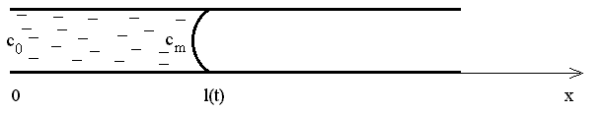
Capillary imbibition of surfactant solutions
Theory
a² πγ _{min} cosθ_{max}
r_{cr} =
∞
2Dηc²
CMC
r < r_{cr} Surfactant concentration is zero on the moving meniscus at any SDS concentration: pure water on the meniscus!
r > r_{cr} Surfactant concentration increases on the moving meniscus with SDS concentration, which results in faster imbibition.

Slide 61
INFLUENCE OF CLUSTER FORMATION ON VISCOSITY OF CONCENTRATED SUSPENSIONS/EMULSIONS

Slide 62
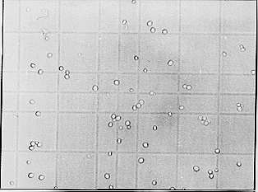
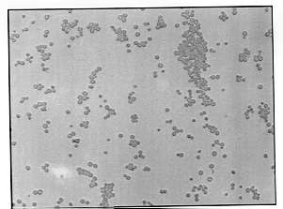

Cluster formation in yeast suspensions
50 µm
γ = 0.002
γ = 0.02
γ = 0.04
100 µm

Slide 63


No clusters Cluster formation Viscosities are different though particle volume fractions are equal

Slide 64

Viscosity on volume fraction of dispersed particles.
_{η}eff _{η}m
Experimental data from review (Thomas), solid lines according to our equation
γ_{m}=1, A=1 (particles do not form clusters)
γ_{m} =0.73 (close to hexagonal packing of particles inside clusters), A=0.61
γ_{m} =0.65 (close to cubic centered packing of particles inside clusters), A=0.67
γ_{m} =0.56 (close to simple cubic packing of particles inside clusters), A=0.72

Slide 65

EMULSIONS
Developed flocculation
γ_{m} density of droplets inside flocs

Slide 66


Slide 67
Theory of reversible coagulation
f
0.3
0.25
1
0.2
0.15
2
0.1
3
0.05
4
0
γ *
0
2
4
6
γ* volume fraction when clusters start to
form

Slide 68
Low flocculated emulsion
_{η} eff
_{η} m
10
_{η} eff
η₀
1
0.0
0.1
0.2
0.3
0.4
γ
Milk at different volume fractions of fat (Leviton, A,
and Leighton, A., 1936).
our theory (cluster formation) no cluster formation
Curve 1
Curve 2

Slide 69


DEADEND ULTRAFILTRATION

Slide 70




Slide 71


Water soluble polymer, n-repeated units (n=5)
Dissociation/association of each unit

Slide 72

λ = C^{p}/C^{f} >1

Slide 73

λ = C^{p}/C^{f} >1

Slide 74









Chemical Sciences
Related Journals
Journal of Thermodynamics & Catalysis
Journal of Plant Biochemistry & Physiology
Organic Chemistry: Current Research

Slide 75





Chemical Sciences
Related Conferences
Medicinal Chemistry & Computer Aided Drug Designing
3rd International Conference on Medicinal Chemistry & Computer Aided Drug Designing

Slide 76




OMICS International Open Access Membership
OMICS International Open Access Membership enables academic and research institutions, funders and corporations to actively encourage open access in scholarly communication and the dissemination of research published by their authors.
For more details and benefits, click on the link below: http://omicsonline.org/membership.php

