Slide 1

OMICS Journals are welcoming Submissions
OMICS International welcomes submissions that are original and technically so as to serve both the developing world and developed countries in the best possible way.
OMICS Journals are poised in excellence by publishing high quality research. OMICS International follows an Editorial Manager® System peer review process and boasts of a strong and active editorial board.
Editors and reviewers are experts in their field and provide anonymous, unbiased and detailed reviews of all submissions.
The journal gives the options of multiple language translations for all the articles and all archived articles are available in HTML, XML, PDF and audio formats. Also, all the published articles are archived in repositories and indexing services like DOAJ, CAS, Google Scholar, Scientific Commons, Index Copernicus, EBSCO, HINARI and GALE.
For more details please visit our website: http://omicsonline.org/Submitmanuscript.php

Slide 2
OMICS Journals are welcoming Submissions
OMICS Group welcomes submissions that are original and technically so as to serve both the developing world and developed countries in the best possible way.
OMICS Journals are poised in excellence by publishing high quality research. OMICS Group follows an Editorial Manager® System peer review process and boasts of a strong and active editorial board.
Editors and reviewers are experts in their field and provide anonymous, unbiased and detailed reviews of all submissions.
The journal gives the options of multiple language translations for all the articles and all archived articles are available in HTML, XML, PDF and audio formats. Also, all the published articles are archived in repositories and indexing services like DOAJ, CAS, Google Scholar, Scientific Commons, Index Copernicus, EBSCO, HINARI and GALE.
For more details please visit our website: http://omicsonline.org/Submitmanuscript.php

Slide 3

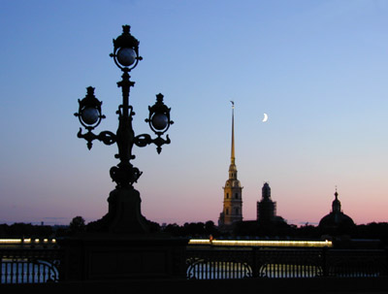
Light desynchronosis, aging and cancer:
Epidemiological and experimental data
Vladimir N. Anisimov
N.N.Petrov Research
Institute of Oncology
aging@mail.ru
В. Анисимов
“J. Gerontol. & Geriatr. Res.

Slide 4
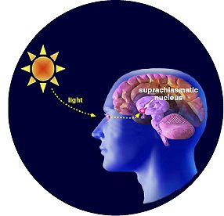
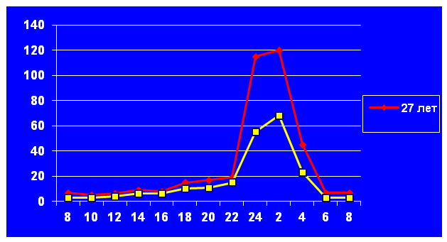
Pineal gland, aging and cancer
Night peak of melatonin inhibited by:
Living at North
Shift work
Jet lag
Light-at-night
Insomnia
Circadian genes KO
Pinealectomy
Peak of melatonin increased by:
Hybernation
Darkness at a day
Blindness
Melatonin
Epitalon

Slide 5
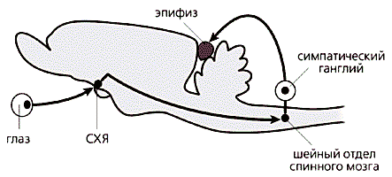
Neuro regulation of pineal function:
Targets for interventions
Pinealectomy
X
X
Sympathectomy
Constant
illumination
X
X
XX
Enucleation
eye
SCN
Light deprivation
SCN damage
Clock genes KO
Jet lag
Insomnia
Hybernation

Slide 6
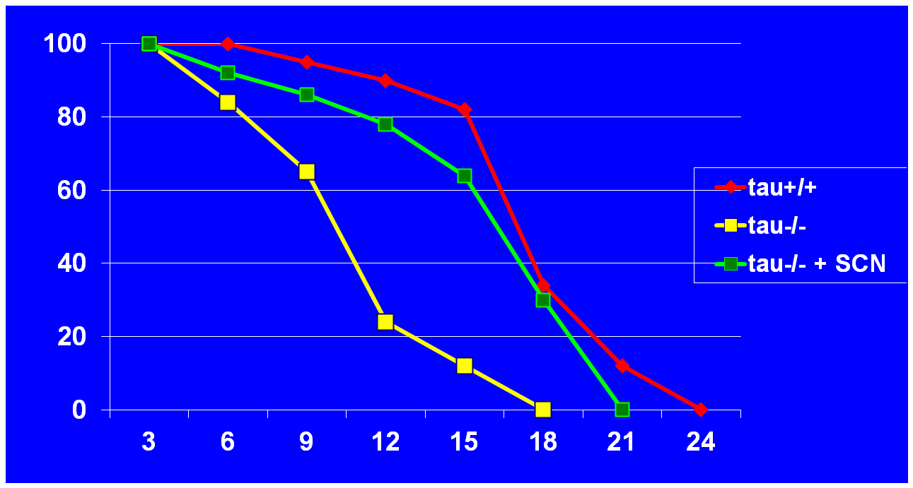
Survival of hamsters bearing tau-mutation in the circadian oscillator of hypothalamic SCN
Возраст, мес.
Hurd M.W., Ralph M.R., 1998

Slide 7

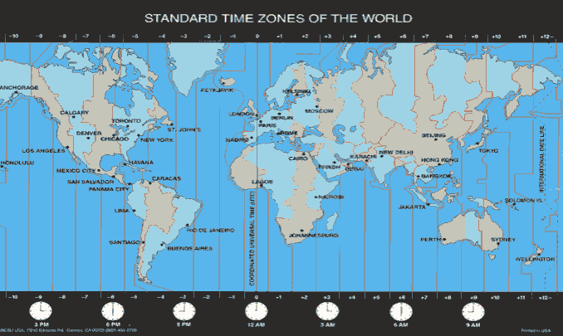
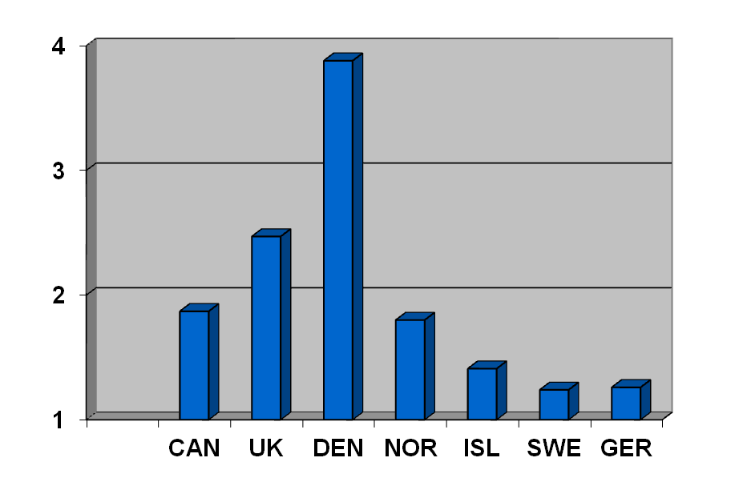
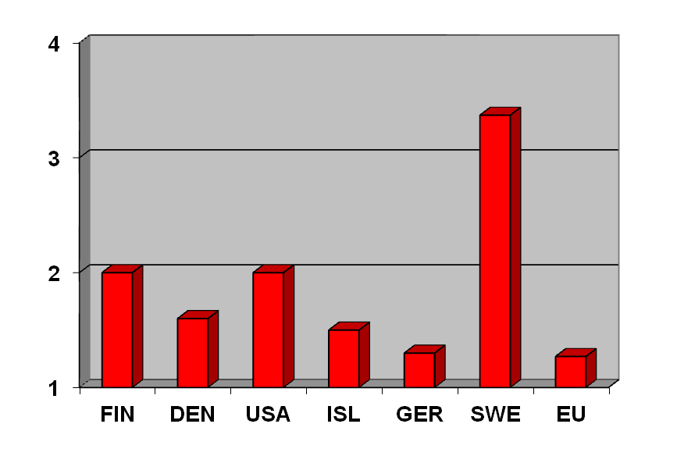
Cancer risk in air crew
Breast cancer
Prostatic cancer
Stewardesses
Pilots
Chronic jetlag increases cancer risk

Slide 8
Light regimen and risk of diseases
Cardiovascular diseases + 51%
Kawachi et al., Circulation, 1995; 92: 3178
Obesity and metabolic syndrome + 56%
Karlsson et al., Occup. Environ. Med. 2001; 58:747
Stomach and duodenum ulcer – 3.9 times
Pietroiusti et al., Occup. Environ. Med. 2006; 63:773
Breast and colon cancer + 36%
Schernhammer et al., J.Natl.Cancer Inst., 2001, 2003
Mean urinary 6-SOMT level was 43% lower in night workers compared to day workers.
Papantoniou et al., 2014

Slide 9
Increase in breast cancer risk depends on the exposure to light at night
Life style Breast cancer risk
_____________________________________
Insomnia
Once a week 1.14 (1.01 - 1.28)
3 times a week 1.4 (1.0 - 2.0)
> 4 times a week 2.3 (1.2 - 4.2)
Bright light in bedroom 1.4 (0.8 - 2.6)
Shift work 1.6 (1.0 -2.5)
Davis S. et al., 2001

Slide 10
Relative risk of breast cancer in shift-worker nurses
Occupation, years Breast carcinoma, RR
____________________________________ 1 - 14 years 1.08 (0.99 - 1.18)
15 - 29 years 1.08 (0.90 - 1.30)
30+ years 1.36 (1.04 - 1.78)
Schernhammer E. et al., 2001
Every 5 year increase of exposure to night shift work correspondingly enhance the risk of breast cancer in female by 3%. The increase in 500-night shifts would result in a 13% increase in breast cancer risk.
Wang F. et al., 2013

Slide 11
Light deprivation and breast cancer risk in females
Visual lesion RR of Authors
(blindness) Breast cancer
_________________________________________
Complete 0.82 (0.47-1.34) Feychting, 1998
Partial 1.06 (0.92-1.21)
________________________________________________
Complete 0.47 (0.01-2.63) Verkasalo, 1999
Significant 0.66 (0.24-1.44)
Moderate 1.05 (1.05-1.30)
________________________________________________
Complete 0.57 (0.35-0.92) Hahn, 1991

Slide 12
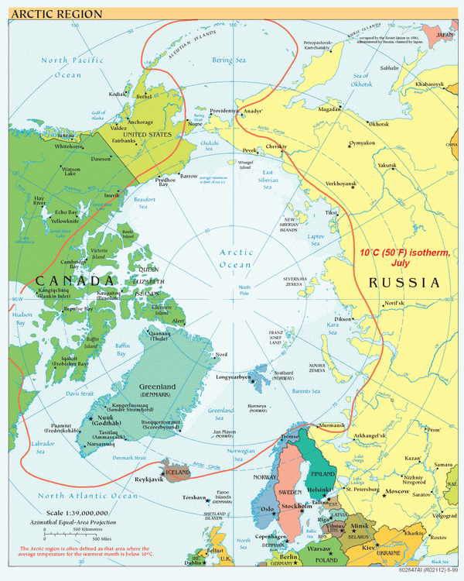
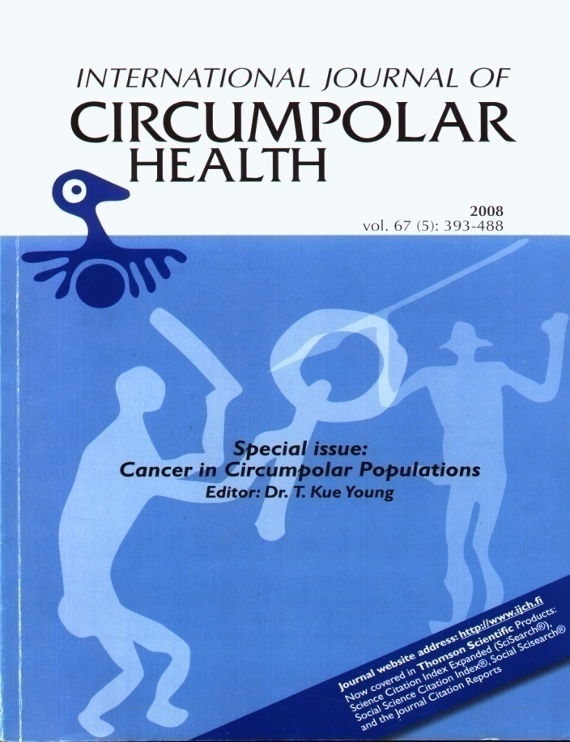
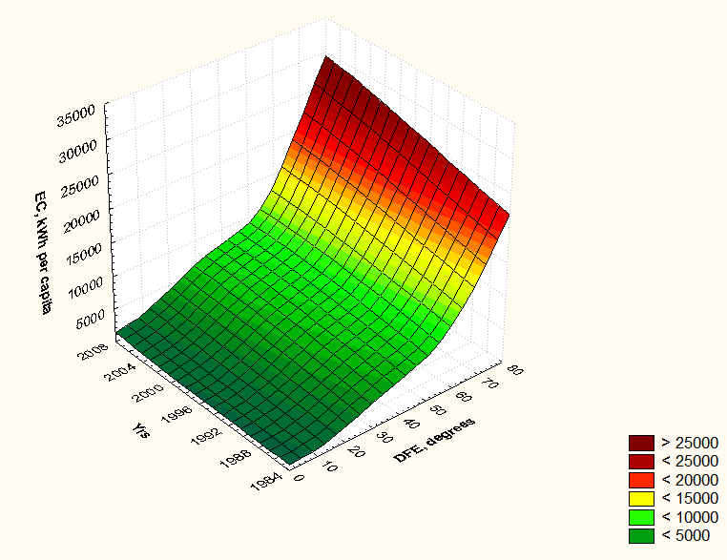
Breast cancer mortality in inuites of Alaska increased 3 times since 1969 due to unknown reason.
Kelly et al., 2006
N
S
Energy consumption, kWh/ person

Slide 13
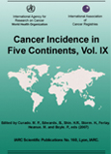
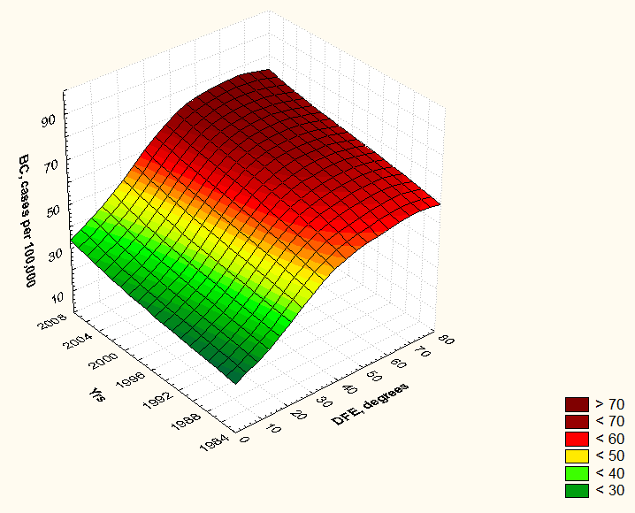
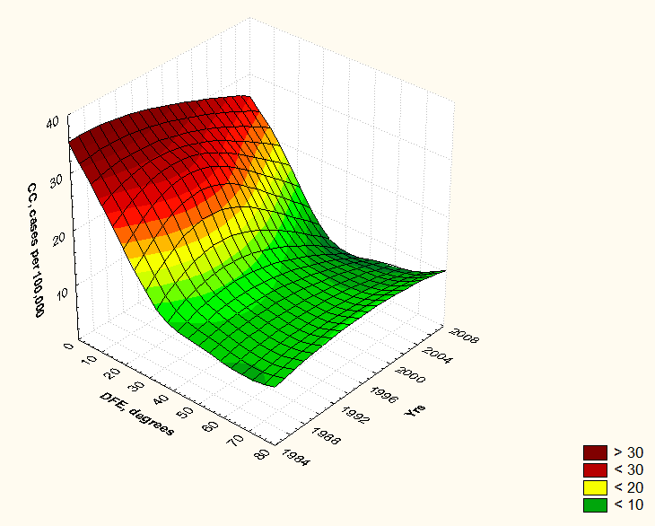
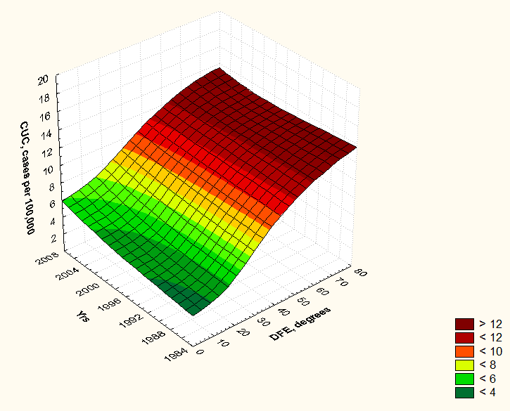
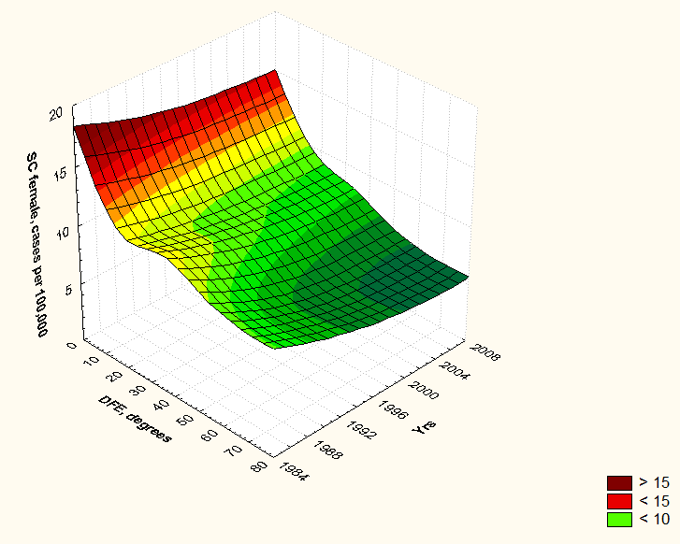
Сancer in Five Continents, vols.VI -IX Lyon: IARC, 1985 - 2007
Breast
Cervix
S
N
S
N
S
Endometrium
Stomach
Breast and colon
cancer risk
increased at North
N
S
S
Borisenkov, Anisimov, 2011
N

Slide 14
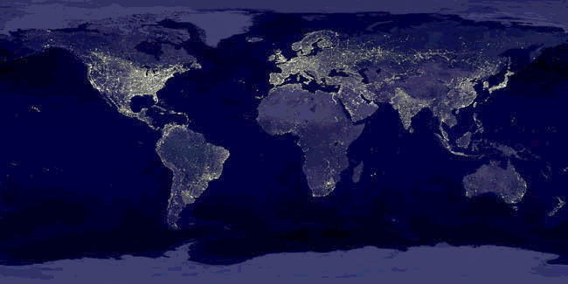
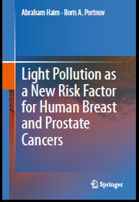
Earth at night
Breast and prostatic cancer risk highest at more illuminated places. Kloog et al., 2008, 2009, 2010

Slide 15
Mutations in clock genes: main effects
Per2-/-: life span reduction, premature switch-off
reproduction function, increases cancer risk
Clock/Clock: obesity, metabolic syndrome,
anovulation, tumorigenesis
Bmal1-/-: life span reduction, lipid peroxidation,
cataract, sarcopenia
Cry1-/-Cry2-/-: no effect on life span and cancer

Slide 16
Suppression of clock genes in human tumors
gene | Cancer | Authors
Per1 | Breast cancer | Chen et al., 2005; Gery et al., 2006
 | Lung cancer | Gery et al., 2006
 | Endometrial cancer | Yeh et al., 2005
 | Pancreatic cancer | Pogue-Geile et al., 2006
Per2 | Acute myeloid leukemia | Gery et al., 2005
 | Breast cancer | Chen et al., 2005
Per3 | Breast cancer | Chen et al., 2005; Zhu et al., 2005

Slide 17
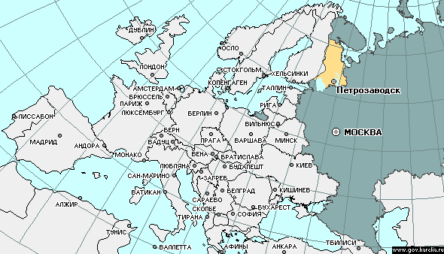
Effect of light regimen on life span and spontaneous tumorigenesis in rats
Rats
Natural
NL
(300 rats)
Constant
LL
(300 rats)
Standard
LD
(300 ratz)
Darkness
DD
(100 rats)
control
control
control
control
MLT
MLT
MLT
Epitalon
Epitalon
Epitalon
Vinogradova, Anisimov, 2009

Slide 18
Effect of light regimen on puberty and ovulatory function in female rats
LL and NL accelerated both switch-on and switch-off of estrus function
*P<0.02
Vinogradova et al., 2009

Slide 19
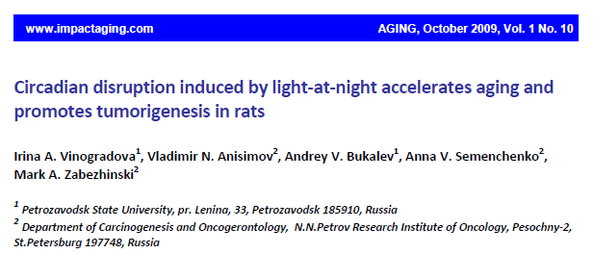
LD – 12 h. : 12 h. ; NL – natural lighting at Petrozavodsk
LL – constant illumination; DD – light deprivation

Slide 20
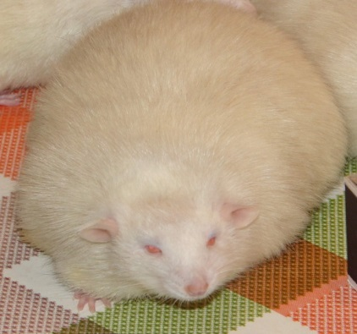
Metabolic syndrome in rats exposed to constant or natural illumination
Obesity and abdominal fat excess
Hypercholesterolemia
Beta-lipoproteinemia
Hyperglycemia and glucosuria
Increase in C-peptide level
premature switching-off of reproductive function
increase in spontaneous tumor incidence
____________________________________________
Overnight treatment with melatonin prevents metabolic
syndrome, slows down reproductive aging and spontaneous
tumor development in а female rats
Vinogradova, Anisimov, 2013

Slide 21
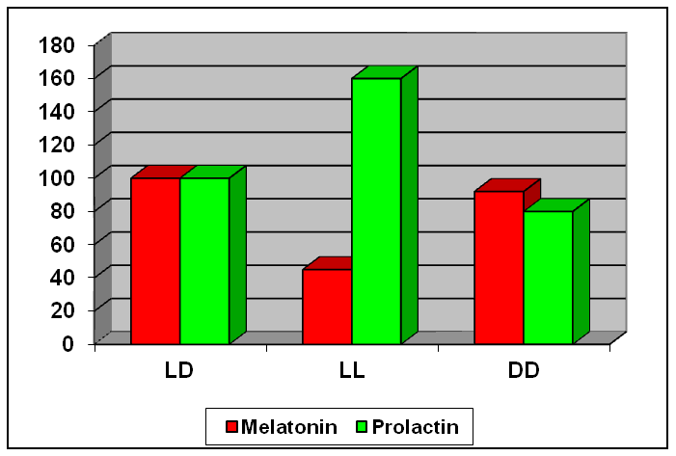
Effect of light regimen on NMU-induced
mammary carcinogenesis in rats
LAN promotes whereas darkness inhibits mammary carcinogenesis
Anisimov et al., Adv. Pineal Res., 1994

Slide 22
Effect of light regime on NEU-induced transplacental carcinogenesis in rats
%
Light at night promotes whereas darkness inhibits tumorigenesis in nervous system and kidney
Beniashvili & Anisimov, Cancer Lett., 2004
Notes:
22

Slide 23
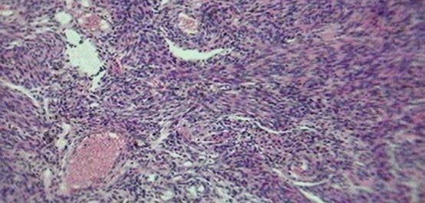
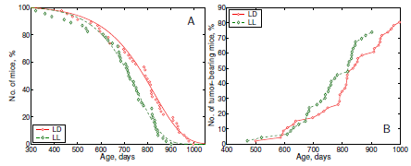
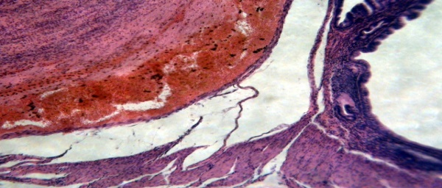
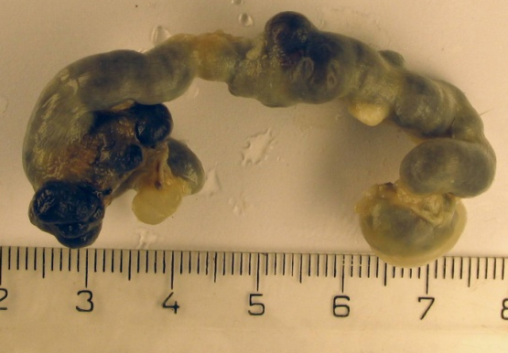
Sarcoma
Hemangioma
LAN increases body weight and temperature, accelerates switching-off of estrous cycle, decreases tumor latency and life span.
З

Slide 24
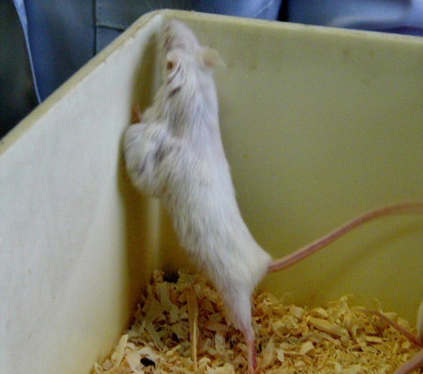
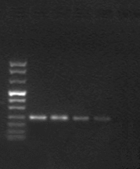
Effect of constant illumination and melatonin on mammary carcinogenesis in transgenic HER-2/neu mice
Mel
M
Saline
Mel
Sal
Group N No of Tumor No of
TBM size, MAC/
cm mouse
_________________________________________
LD 30 23 (77%) 1,9 3,3
LL-300 лк 28 20 (71%) 1,8 5,2*
LL-2500 лк 38 19 (96%) 2,9* 4,8*
LL + MLT 22 13 (59%) 1,3* 3.5*
bp
1114
900
692
501
404
320
242
190
147
124
* P < 0.05
Anisimov et al., Int. J. Cancer, 2004

Slide 25
Effect of light regime on 1,2-dimethylhydrazine-induced colon carcinogenesis in rats
%
* p<0,05
*
PCNA
*
*
Descended colon
EC
Light at night promotes whereas darkness inhibits colon carcinogenesis
Panchenko et al., 2006

Slide 26
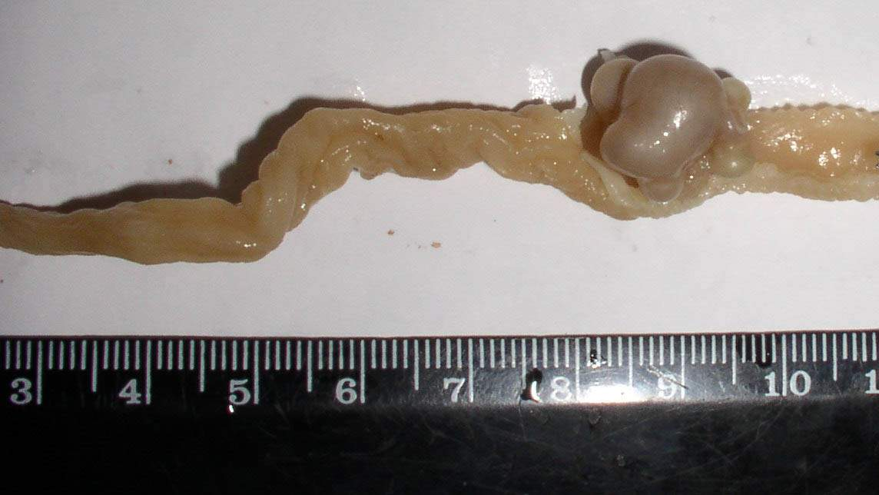
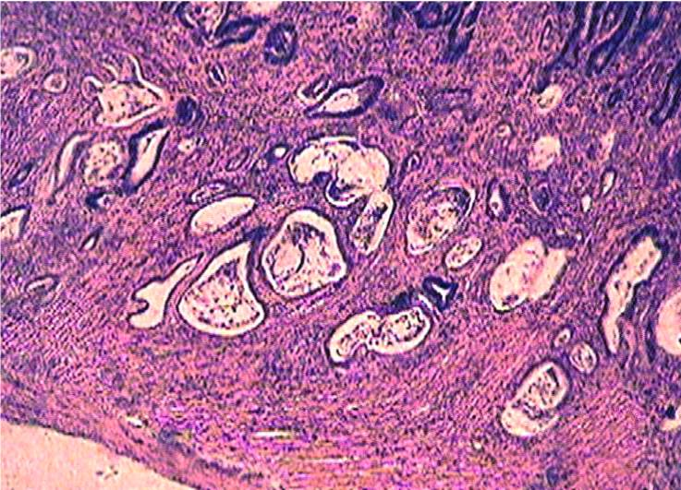
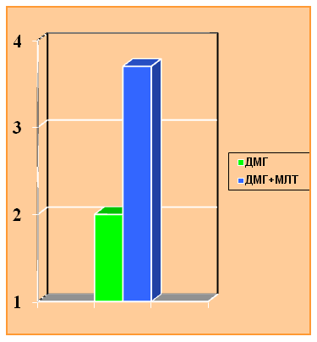
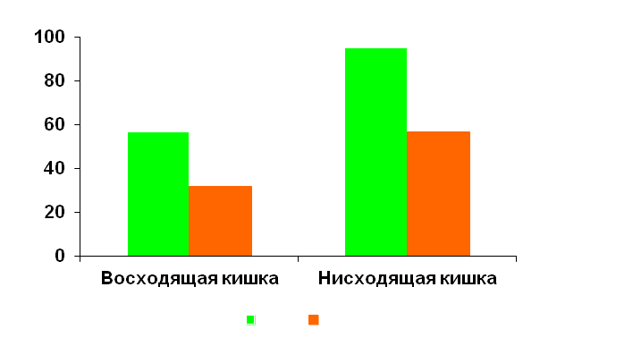
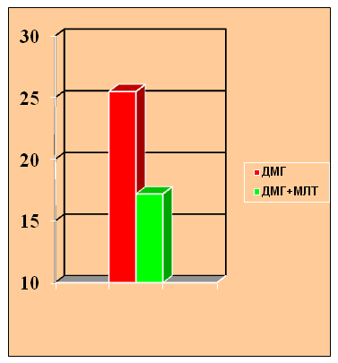
Melatonin inhibits 1,2-dimethylhydrazine-induced colon carcinogenenesis in rats
(Anisimov et al., Carcinogenesis, 1987)
*p<0.05
Tumor
incidence
*
*
Ascendent colon Descendent colon
- C
- Mel
*
*
MI
AI

Slide 27
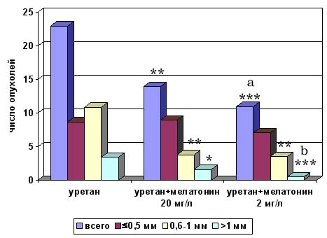
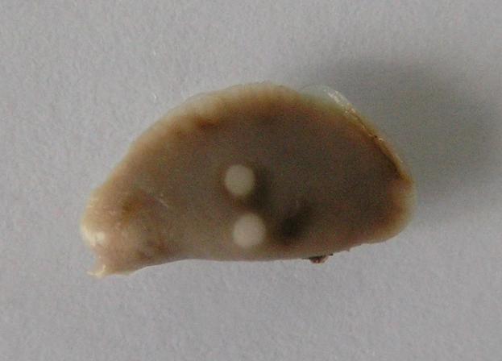
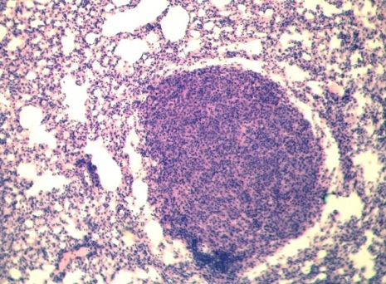
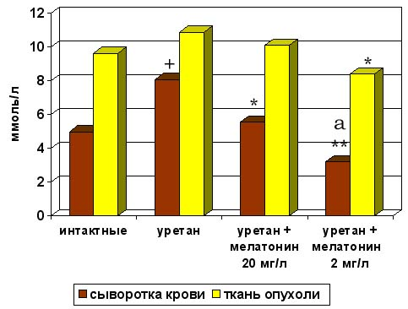
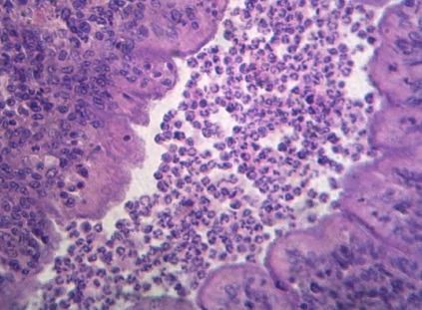
Effect of melatonin on urethan-induced lung carcinogenesis in mice
adenoma
adenocarcinoma
МДА
Vesnushkin et al.2007

Slide 28
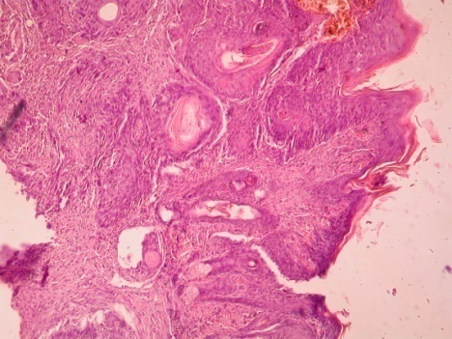
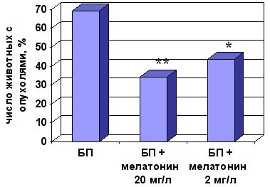
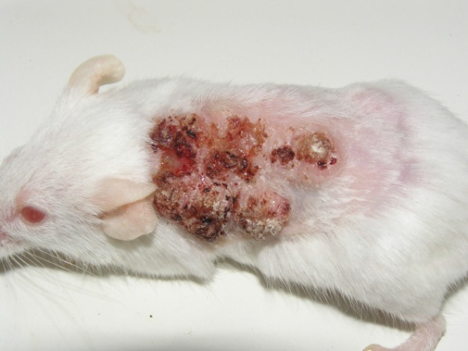
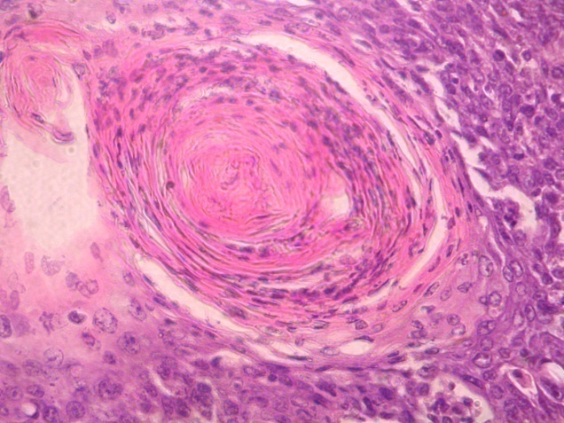
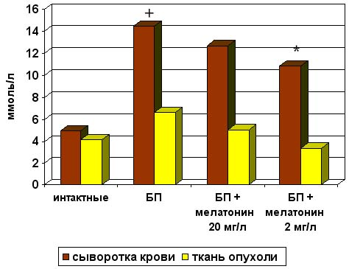
Effect of melatonin on benzo(a)pyrene-induced skin carcinogenesis in mice
Mitotic index
MDA
Vesnushkin et al;. 2007

Slide 29
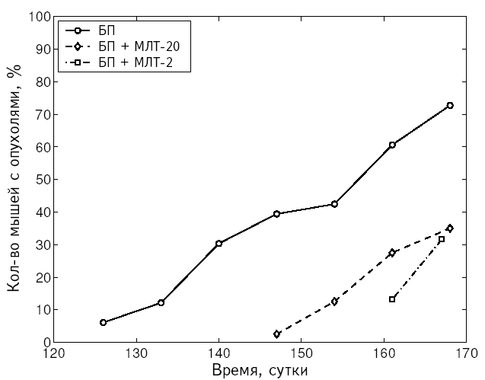
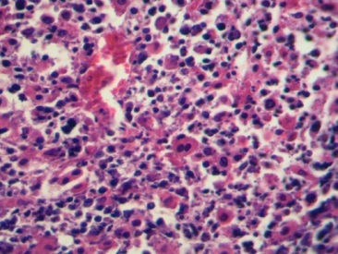
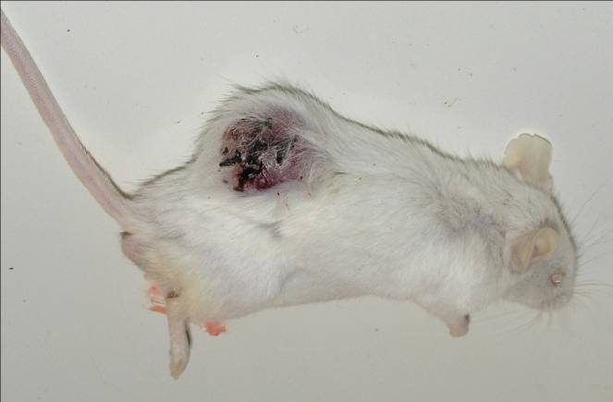
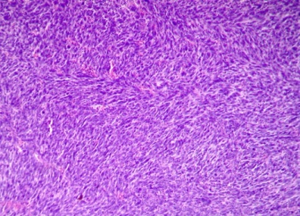
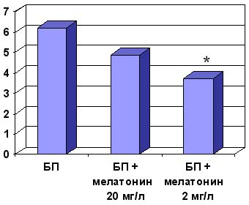
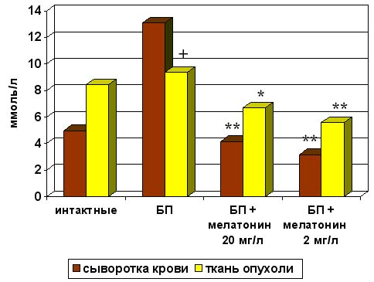
Melatonin inhibits B(a)P-induced sarcomogenesis in mice
Vesnushkin et al., 2007
Mitotic index
MDA in serum and in tumors

Slide 30
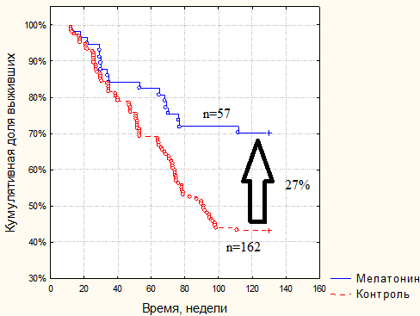

Melatonin, aging and cancer
Мыши-самки СВА
Meta-analysis of 10 randomized trials showed dercrease in one-year mortality up to 0.66 (95% CI = 0.59-0.73) in solid tumor patients
Mills et al., J.Pineal Res,2005
Melatonin inhibits tumorigenesis in rodents:
mammary gland*
endometrium
cervix and vagina*
colon*
skin*
soft tissues*
liver
lungs* * Anisimov et al.,
Survivors
Если эпифиз уподобить биологическим часам, то
мелатонин можно уподобить маятнику, который обеспечивает
ход этих часов и снижение
амплитуды которого приводит
к их остановке.
Stomach cancer
Ermachenkov et al, 2013

Slide 31


Effect of melatonin on life span, spontaneous tumorigenesis and gene expression in mice
СВА
MLT and gene expression:
Total clones : 15 247
Effect of MLT: 233 (1,53%)
Stimulation (>2 times): 164
Suppression (> 2 timrs): 69
Genes:
Cell cycle
Cell proliferation
Adhesion
Membrane transport
Leukenia
Mitochondrial genes
SHR
Anisimov et al., J. Gerontol. Biol.Med., 2001
Exp. Gerontol., 2003

Slide 32
Effect of melatonin on life span of mice
Strain % Authors______________
Balb/c + 18% Pierpaoli & Regelson, 1994
NZB + 40% Pierpaoli et al., 2001
C57BL/6J + 20% Pierpaoli & Maestroni, 1987
C3H + 20% Oxenkrug et al., 2001
CBA + 7% Anisimov et al., 2001
HER-2/neu + 13% Anisimov et al., 2002
NOD + 17% Conti & Maestroni, 1998
SAMP-8 + 35% Rodriguez et al., 2007

Slide 33
Constant illumination: molecular mechanisms
Decrease in melatonin production
Metabolic
syndrome
Oxydative stress
Telomere shortening
Telomere lesion
IGF-1
p53, pRb
p53
DNA
repair
Cell
senescence
Apoptosis
Genomic instability
Aging
Cancer

Slide 34

On the basis of ‘limited evidence in humans for the carcinogenicity of shift-work that involves nightwork”, and “sufficient evidence in experimental animals for the carcinogenicity of light during the daily dark period (biological night)” the Working Group concluded that “shift-work that involves circadian disruption is probably carcinogenic to humans” (Group 2A).
Straif K. et al. Lancet Oncol. 2007; 8: 1065
WHO International Agency for Research on Cancer, Lyon, France

Slide 35
Pineal, aging & cancer: Conclusions
Inhibition of nocturnal
melatonin:
Living at North
Shift work
Jet lag
Light-at-night
Insomnia
Circadian genes KO
Pinealectomy
Peak of melatonin increased by:
Hybernation
Darkness at a day
Blindness
Melatonin
Epitalon
Premature aging
and cancer
Slow down of aging
and cancer prevention

Slide 36


Journal of Gerontology& Geriatric Research Related Journals
Aging Science
Alzheimer's Disease & Parkinsonism
Depression and Anxiety
Emergency Mental Health
Palliative Care & Medicine

Slide 37

Journal of Gerontology& Geriatric Research Upcoming Conferences
http://www.conferenceseries.com/

Slide 38


OMICS Group Open Access Membership
OMICS publishing Group Open Access Membership enables academic and research institutions, funders and corporations to actively encourage open access in scholarly communication and the dissemination of research published by their authors.
For more details and benefits, click on the link below:
http://omicsonline.org/membership.php
www.ilmo.it

