Slide 3
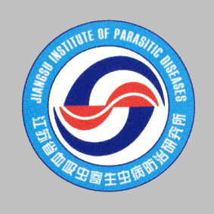
Combating neglected tropical diseases
Wei Wang
Jiangsu Institute of Parasitic Diseases
Key Laboratory on Technology of Parasitic Disease Prevention and Control, Ministry of Health, P.R.China

Slide 4
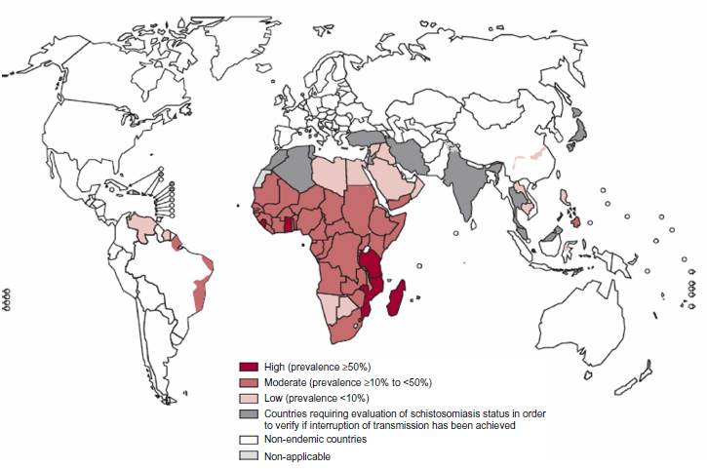
Research interests
Epidemiology of neglected tropical diseases and emerging infectious diseases

Slide 5
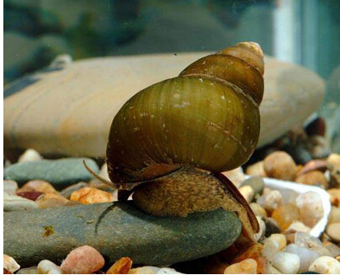
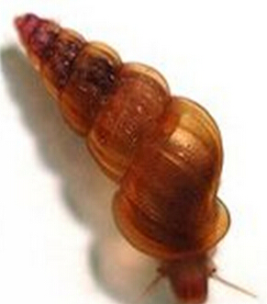
Research interests
Vector control

Slide 6
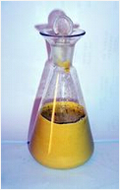
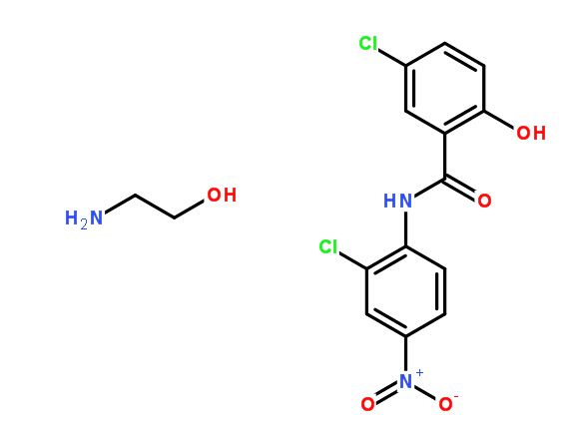
Research interests
Screening of novel molluscicides

Slide 7
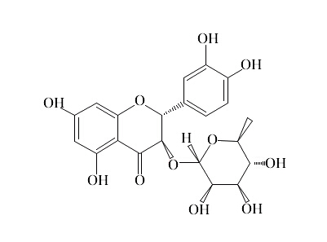
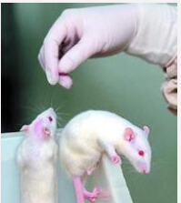
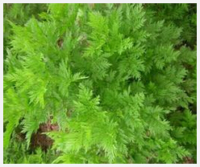
Research interests
Screening of novel anti-helminthetic agents

Slide 8
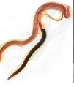
Research interests
Drug resistance

Slide 9
Current positions
Journal Editor
American Journal of Microbiology
Chinese Journal of Schistosomiasis Control

Slide 10
Current positions
Journal Editorial board member
Asian Pacific Journal of Tropical Biomedicine
World journal of meta analysis
Edorium Journal of Advances in Disease Diagnosis
HSOA Journal of Cancer Biology and Treatment
HSOA Journal of Microbial Pathophysiology and Pathogenesis
HSOA Journal of Clinical Immunolgy and Immunotherapy
Journal Club of Pharmaceutical Sciences

Slide 11
Current positions
F1000 specialist
Asian Council of Science Editors

Slide 12
Peer-reviewed articles
Dr. Wei Wang has published more than 100 peer-reviewed journals, and has a total impact factor of over 100. The articles have total cites of over 300 as shown in Web of Science and more than 400 as revealed by Google Scholar.

Slide 13
