Slide 1
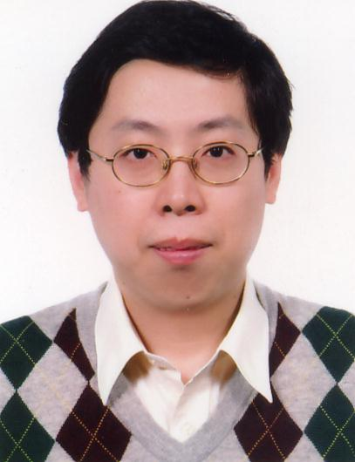
International Journal of Sensor Networks and Data Communications
Wen-Tsai Sung
Professor
National Chin-Yi University of Technology
Department of Electrical Engineering

Slide 2
International Journal of Sensor Networks and Data Communications
RESEARCH INTERESTS :
Wireless Sensors Network
Data Fusion
System Biology
System on Chip
Computer-Aided Design for Learning
Bioinformatics and Biomedical Engineering.

Slide 3
Brief Biography:
Wen-Tsai Sung is working with the Department of Electrical Engineering, National Chin-Yi University of Technology as a professor and Vice-Dean of Academic Affairs.
He received a PhD and MS degree from the Department of Electrical Engineering, National Central University, Taiwan in 2007 and 2000.
He has won the 2009 JMBE Best Annual Excellent Paper Award and the dragon thesis award that sponsor is Acer Foundation.
He has published a number of international journal and conferences article related to these areas.
Currently, he is the chief of Wireless Sensors Networks Laboratory. At present, he serves as the Editor-in-Chief in three international journals: International Journal of Communications (IJC), Communications in Information Science and Management Engineering (CISME) and Journal of Vibration Analysis, Measurement, and Control (JVAMC), he also serves as the other international journals in Associate-Editor and Guest Editor (IET Systems Biology).

Slide 4
International Journal of Sensor Networks and Data Communications
1.Serve as the keynote speech recently: 2013 3rd International Conference on Applied Mechanics, Materials and Manufacturing (ICA3M 2013), 24-25, August, Dalian, China

Slide 5
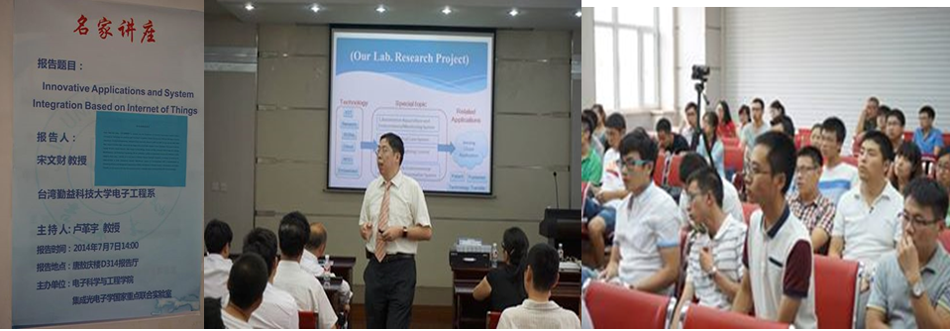
International Journal of Sensor Networks and Data Communications
2. 2014.7.5~10. China Jilin Electronics, University invited lecture, "IoT System Integration and Applications",( Location: China Changchun City, Jilin University, 985,211 engineering school)

Slide 6
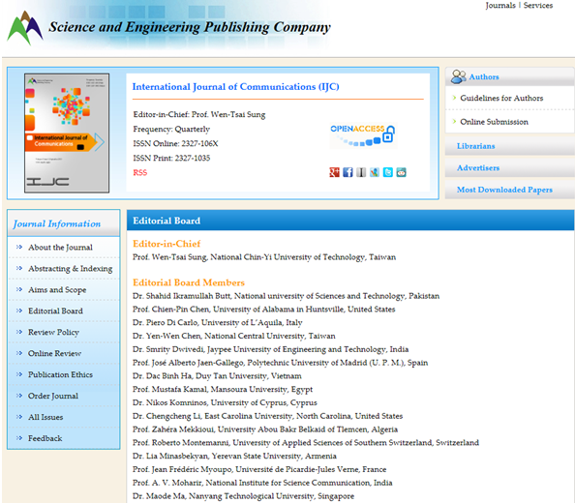
(Editor-in-Chief, International Journal of Communications (IJC)
international journal)

Slide 7
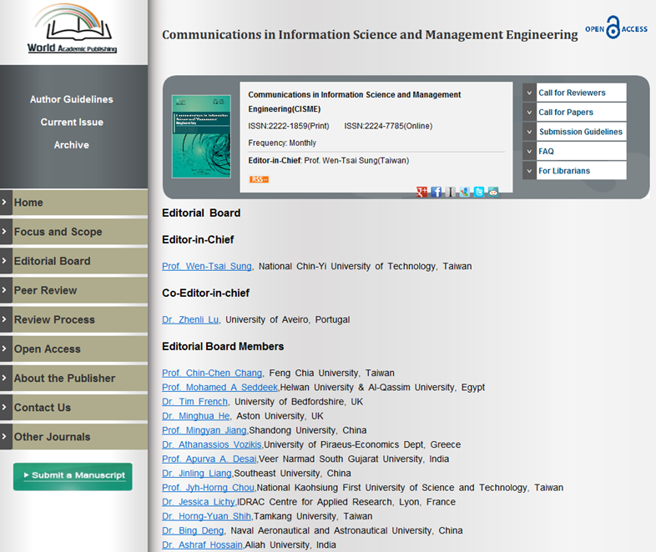
(Editor-in-Chief, Communications in Information Science and Management Engineering
(CISME) international journal)

Slide 8
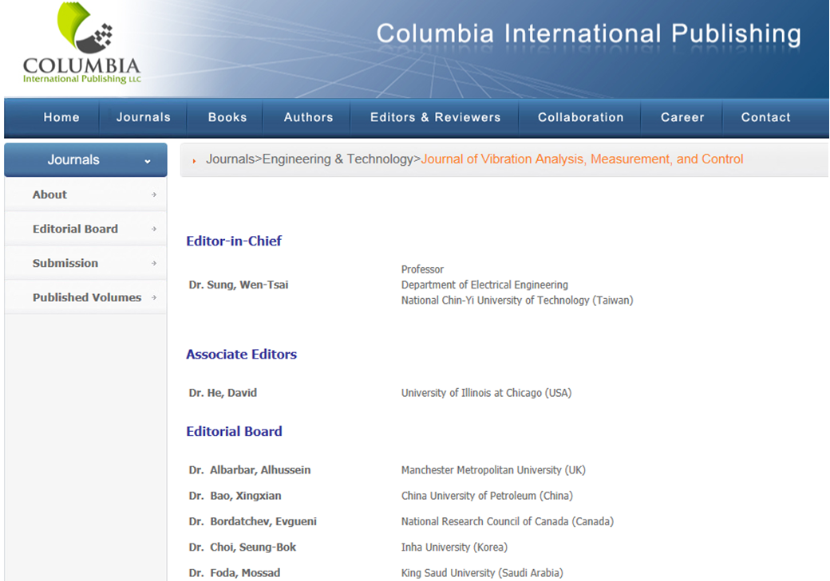
3. Editor-in-Chief,-Journal of Vibration Analysis, Measurement, and Control (JVAMC)

Slide 9
International Journal of Sensor Networks and Data Communications
4. Guest Editor- IET Systems Biology
5. Associate-Editor -International Journal of Sensor Networks and Data Communications (IJSNDC)
6. Associate-Editor -BIOINFO Sensor Networks
7. Editors-International Journal of Digital Content Technology and its Applications (JDCTA)
8. Editor -International Journal of Artificial Intelligence and Expert Systems (IJAE)
9. Editor -Scientific Journal of Computer Science (IJAE)
10. Editor -Application of Information and Communication Technology (AICT)
11. Editor -International Journal of Communications (IJC)

Slide 10
International Journal of Sensor Networks and Data Communications
General Committee Chairs
2014 International Symposium on Smart Sensors and Information Engineering (ISSSIE 2014) will be held on August 16-17, 2014 in Dalian, China. ISSSIE 2014 will be co-held with ICAICTE 2014 (2014 2nd International Conference on Advanced ICT for Education). http://www.isssie.org/
2014 International Conference on Industrial Engineering and Engineering Management (IEEM 2014) will be held on November 15-16, 2014, Guangzhou, China. http://www.ieem-conf.org/index.htm

Slide 11
International Program Committee or Chair
1.[ICIT 2015], The 3rd ScienceOne International Conference on Information Technology, which will be held in the glamorous city of Dubai on January 21-23, 2015. http://thescienceone.com/icit/index.php
2. [SESR 2014] 2014 International Conference on System Engineering and Science Research (SESR 2014) will be held from October 24-25, 2014, in Chicago, Illinois, USA. http://www.sesr.org/Home.aspx
3. [ICCEA2014] The 2014 International Conference on Control Engineering and Automation aims to bring researchers, engineers, and students to the areas of Control Engineering and Automation. November 29-30, 2014 • Chongqing, China http://www.iccea2014.org/index.html
4. [ICAMDM 2014] 2014 The 3rd International Conference on Advanced Materials Design and Mechanics (ICAMDM2014)-- May 23-24,2014 Singapore
5. [IS3C 2014] IEEE IS3C2014 is the International Symposium on Computer, Consumer and Control (IS3C2014)-- June 10-12,2014 Taiwan.
6. [ACTA 2014] The International Conference on Automatic Control Theory and Application (ACTA 2014) will be held from June 17th-19th, 2014, Bangkok, Thailand.

Slide 12
7.[SESR 2014] 2014 International Conference on System Engineering and Science Research (SESR 2014) will be held from October 25-26, 2014, in Indianapolis, Indiana, USA.
8. [ICAMDM 2013] 2013 the 2nd International Conference on Advanced Materials Design and Mechanics (ICAMDM2013)-- May 17-18, 2013 Kuala Lumpur,Malaysia
9. [WICCN 2013] 2013 International Conference of Communications and Networks（WICCN2013） -December 13-15, 2013, in Sanya, Hainan, China.
10. [ICA3M 2013] 2013 3rd International Conference on Applied Mechanics, Materials and Manufacturing (ICA3M 2013) will take place in Dalian, China, August 24-25, 2013.
11.[Energy 2013] 2013 International Conference on Energy (Energy 2013)-- 27-29 June,2013, Nanyue Hengshan, China
12.[ICCCI 2013] The 2013 International Conference on Computer Communication and Informatics (ICCCI 2013)—09-11,Jan. Coimbatore, INDIA.
13.[ICAMAR 2013] 2013 international Conference on Applied Mechatronics and Android Robotics (ICAMAR2013)—13,July,Taipei,Taiwan.
14. [ICAMDM 2012] 2012 International Conference on Advanced Materials Design and Mechanics (ICAMDM 2012)-- 5-7 June,2012, Xiamen, China.
15.[SCET 2012] 2012 Spring World Congress on Engineering and Technology (SCET), to be held on May.27-30, 2012, in Xi'an China

Slide 13
Wen-Tsai Sung*, Kuo-Yi Chang, “Health parameter monitoring via a novel wireless system”, Applied Soft Computing, Elsevier Company. , Volume 22, September 2014, Pages 667-680, (SCIE/EI) IF: 2.679. Ranking: 14/102
Wen-Tsai Sung*, Hung-Yuan Chung, “A distributed energy monitoring network system based on data fusion via improved PSO”, Measurement, Elsevier Company. Volume 55, September 2014, Pages 362-374 (SCIE/EI) IF: 1.130. Ranking: 28/90.
Wen-Tsai Sung*, Hung-Yuan Chung, Kuo-Yi Chang, “Agricultural Monitoring System Based on Ant Colony Algorithm with Center Data Aggregation”, IET Communications, Volume 8, Issue 7 2014, pp 1132 - 1140, (SCIE/EI) IF: 0.720. Ranking: 175/247.
Jui-Ho Chen, Wen-Tsai Sung*, and Hsi-Chun Wang, “Employing RFID for an Equipment Management System via Wireless Sensor Network”, Mathematical Problems in Engineering. Volume 2014 (2014), Article ID 245839, 11 pages (SCIE/EI) IF: 1.082.
Wen-Tsai Sung*, Hung-Yuan Chung, Kuo-Yi Chang, “Agricultural Monitoring System Based on Ant Colony Algorithm with Center Data Aggregation”, IET Communications, Volume 8, Issue 7 2014, pp 1132 - 1140, (SCIE/EI) IF: 0.720. Ranking: 175/247
Kuang-Yow Lian , Sung-Jung Hsiao, Wen-Tsai Sung*, “Smart Home Safety Handwriting Pattern Recognition with Innovative Technology”, Computers & Electrical Engineering, Elsevier Company. Volume 40, Issue 4,Pages 1123–1142 (SCIE/EI) IF: 0.992. Ranking: 26/50
Wen-Tsai Sung*, Jui-Ho Chen, Chrng-Li Hsiao “Data Fusion for PT100 Temperature Sensing System Heating Control Model”, Measurement, Elsevier Company. Volume 52, Issue June 2014,Pages 94–101 (SCIE/EI) IF: 1.130. Ranking: 28/90
Peer reviewed and Indexed Publications

Slide 14
Wen-Tsai Sung*, Jui-Ho Chen, Kung-Wei Chang, “Mobile Physiological Measurement Platform with Cloud and Analysis Functions Implemented via IPSO”, IEEE Sensors Journal, Volume:14 , Issue: 1,pp 111 – 123, Jan. 2014 (SCIE/EI) IF: 1.852. Ranking: 13/57
Wen-Tsai Sung*, Chia-Cheng Hsu, “Intelligent Environment Monitoring System Based on Innovative Integration Technology via PSoC Platform and ZigBee Network”, IET Communications, Volume 7, Issue 16, 05 November 2013, pp 1789 – 1801, (SCIE/EI) IF: 0.720. Ranking: 175/247
Kuang-Yow Lian , Sung-Jung Hsiao, Wen-Tsai Sung*, “Mobile Monitoring and Embedded Control System for Factory Environment”, Sensors, Volume 13, issue. 12:pp 17379-413. (SCIE/EI) IF: 2.048. Ranking: 10/57
Wen-Tsai Sung*, Jia-Syun Lin, “Design and Implementation of a Smart LED Lighting System Using a Self Adaptive Weighted Data Fusion Algorithm”, Sensors, Volume 13, issue. 12: pp.16915-16939. (SCIE/EI) IF: 2.048. Ranking: 10/57
Wen-Tsai Sung*, Sung-Jung Hsiao “Implementation of Enhanced Fractionally Spaced Algorithm for Blind Equalization Technology in WSNs”, Ad Hoc Networks, Elsevier Company. Volume 14, Issue March 2014, Pages 26–34 (SCIE/EI) IF: 1.943. Ranking: 22/135

Slide 15
Wen-Tsai Sung*, Jui-Ho Chen, Kuo-Yi Chang “Trust Function for Multi-Physiological Signals Fusion”, Measurement, Elsevier Company. Volume 47, Issue January 2014,Pages 827–840 (SCIE/EI) IF: 1.526. Ranking: 19/87
Wen-Tsai Sung*, Kuo-Yi Chang, “Evidence-based Multi-Sensor Information Fusion for Remote Health Care Systems”, Sensors and Actuators A: Physical, Elsevier Company., Volume 204, Issue 15 December 2013,Pages 1-19 (SCIE/EI) IF: 1.943. Ranking: 12/57
Wen-Tsai Sung*, Yu-Feng Liu, “Neural Network Approaches to Data Fusion Calculation and Correction in Wireless Sensor Network - A Case Study Comparison between BPN, RBFN and GRNN”, International Journal of Nonlinear Sciences and Numerical Simulation, Volume 14, Issue 6, Pages 395–411, September 2013 (SCIE/EI) IF: 0.453. Ranking: 69/87
Wen-Tsai Sung*, Chia-Cheng Hsu, “IOT System Environmental Monitoring using IPSO Weight Factor Estimation”, Sensor Review. Volume 33 issue 3 pp.246 - 256 (SCIE/EI) IF: 0.616. Ranking: 43/57

Slide 16
Wen-Tsai Sung*, Jui-Ho Chen, Hsi-Chun Wang “Optimization Data Fusion Approaches for Intelligent House System”, Applied Mathematics & Information Sciences, Vol.7, No.2L ,pp. 441-447.. June 2013, (SCIE/EI) IF: 1.232. Ranking: 53/250
Wen-Tsai Sung*, Jui-Ho Chen, Kung-Wei Chang, “Study on a Real-Time BEAM System for Diagnosis Assistance based on System on Chips Design”, Sensors, , 2013, Volume 13,issue 5,pp. 6552-6577 (SCIE/EI) IF: 2.048. Ranking: 10/57
Wen-Tsai Sung*, “Wireless Sensing Network Transmission System with Improved Constant Modulus Algorithm”, EURASIP Journal on Wireless Communications and Networking, 2013, Springer Company, 2013:101 (15 April 2013) (SCIE/EI) IF: 0.805. Ranking: 165/247
Wen-Tsai Sung*, Chrng-Li Hsiao, “IHPG Algorithm for Efficient Information Fusion in Multi-Sensor Network via Smoothing Parameter Optimization”, INFORMATICA, Volume 24, Issue 2,Pages 219-230 (SCIE/EI) IF: 0.901. Ranking: 98/250
Kuang-Yow Lian , Sung-Jung Hsiao, Wen-Tsai Sung* “Intelligent Multi-Sensor Control System Based on Innovative Technology Integration via ZigBee and Wi-Fi Network”, Journal of Network and Computer Applications, Elsevier Company. Volume 36, Issue 2, March 2013, Pages 756–767. (SCIE/EI) IF: 1.772. Ranking: 16/105

Slide 17
Wen-Tsai Sung*, Jui-Ho Chen, Kuo-Yi Chang, “ZigBee based multi-purpose electronic score design and implementation using EOG”, Sensors and Actuators A: Physical, Elsevier Company. Volume 190, Issue 1, February 2013, Pages 141–152 (SCIE/EI) IF: 1.943. Ranking: 12/57
Wen-Tsai Sung*, Hung-Yuan Chung “Employing Reduced Order Approach for Computing Protein Folding via Langevin Equation and Lyapunov Theorem”, International Journal of Innovative Computing, Information and Control, Vol.8, No.6, pp.4319-4332. June.2012, (SCIE/EI) IF: 1.667, Ranking: 7/53
Wen-Tsai Sung*, Ming-Han Tsai, “Data Fusion of Multi-Sensor for IOT Precise Measurement Based on Improved PSO Algorithms”, Computers and Mathematics with Applications, Elsevier Company. Volume 64, Issue 5, September 2012, Pages 1450–1461 (SCIE/EI) IF: 1.996. Ranking: 17/250
Wen-Tsai Sung*, Yen-Chun Chiang “Improved Particle Swarm Optimization Algorithm for Android Medical Care IOT using Modified Parameters”, Journal of Medical Systems, Springer Company. Vol.36 Number 6,pp.3755-3763.. 2012, (SCIE/EI) IF: 1.372. Ranking: 14/25
Wen-Tsai Sung*, Guan-Yu Chen “Employ DaVinci DM6446 Platform for H.264 Video Processing Analysis and Case Discussion”, International Journal of Innovative Computing, Information and Control, Vol.8, No.3(A), pp. 1849-1866. Mar.2012, (SCIE/EI) IF: 1.667. Ranking: 12/60
Ing-Jiunn Su, Chia-Chih Tsai, Wen-Tsai Sung* “Area temperature system monitoring and computing based on adaptive fuzzy logic in wireless sensor networks”, Applied Soft Computing, Elsevier Company. , Volume 12, Issue 5. pp. 1532–1541.May. 2012, (SCIE/EI) IF: 2.679. Ranking: 14/102

Slide 18
Wen-Tsai Sung*, Jui-Ho Chen, Hsi-Chun Wang “Optimization Data Fusion Approaches for Intelligent House System”, Applied Mathematics & Information Sciences, Vol.7, No.2L ,pp. 441-447.. June 2013, (SCIE/EI) IF: 1.232. Ranking: 53/250
Wen-Tsai Sung*, Jui-Ho Chen, Kung-Wei Chang, “Study on a Real-Time BEAM System for Diagnosis Assistance based on System on Chips Design”, Sensors, , 2013, Volume 13,issue 5,pp. 6552-6577 (SCIE/EI) IF: 2.048. Ranking: 10/57
Wen-Tsai Sung*, “Wireless Sensing Network Transmission System with Improved Constant Modulus Algorithm”, EURASIP Journal on Wireless Communications and Networking, 2013, Springer Company, 2013:101 (15 April 2013) (SCIE/EI) IF: 0.805. Ranking: 165/247
Wen-Tsai Sung*, Chrng-Li Hsiao, “IHPG Algorithm for Efficient Information Fusion in Multi-Sensor Network via Smoothing Parameter Optimization”, INFORMATICA, Volume 24, Issue 2,Pages 219-230 (SCIE/EI) IF: 0.901. Ranking: 98/250
Kuang-Yow Lian , Sung-Jung Hsiao, Wen-Tsai Sung* “Intelligent Multi-Sensor Control System Based on Innovative Technology Integration via ZigBee and Wi-Fi Network”, Journal of Network and Computer Applications, Elsevier Company. Volume 36, Issue 2, March 2013, Pages 756–767. (SCIE/EI) IF: 1.772. Ranking: 16/105

Slide 19
Wen-Tsai Sung*, Ming-Han Tsai, “Multi-Sensor Wireless Signal Aggregation for Environmental Monitoring System via Multi-bit Data Fusion”, Applied Mathematics & Information Sciences, Vol.5, No.3,pp. 589–603.Sep. 2011, (SCIE/EI) IF: 1.232. Ranking: 53/250
Wen-Tsai Sung*, Hung-Yuan Chung, Yao-Chi Hsu, Kuan-Yu Chen, “A Light Wind Speed Measurement System Design to Strengthen Wireless Sensor Network Functions”, International Journal of Innovative Computing, Information and Control, Vol.7, No.2, pp.859-868. Feb.. 2011, (SCIE/EI) IF: 1.667, Ranking: 12/60
Meng-Hui Wang, Yu-Kuo Chung, Wen-Tsai Sung, “Using thermal image matter-element to design a circuit board fault diagnosis system “, Expert Systems with Applications, Elsevier Company. Vol. 38, Issue 5, pp. 6164-6169. May 2011 (SCI/EI) IF: 1.965. Ranking: 30/121
Wen-Tsai Sung, Kuan-Yu Chen,Yao-Chi Hsu, “Design a Breeze Sensor System Based on Electric Field via Two-Elemental Direction ", Expert Systems with Applications, Elsevier Company. Vol. 38, Issue 5, pp. 5584-5590. May 2011 (SCI/EI) IF: 1.965. Ranking: 30/121
Wen-Tsai Sung*, Yao-Chi Hsu, “Designing an Industrial Real-time Measurement and Monitoring System Based on Embedded System and ZigBee ", Expert Systems with Applications, Elsevier Company. Vol. 38, Issue 4, pp. 4522-4529. April 2011 (SCI/EI) IF: 1.965. Ranking: 30/121
Wen-Tsai Sung*, Shih-Ching Ou ,Yu-Feng Liu, Chia-Hao Chen " Employed VeriLite Simulation to Improve SOC Design and Verification ", Computer Applications in Engineering Education, John Wiley & Sons, Inc. Volume 20, Issue 2, pages 374–382, June 2012 (SCIE/EI) IF: 0.333, (NSC 97-2622-E-167-014-CC3)
Wen-Tsai Sung*, Jui-Ho Chen,”Enhancing Molecular Docking Efficiency for Computer-Aided Drug Design via Systems Theorem” International Journal of Computing, Consumer and Control (IJ3C)Vol. 1,no.1,pp.54-61, Jan. 10,2012,

Slide 20
Part. C Patent：
No. | name | Patent Number | Inventor | approval date
1 | Automatic drip device | M384666 | Wen-Tsai Sung | 2010/7/21
2 | Protein folding computing device | M384314 | Wen-Tsai Sung | 2010/7/11
3 | Industrial real-time embedded systems with measurement and monitoring devices | M380524 | Wen-Tsai Sung | 2010/5/11
4 | Urinary monitoring care unit | M377976 | Wen-Tsai Sung | 2010/4/11

Slide 21
Part. D Technology transfer：
Technical name | Authority | By authority | Date of signing
Development of a multimedia teaching system embedded | Wen-Tsai Sung | Acer excellent, Inc. | 2008.8.1
Design based on a multi-source data fusion physiological signal processing system | Wen-Tsai Sung | Source Ding Technology Co., Ltd. | 2009.7.1
Construct part of the calculation of the docking system on chip design to enhance the effectiveness of the study drugs | Wen-Tsai Sung | Daniel Technology Co., Ltd. | 2010.6.1
To build a BEAM chip design technology-aided diagnosis system of real-time | Wen-Tsai Sung | Yizhong Technology Co., Ltd. | 2011.11.1

Slide 22
Sensor Networks and Data Communications Related Journals
Information Management & Computer Security
Computers & Security
Industrial Management and Data Systems
International Journal of Medical Informatics
Online Information Review
International Journal of Sensor Networks
Computer Networks
Computer Communications
International Journal of Computer Networks & Communications

Slide 23
Sensor Networks and Data Communications Related Conferences
Global Summit on Electronics and Electrical Engineering, November 03-05, 2015 Valencia, Spain
4th International Conference and Exhibition on Biometrics & Biostatistics, November 16-18, 2015 San Antonio, USA
2ndInternational Conference on Big Data Analysis and Data Mining, November 30-December 02, 2015 San Antonio, USA
2nd International Conference and Business Expo on Wireless & Telecommunication April 21-22, 2016 Dubai, UAE

Slide 24
OMICS International Open Access Membership
OMICS International Open Access Membership enables academic and research institutions, funders and corporations to actively encourage open access in scholarly communication and the dissemination of research published by their authors.
For more details and benefits, click on the link below:
http://omicsonline.org/membership.php

