Slide 1
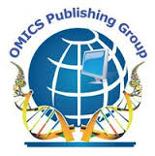
OMICS Group
OMICS Group International through its Open Access Initiative is committed to make genuine and reliable contributions to the scientific community. OMICS Group hosts over 400 leading-edge peer reviewed Open Access Journals and organizes over 300 International Conferences annually all over the world. OMICS Publishing Group journals have over 3 million readers and the fame and success of the same can be attributed to the strong editorial board which contains over 30000 eminent personalities that ensure a rapid, quality and quick review process. OMICS Group signed an agreement with more than 1000 International Societies to make healthcare information Open Access.

Slide 2
OMICS Journals are welcoming Submissions
OMICS Group welcomes submissions that are original and technically so as to serve both the developing world and developed countries in the best possible way.
OMICS Journals are poised in excellence by publishing high quality research. OMICS Group follows an Editorial Manager® System peer review process and boasts of a strong and active editorial board.
Editors and reviewers are experts in their field and provide anonymous, unbiased and detailed reviews of all submissions.
The journal gives the options of multiple language translations for all the articles and all archived articles are available in HTML, XML, PDF and audio formats. Also, all the published articles are archived in repositories and indexing services like DOAJ, CAS, Google Scholar, Scientific Commons, Index Copernicus, EBSCO, HINARI and GALE.
For more details please visit our website: http://omicsonline.org/Submitmanuscript.php

Slide 3
Dr Y. Guillaume Aboua
Cape Peninsula University of Technology
PO Box 1906, Bellville 7535, South Africa
Faculty of Health & Wellness Sciences
Department of Biomedical Sciences
Reproductive Biology
abouaY@cput.ac.za
Tel: 021 959 6983

Slide 4
1.Reactive Oxygen Species and Sperm Function

Slide 5
Background
Many environmental, physiological, and genetic factors have been shown to impair sperm function through oxidative damage. Oxidative stress (OS) arises as a consequence of excessive reactive oxygen species (ROS) production and/or impaired antioxidant defence mechanisms. The decline in male reproductive health has generated considerable public and scientific concerns about the possible role of environmental contaminants. A better understanding of how OS affect sperm function will be beneficial as it might help in the design of new and effective treatment strategies to combat the problem of increasing male subfertility.

Slide 6
2.Reactive Oxygen Species, Oxidative Stress and male infertility

Slide 7
Background
Despite the vulnerability of sperm to oxidative stress, it is also clear that normal sperm function depends on low levels of ROS generation in order to promote the transduction signal pathways associated with capacitation. Modulators of ROS generation by spermatozoa may therefore have clinical utility in regulating the fertilizing capacity of these cells and preventing the development of anti-sperm immunity. The mechanisms by which oxidative stress limits the functional competence of mammalian spermatozoa involve the peroxidation of lipids, electron leakage from the sperm mitochondria, the induction of oxidative DNA damage, and the formation of protein adducts.

Slide 8
3. Measurement of ROS
generation
by human spermatozoa

Slide 9
A variety of techniques have been developed for this purpose including chemiluminescence (luminol and lucigenin), flow cytometry (MitoSOX Red, dihydroethidium, 4,5-diaminofluorescein
diacetate and 2′,7′-dichlorodihydrofluorescein diacetate) and spectrophotometry (nitroblue tetrazolium).
ROS generation is triggered with a variety of reagents including 2-hydroxyestradiol, menadione, 4-hydroxynonenal and arachidonic acid.

Slide 10
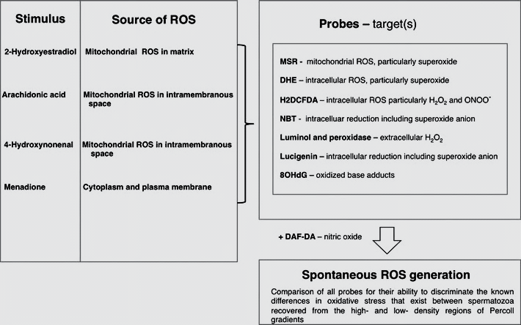
Reproduced from Aitken et al 2013

Slide 11
4. Diabetes mellitus: impact on male sexual function and infertility

Slide 12
Background
DM basically impinges on the male reproductive system and fertility through its effects on
Erectile dysfunction (ED)
Impaired semen parameters.
The mechanisms via which DM can impact on infertility is
Hyperinsulinemia
Changes in reproductive hormonal levels
Oxidative stress
Adipokines
Adipocyte derived hormones such as resistin and leptin

Slide 13
5. Potentials of Phytotherapeutic Treatment of Erectile Dysfunction (ED)

Slide 14
Background
It is often difficult to establish the exact etiology of ED, as it is frequently a secondary symptom of an underlying condition, the nature of which can be physical, psychological, or biochemical. Physical conditions include diseases such as diabetes, renal failure, malaria, & cancer, as well as cardiovascular factors (hypertension, atherosclerosis and heart disease, all of which can also be associated with life style factors (age, smoking, and drug / alcohol intake).

Slide 15
Significant
Phytotherapeutic drugs generally have a broad spectrum of action in the body, and are often capable of influencing virtually all metabolic processes with minimal side effects. Studies investigating the potential of phytotherapeutic treatments for ED are extremely limited.
Herbal therapies appear to have potential benefits, but the health risks of various phytotherapeutic compounds still need to be elucidated.

Slide 16
6. Leukocytospermia and
Oxidative Stress

Slide 17
Background
The invasion of microorganisms and infective bacteria in the genito-urinary tract leads to the rapid increase in white blood cells that can present in the ejaculate.
Inflammatory response, aimed at killing the microorganisms via the production and release of pathological ROS levels leading to Oxidative Stress.
Leukocytospermia (leukocyte concentration >106/ml semen ) is present in ±20% of male factor infertility.

Slide 18
Significance
Leukocytospermia represents an additional risk factor that should be treated, especially when in vitro therapy is to be scheduled, in order to improve gamete quality.
The relationship between leukocytospermia, OS as well as possible treatment regimes are explored.

Slide 19
7. Effects of Methamphetamine (MA) on male reproductive function

Slide 20
Background
Nicotine and Methamphetamine (MA) addiction are serious worldwide public health problems with many consequences and complications. Significant morbidity including cardiovascular, infectious, pulmonary, dental diseases and other system complications are associated with abuse of these substances.
Using a wistar rat model, we are investigating the effects of chronic usage of MA on sexual beheviour and on male reproductive function.
This study maight shed more light on the exact level of male spermatogenesis that is influenced by the exposure to Methamphetamine .

Slide 21
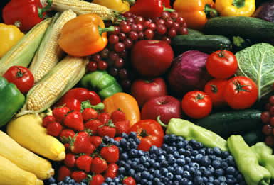
8. Dietary antioxidants and male infertility

Slide 22
Background
Antioxidants are able to protect biological systems against the potentially harmful effects of processes or reactions that can cause excessive oxidation.
Different antioxidant protection systems play important and interdependent roles in reducing OS in male reproductive function.
Antioxidants mostly derived from the human diet maintain a healthy sperm production and can offer an alternative when managing male infertility because they are cost effective and have little or no side effects on male reproductive function.

Slide 23
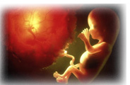
Andrology Related Journals Related Journals
Journal of Pregnancy and Child Health
Reproductive System & Sexual Disorders
Journal of Women′s Health Care
Gynecology & Obstetrics

Slide 24
OMICS Group Open Access Membership
OMICS publishing Group Open Access Membership enables academic and research institutions, funders and corporations to actively encourage open access in scholarly communication and the dissemination of research published by their authors.
For more details and benefits, click on the link below:
http://omicsonline.org/membership.php

Slide 25
Andrology-Open Access Journal Related Conferences
International Conference on Women's Health, Gynecology & Obstetrics
2nd International conference on HIV/AIDS, STDs & STIs-2014

