Slide 1


OMICS international
OMICS International through its Open Access Initiative is committed to make genuine and reliable contributions to the scientific community. OMICS International hosts over 700 leading-edge peer reviewed Open Access Journals and organizes over 1000 International Conferences annually all over the world. OMICS International journals have over 10 million readers and the fame and success of the same can be attributed to the strong editorial board which contains over 50000 eminent personalities that ensure a rapid, quality and quick review process. OMICS International signed an agreement with more than 1000 International Societies to make healthcare information Open Access.
Contact us at: contact.omics@omicsonline.org

Slide 2

OMICS Journals are welcoming Submissions
OMICS International welcomes submissions that are original and technically so as to serve both the developing world and developed countries in the best possible way.
OMICS Journals are poised in excellence by publishing high quality research. OMICS International follows an Editorial Manager® System peer review process and boasts of a strong and active editorial board.
Editors and reviewers are experts in their field and provide anonymous, unbiased and detailed reviews of all submissions.
The journal gives the options of multiple language translations for all the articles and all archived articles are available in HTML, XML, PDF and audio formats. Also, all the published articles are archived in repositories and indexing services like DOAJ, CAS, Google Scholar, Scientific Commons, Index Copernicus, EBSCO, HINARI and GALE.
For more details please visit our website: http://omicsonline.org/Submitmanuscript.php

Slide 3


Editorial Board
Yoshiaki Omura
Director of Medical Research
Heart Disease Research Foundation
New York,USA
Tel: 212-781-6262
Fax: 212-923-2279

Slide 4
Biography
Yoshiaki Omura M.D., Sc.D. (Med), F.A.C.A, F.I.C.A.E is President at International College of Acupuncture & Electro-Therapeutics .The Selective Drug Uptake Enhancement Technique was developed by Yoshiaki Omura, M.D.
> > >

Slide 5
Yoshiaki Omuraresearch interest include Electro therapeutics.

Slide 6
Publications
Important Clinical Implications of Side Effects of Chemotherapy for the Brain & Heart (Which are frequently Unrecognized) are often due to Overdose of Chemotherapy Medicine, and how to Prevent them
Yoshiaki Omura
Basic electrical parameters for safe and effective electro-therapeutics [electro-acupuncture, TES, TENMS (or TEMS), TENS and electro-magnetic field stimulation with or without drug field] for pain, neuromuscular skeletal problems, and circulatory disturbances.
Omura Y.

Slide 7
A Book: Acupuncture Medicine: Its Historical and Clinical Background
Omura Y.
New simple early diagnostic methods using Omura's "Bi-Digital O-Ring Dysfunction Localization Method" and acupuncture organ representation points, and their applications to the "drug & food compatibility test" for individual organs and to auricular diagnosis of internal organs--part I.
Omura Y

Slide 8
Relationship between transmembrane action potentials of single cardiac cells and their corresponding surface electrograms in vivo and in vitro, and related electromechanical phenomena.
Yoshiaki Omura
A new, simple, non-invasive imaging technique of internal organs and various cancer tissues using extended principles of the "Bi-Digital O-Ring Test" without using expensive imaging instruments or exposing the patient to any undesirable radiation--Part I.
Omura Y

Slide 9
Development of a Novel Enzyme-Linked Immunosorbent Assay for Blood and Urinary Eosinophil-Derived Neurotoxin: A Preliminary Study in Patients with Bronchial Asthma
Morioka J, Kurosawa M, Inamura H, Nakagami R, Mizushima Y, Chihara, Yokoseki T, Kitamura S, Omura Y, Shibata M
Electrical parameters for safe and effective electro-acupuncture and transcutaneous electrical stimulation: Threshold potentials for tingling, muscle contraction and pain; and how to prevent adverse effects of electro-therapy: I.
Omura, Yoshiaki

Slide 10
Surveillance transbronchial biopsies in infant lung and heart-lung transplant recipients.
Don Hayes, Peter B Baker, Benjamin T Kopp, Stephen Kirkby,Mark Galantowicz, Patrick I McConnell, Todd L Astor
Right heart catheterization measuring central hemodynamics in cystic fibrosis during exercise.
Don Hayes, Curt J Daniels, Heidi M Mansour, Benjamin T Kopp,Andrew R Yates, Karen S McCoy, Alpa V Patel, Stephen Kirkby

Slide 11

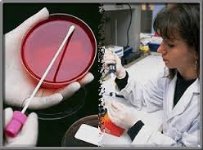
Journal of Air & Water Borne Diseases
Related Journals
Journal of Bacteriology & Parasitology
Journal of Medical Microbiology & Diagnosis
Journal of Microbial & Biochemical Technology
Journal of Plant Pathology & Microbiology
Journal of Vaccines & Vaccination

Slide 12

Journal of Air & Water Borne Diseases
Related Conferences
Allergy Conference
4th Bacteriology and Infectious Diseases Conference
2nd Infectious Diseases Congress

Slide 13
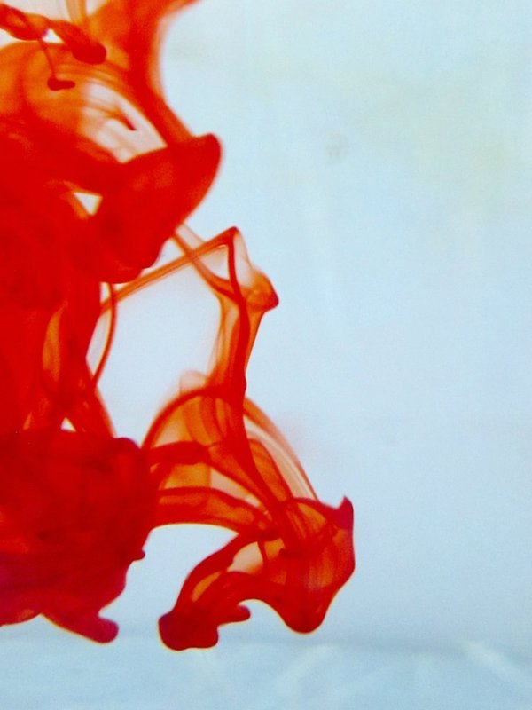

OMICS International Open Access Membership
OMICS International Open Access Membership enables academic and research institutions, funders and corporations to actively encourage open access in scholarly communication and the dissemination of research published by their authors.
For more details and benefits, click on the link below:
http://omicsonline.org/membership.php

