Slide 1
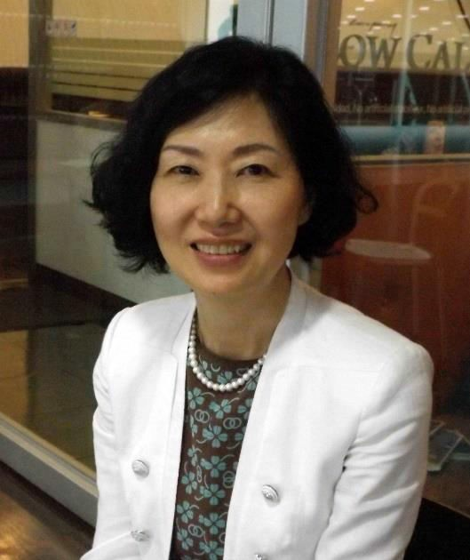





Prof. You Mie Lee, Ph.D
Lab of Vascular Network Research
◎ Research Field : Molecular Pathophysiology
Cancer Biology, Angiogenic Diseases
◎ Present - Dean, Professor, KNU, College of Pharmacy
Chairperson, KSMCB (Korea Soc Mol & Cell Biol)
Chairperson, VSMO (Vascular Sci Medi Org)
- PI, National Basic Research Lab (Vascular Homeostasis Regulation)
◎ Career
- Education
: Seoul National Univ. College of Pharmacy, Bachelor/ Master/ Ph.D
- Meeting Society: KSPharm, KSMCB, AACR, KSBMB, etc
- Research
: Tokyo Medical and Dental University, Harvard Medical School,
Children’s hospital, Research fellow, SNU Research professor
: KNU faculty meeting member, Women’s Bioscience Forum chairperson
nominated by Marquis Who’s Who in the World (2009- present)
- Services, etc

Slide 2
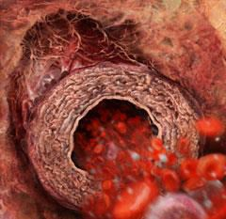


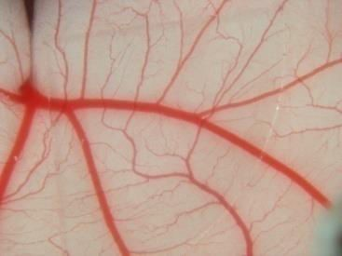
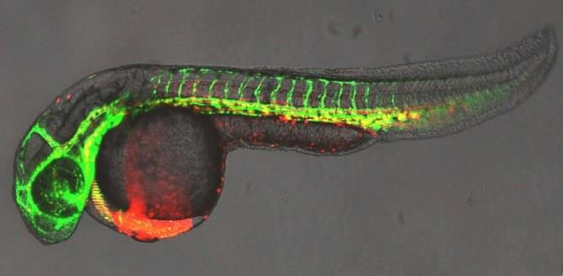

Research Interest
http://pharmacy.knu.ac.kr/vnrl/
1 Tumor angiogenesis and its inhibitors
Regulation mechanism of HIF
Inhibition of HIF-mediated gene expression
Development of novel angiogenic inhibitors
Epigenetic regulation in angiogenesis
Epigenetic control of tumor suppressors
Epigenetic modulators to restore the expressi tumor suppressor to inhibit angiogenesis
Genetically engineered zebrafish
on of
Endothelial progenitor cells (EPC)
Differentiation of EPCs derived from bone marrow (BM) and cord blood
Therapeutic approach to utilize EPCs in angiogenic diseases
Inhibition of vasculogenic process from BM in tumor angiogenesis
<Representative Publications>
Nature Med 2001; J Cell Biochem,2011;
MCT 2010; BBA-MCR 2010; Oncogene 2009, 2013,
JBC 2012; MNFR 2013, NAR 2014 and etc
Recent 3 years; 40 SCI papers, IF: 140

Slide 3


Angiogenic Diseases
Bood vessels
Atherosclerosis, hemangioma, etc.
Skin
Warts, Kaposi sarcoma, Psoriasis, neoplasm
Adipose tissue
Obesity
Bone, joint
Rheumatoid arthritis, synovitis, cancer
Brain, nerves, eye
Diabetic retinopathy, retinopathy of prematurity, vascular dementia
Lymph vessels
tumor metastasis
Haematopoiesis
AIDS, hematologic malignancy

Slide 4
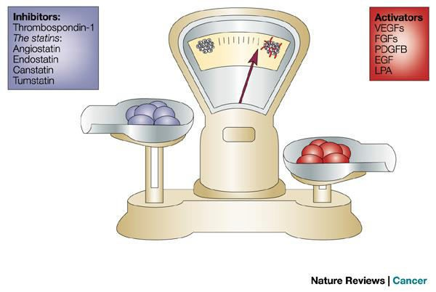
Angiogenic Balance

Slide 5
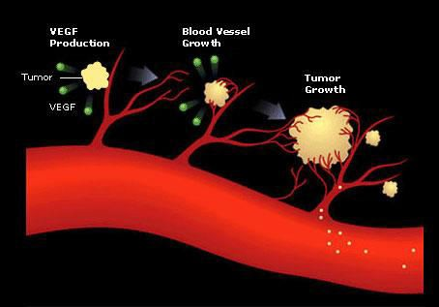
Tumor growth and angiogenesis

Slide 6




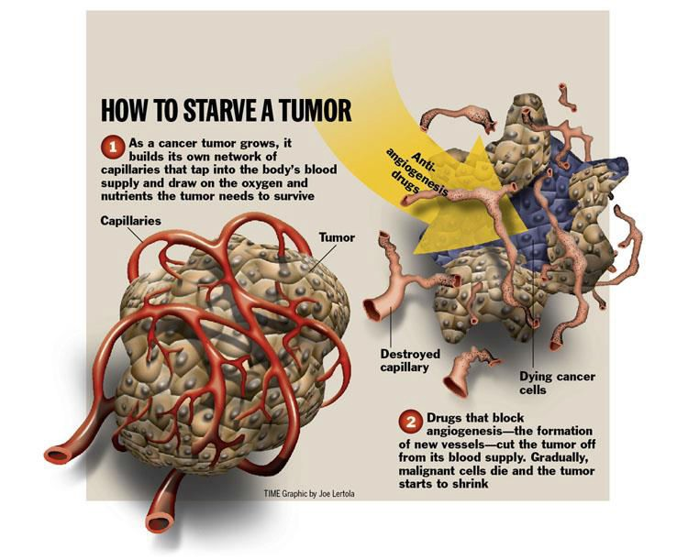
Anti-angiogenic therapy

Slide 7
Angiogenic inhibitors
Endogenous (~ 30)
Angioarrestin
Angiostatin (plasminogen fragment) Cartilage-derived inhibitor (CDI) Endostatin (collagen XVIII fragment)
Heparinases hCG
IL12
Kringle 5 (plasminogen fragment) TIMPs
Plasminogen ativator inhibitor
Retinoids TSP-1 TGF-β
Natural sources
Tree bark
Fungi (TNP-470)
Shark Muscle and Cartilage
Sea coral Green tea Herbs Soybean

Slide 8
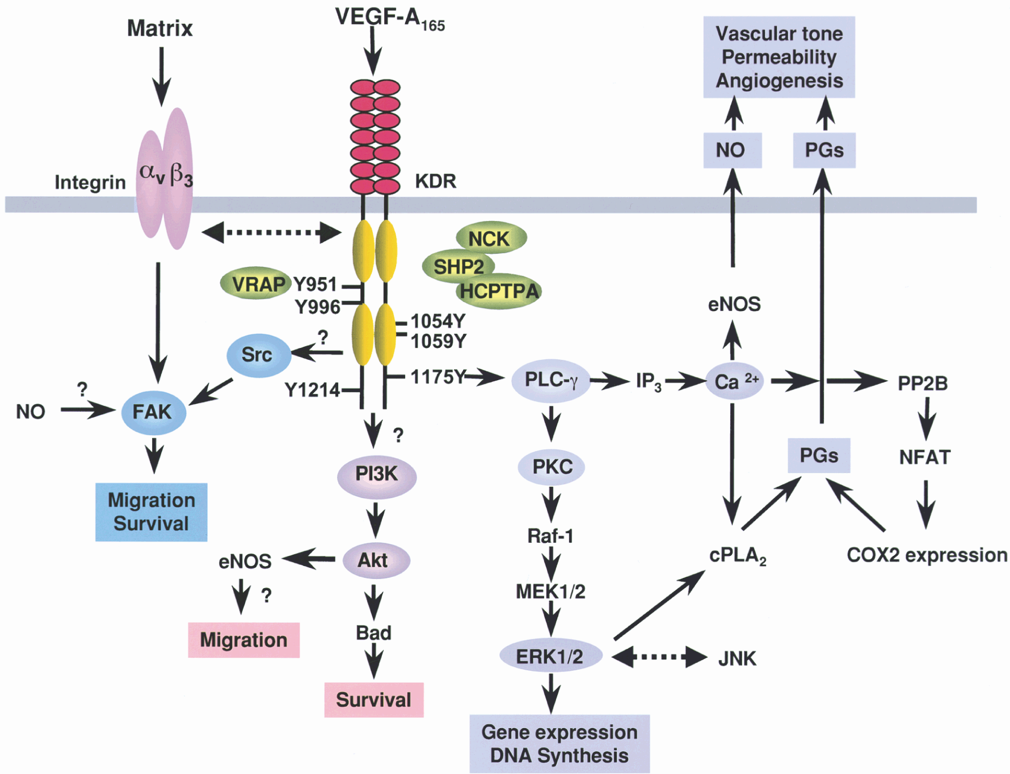
VEGF signaling pathway

Slide 9

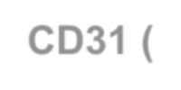


Hypoxia (EF5)
CD31 (EC)
normoxia
EF-5 (hypoxic marker),
Weinberg R, The Biology of Cancer, 2007

Slide 10
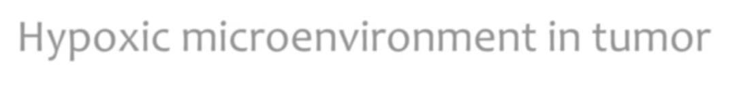
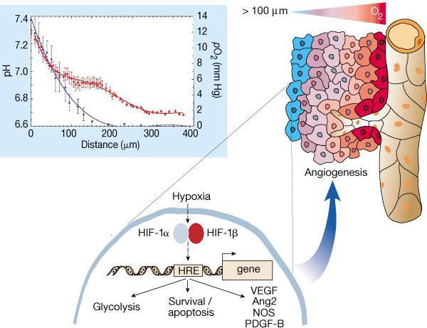
Hypoxic microenvironment in tumor
Nature 407:249-257, 2000

Slide 11
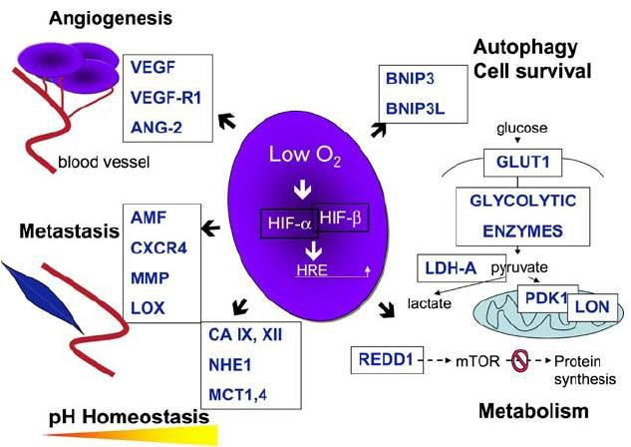
Role of HIF-1 in cancer cell responses
Chemoresistance
MDR1 MT-IIA CA9
J Mol Med (2007) 85:1301-1307

Slide 12

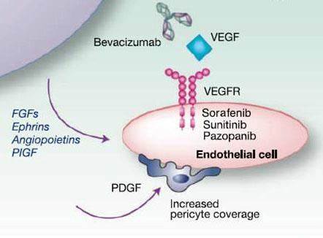

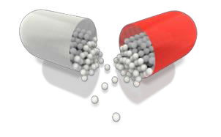

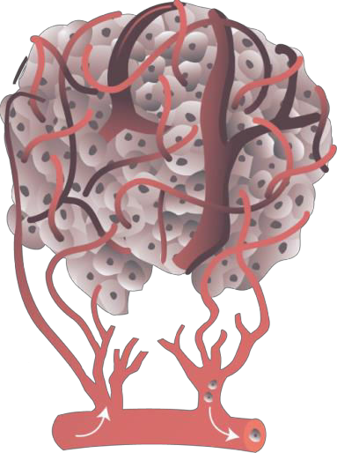

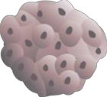





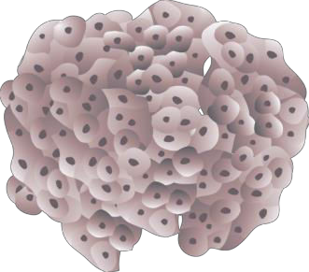





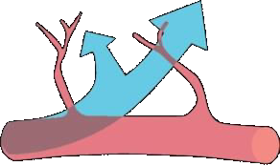


Angiogenesis
Hypoxia
(저산소 미세환경)
HIF-1
10 billion $/year (Roche®)
VEGF
Mutation
dormant
Secretion of angiogenic factors
Regression of cancer
Rapid growth of cancer
= Proangiogenic factor, eg. VEGF
= Angiogenic inhibitor
Carmeliet and Jain. Nature. 2000

Slide 13
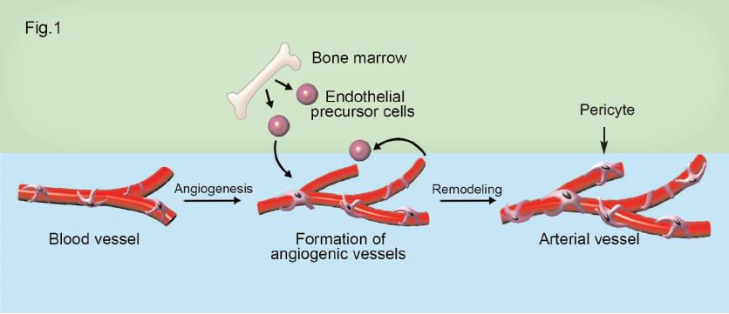
Vasculogenesis vs. Angiogenesis
Vasculogenesis
Angiogenesis

Slide 14





























Inhibitors of HIF-1 in tumor angiogenesis
Hypoxia
Growth factors, RTK, oncogenic activation
PI3K
Ras
Siah 1a/2
????
AKT
Raf
PHDs
Ub-mediated
degradation
mTOR
MEK1/2
HIF-1α
stabilization
MAPK
pVHL
OH
HIF-1α
synthesis and activity
HIF-1α
Hsp90
HIF-1α
Ub-mediated degradation
HIF-1α
HIF-1β
p300/CBP
Target genes
Nulceus
HIF-1α
HRE
Angiogenesis, Vasculogenesis

Slide 15

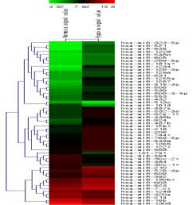

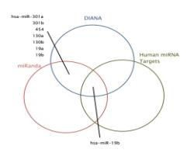
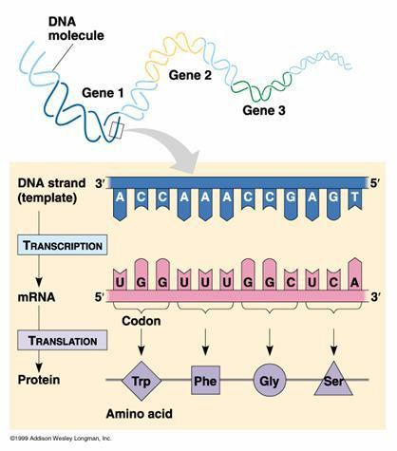

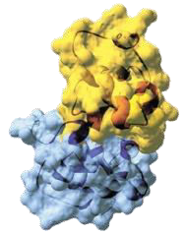


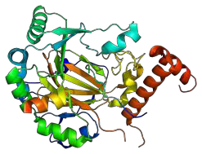


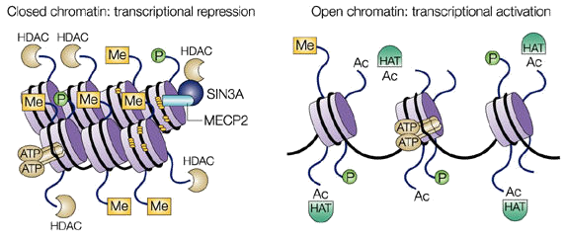








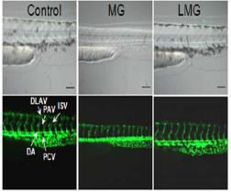
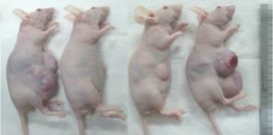
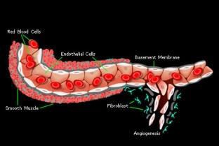

Research Approach
Hypoxia-induced genes
Mechanism of HIF expression
-DNA chip
-Proteomics
Computer Analysis
Gene finding
HIF
A, B, C, .…X
<Epigenetic regulation>
Finding of regulatory molecules
Confirm with K/O or K/D animals
Functional analysis

