Slide 1
OMICS Group International through its Open Access Initiative is committed to make genuine and reliable contributions to the scientific community. OMICS Group hosts over 400 leading-edge peer reviewed Open Access Journals and organizes over 300 International Conferences annually all over the world. OMICS Publishing Group journals have over 3 million readers and the fame and success of the same can be attributed to the strong editorial board which contains over 30000 eminent personalities that ensure a rapid, quality and quick review process. OMICS Group signed an agreement with more than 1000 International Societies to make healthcare information Open Access.

Slide 2
OMICS Journals are welcoming Submissions
OMICS Group welcomes submissions that are original and technically so as to serve both the developing world and developed countries in the best possible way.
OMICS Journals are poised in excellence by publishing high quality research. OMICS Group follows an Editorial Manager® System peer review process and boasts of a strong and active editorial board.
Editors and reviewers are experts in their field and provide anonymous, unbiased and detailed reviews of all submissions.
The journal gives the options of multiple language translations for all the articles and all archived articles are available in HTML, XML, PDF and audio formats. Also, all the published articles are archived in repositories and indexing services like DOAJ, CAS, Google Scholar, Scientific Commons, Index Copernicus, EBSCO, HINARI and GALE.
For more details please visit our website: http://omicsonline.org/Submitmanuscript.php

Slide 3
About a Functional Medicine
Functional Medicine is a branch of medicine which bases its clinical method for the study of physiological processes.
It 'a discipline that analyzes the correlations between physiological response, response and input stressogeno dysfunctional.

Slide 4
It is said to be more fully Functional Medicine Regulatory:
Functional because it allows us to understand the dysfunction of organs and systems before they cause demonstrable harm to specific examinations (predisease pathways)
Regulatory occurs because restoring the normal physiological conditions
F.M.R. act as an interface between conventional medicine and complementary medicine natural to combine and/or integrate into a global perspective, structured as transmissible science that allows to integrate medical knowledge (science) with the herbal, homeopathy and nutrition in a unified framework.

Slide 5
Functional medicine embraces the totality of the regulatory capacities of the body:
- biophysical
biochemical
enzymatic
endocrine
immunological
bioenergetic
trough the neurovegetative (orthosympathetic/parasympathetic) , metabolic (anabolism/catabolism) and cerebral regulation

Slide 6
Extra-cellular Matrix
Emerging perspectives of molecular biology and neuroscience converge well with the basic concepts of Functional Medicine Regulatory homeodynamic on the functioning of the body: each district, organ, system, function is interconnected to others and exchange them with continuous biochemical and biophysical information through Extra-cellular matrix

Slide 7
Extra-cellular Matrix: functional unit An anatomic-functional forum for exchanging and regulating autonomic, metabolic and immune response.

Slide 8
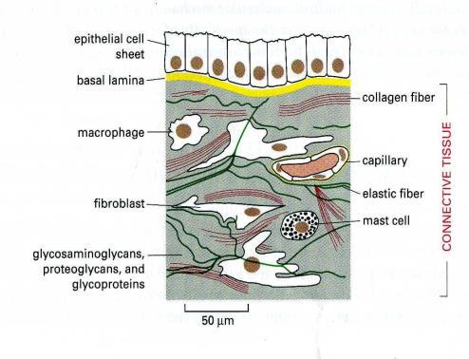
Anatomy of Extracellular Matrix
We can immagine it like a three-dimensional network
formed by big glyco proteic polymers :

Slide 9
Composition of Extracellular Matrix: functional unit
Stucture/Anatomy
Functional component
Proteoglycans
GAGs + proteins
Proteins
Structural (collagen, elastin)
Adesive (fibronectin, laminin ecc.)
Basal lamina
Intrafibrillar water
Cells
Assons
Capillars
Linfatic
Notes:
Cellule: fibroblasti, cellule muscolari lisce, condroblasti, osteoblasti, cellule epiteliali

Slide 10
«Languages» of Extra-cellular Matrix
Citochine and growth factors
Nervous impulses and nerve pathways
Electrochemical synapses
Electromagnetic impulses

Slide 11
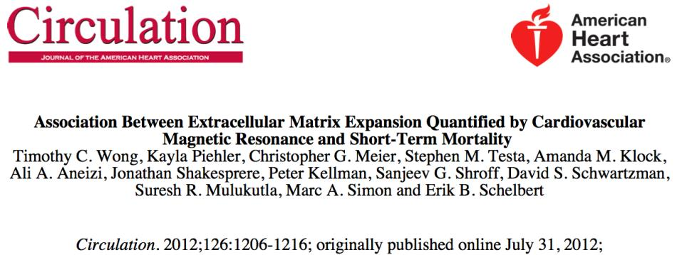
Matrice extracellulare del miocardio
793 patients
Magnetic resonance with gadolinium to access a volume of extracellular myocardial matrix
Increase of volume ECM is associated with increased risk of: death, cardiac transplantation and need of mechanical cardiac assistance
Wong. Circulation 2012; 126: 1206-1216
Notes:
La medicina convenzionale si accorge di recente dell’importanza della matrice extracellulare del miocardio.
Maggiore è il volume, peggiore è la prognosi

Slide 12
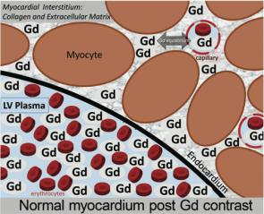
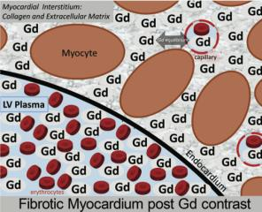
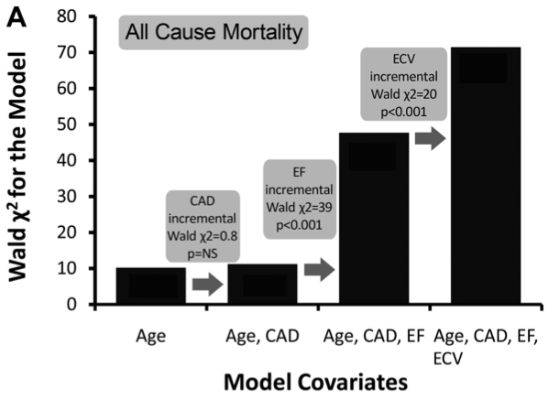
Expansion of ECM and all Cause Mortality
Notes:
Il mezzo di contrasto gadolinio si distribuisce nella matrice extracellulare e consente di quantificarne il volume
La stratificazione del rischio di mortalità si basa innanzitutto sull’età, più è avanzata, maggiore è il rischio di decesso.
Aggiungendo il dato della frazione di eiezione (FE) si aumenta la stima del rischio, che aumenta con il ridursi della FE
La stima del volume della matrice extracellulare cardiaca (ECV) permette di aumentare la stima del rischio, con un incremento della mortalità se aumenta l’ECV

Slide 13
Multiple Roles of the Extracellular Matrix in Inflammation:
provides specific molecular and spatial information that influences cell proliferation, differentiation and apoptosis
directly influence leukocyte recruitment to the inflammed tissue by providing differential signals resulting from its spatial and molecular composition, or indirectly by its potential to bind and present cytokines or chemotactic factors
mediates inflammation-induced angiogenesis and the subsequent remodelling steps
provides specific mechanical forces, exposes cryptic adhesion sites, and releases biologically active fragments (matrikines) and matrix-sequestered growth factors

Slide 14
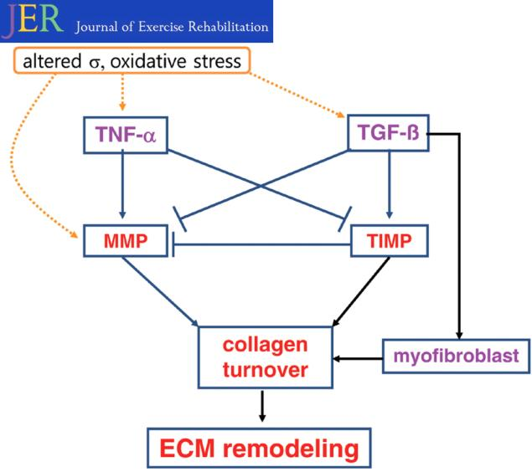
Rimodelling of ECM

Slide 15
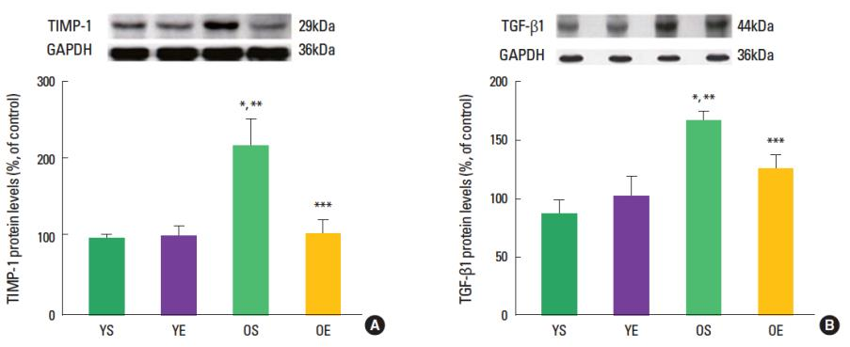

Slide 16
Acidosis
Extreme systemic acidosis is incompatible with life.
Functional Medicine focuses at a slight acidic tilt, what brings serious health consequences.
Moderate, non-life threatening acidosis, results in sub-optimal functioning of uncounted cells, tissues, and organs. To survive, the body must excrete and/or neutralize excess acids regaining a life-supporting acid-base balance.

Slide 17
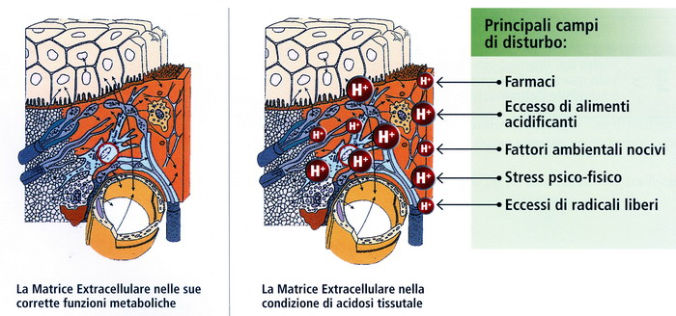
Acidosis and Extracellular Matrix
Matrix with acid pH loss his capacity to compensate
From Sol to Gel
Loss of basic substances (Ca, K, Mg, Na)
Notes:
Una volta si pensava fosse un contenitore
GAG glucosaminoglicani

Slide 18
Consequences of low grade metabolic acidosis 1
Loss of calcium in the urine with ospetopenia and osteoporosis
Loss of potassium and magnesium stores from the body , resulting in a tendency towards hypertension and inflammation and pain
Increased levels of blood parathyroid hormone (PTH)
Protein catabolism and depressed protein metabolism, resulting in a muscle wasting and increased age-related muscle loss
Suppression of growth hormone, insulin-like growth factor, and other pituitary hormones
Accelerated aging from accumulated acid waste products,
Increased production of free radicals—unstable molecules that cause cellular damage, resulting in the worsening of pain and inflammation, and the lowering of immune capacity, increasing risk of degenerative disease and premature aging

Slide 19
Consequences of low grade metabolic acidosis 2
Tendency for connective tissue to weaken due to increased free radicals
Excessive acid has actually been found to be stored within the connective tissue.
Decreased efficiency of cellular ATP energy production, causing impaired cellular function and, eventually, impaired organ function
Increased fluid retention, resulting in the excessive accumulation of fluids within body tissues
Disrupted balance of intestinal bacteria
Encouragement of the growth and spread of yeast and fungi, these potential pathogens thrive in an acid terrain

Slide 20
Consequences of low grade metabolic acidosis 3
Creation of a more fertile breeding ground for many viruses, including HIV: viruses thrive in an acidic, low-antioxidant environment
Reduced size of the brain's pool of energy reservesm, weakened mental capacity
Decreased ability to perform exercise at a high level of intensity: acidity creates a low-oxygen environment that is worsened by exercise
Increased acidity of the mouth, leading to imbalanced oral bacteria and, consequently, increased dental decay and periodontal (gum) disease.
Creation of a mild form of hypothyroidism (low thyroid function) and a chronic overproduction of the stress hormone cortisol
Development of low blood phosphorus levels

Slide 21
Therapeutic goals of M.F.R.
Detoxification and drainage of Extra-cellular matrix
Maintenance of Metabolic balance (acid/basic)
Restoring of Intestinal Eubiosis
Prevention of Oxidative Stress
Evaluation of correlation between Psyche/Brain/Organon (PNEI)
Decrease stress (mindfulness, yoga, breathing techniques ecc.)

Slide 22
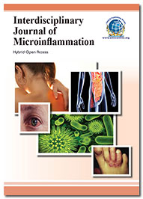
Interdisciplinary Journal of Microinflammation
Related Journals
Clinical Microbiology
Allergy & Therapy
Medical Microbiology & Diagnosis
www.ilmo.it

Slide 23
Interdisciplinary Journal of Microinflammation Related Conferences
3rd International Conference on Clinical Microbiology & Microbial Genomics
www.ilmo.it

Slide 24
OMICS Group Open Access Membership
OMICS publishing Group Open Access Membership enables academic and research institutions, funders and corporations to actively encourage open access in scholarly communication and the dissemination of research published by their authors.
For more details and benefits, click on the link below:
http://omicsonline.org/membership.php
www.ilmo.it

